Slide 1



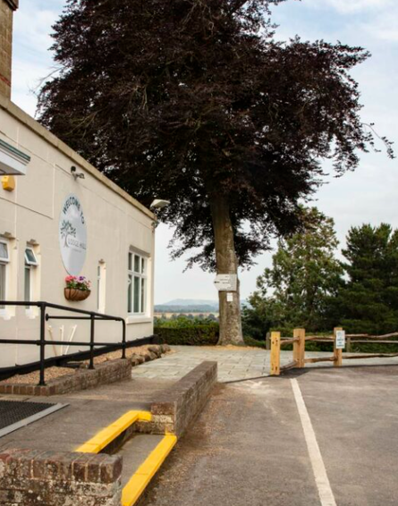


Lodge Hill 2025
Thursday 18th- Friday 19th September 2025

Slide 2
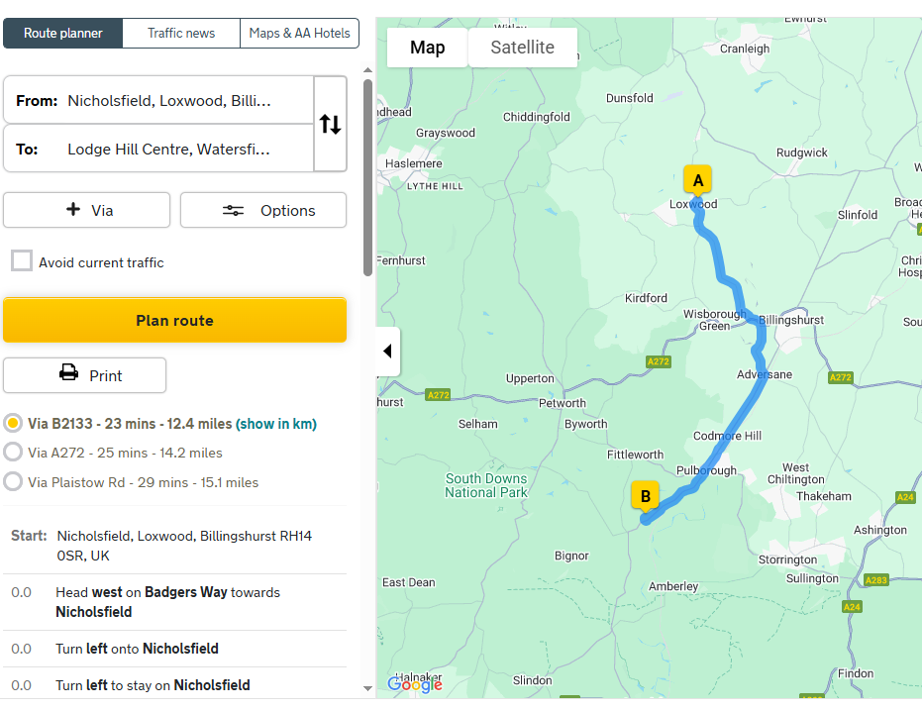
Lodge Hill 2025
Lodge Hill Centre, London Road, Watersfield, Pulborough, West Sussex RH20 1LZ

Slide 3
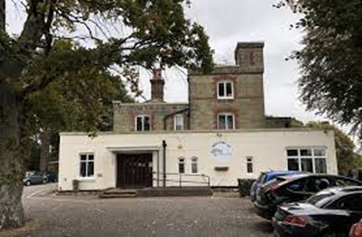
Lodge Hill 2025
Drop off and collection
Please drop off and collect from Lodge Hill main reception.
Arrive: Thursday 18th September at 10am
Collect: Friday 19th September at 2:30pm
Lodge Hill Centre, London Road, Watersfield, Pulborough, West Sussex RH20 1LZ

Slide 4


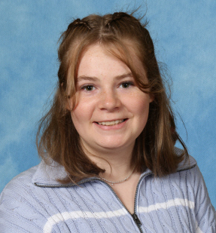


Lodge Hill 2025
Who is going?
Mr Fiveash
Mrs Trench
Miss Parsons
Miss Price
All Lodge Hill Staff are first aid trained.
If you need to reach us, please contact the school office.
If we need to contact you, you will receive a call from the office.

Slide 5
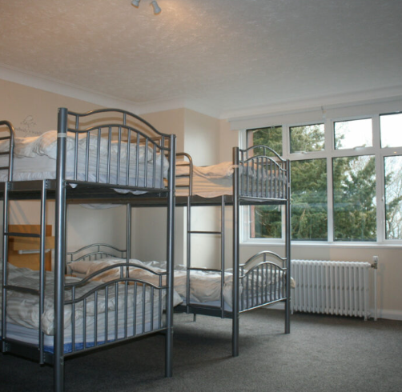
Lodge Hill 2025
Hardwick Hall
  Our main catered accommodation sleeping up to 135 guests across 27 bedrooms over 3 floors in dormitory style bedrooms.
  All rooms have their own sinks and include access to one of our 14 shower rooms provided.
  Access to our bedroom floor is via a card system.
  Bedding is not provided! You will need to bring a sleeping bag (or duvet and bottom sheet) and a pillow case with you along with your own towel.

Slide 6
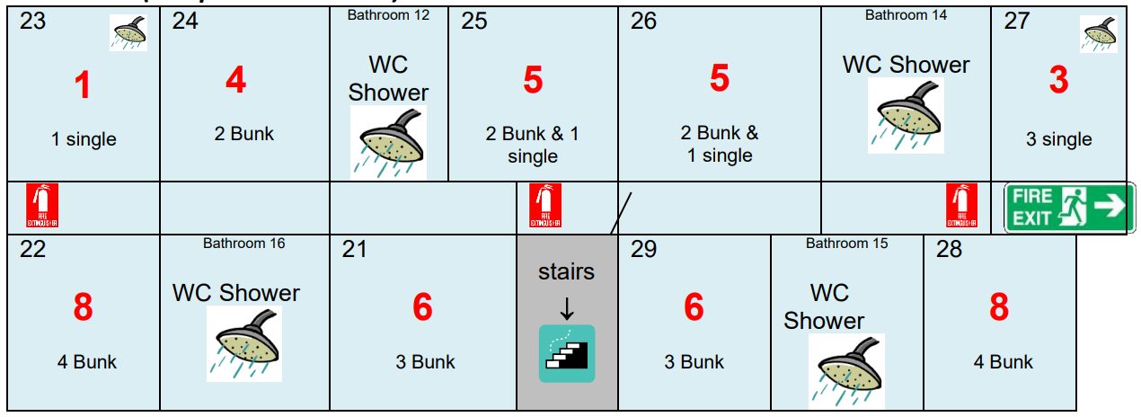
Lodge Hill 2025
  Top floor of the main building sleeps 46 children across 9 rooms
  Room sizes range from 3–8 children
  Separate rooms for girls and boys
  Children can list 3 friends they’d like to share with. We ensure they are with at least one of their chosen friends
Top Floor

Slide 7
Lodge Hill 2025
Activities
  Children will be split into two groups for activities.
  Both groups will complete the same activities on the same day (just in a different order).
  Activities have been chosen to be different from the Year 6 residential. Selected activities ensure this trip is a great introduction and avoids any repetition.

Slide 8
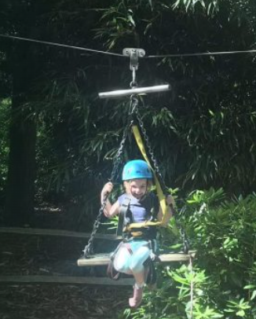
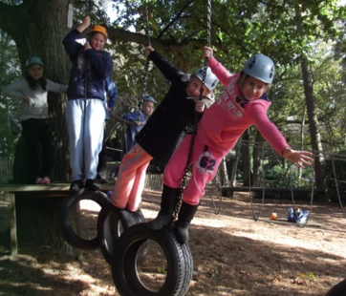
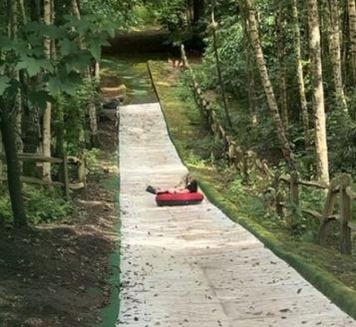
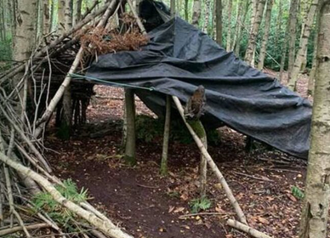
Lodge Hill 2025
Activities
Low Zip Line
Low Ropes
Sno-Tubing
Shelter Building
https://lodgehill.org.uk/about-us/

Slide 9
Lodge Hill 2025
Daily Timetable
Thursday
10:00am Arrival & unpack
11:00 - 12:30 First activity
12:30 - 13:45 Lunch
1:15 - 2:45pm Second activity
2:30pm Snack
3:00pm Teacher led activity
5:00pm Downtime
6:00pm Dinner
7:30 - 9:00pm Evening activity
9:00pm Get ready for bed
Friday
8:00am Breakfast
8:45am Pack up bedrooms
9:15 - 10:30am First activity
10:45am Morning break
11:00am Second activity
12:30pm Lunch
1:30pm Teacher led activity
2:30pm Collection

Slide 10
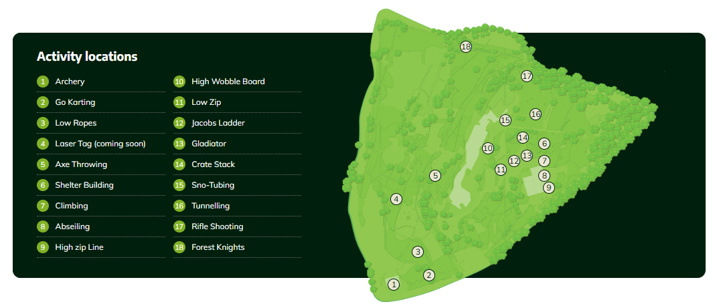
Lodge Hill 2025
Activity Map

Slide 11
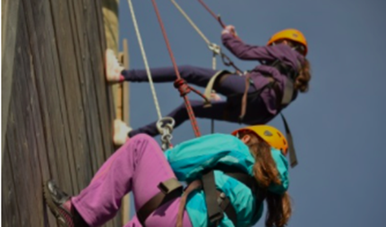
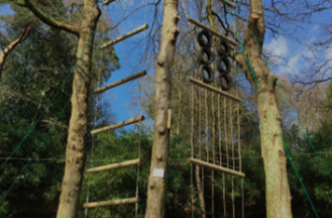
Lodge Hill 2025
Photos
  A separate Google Drive folder has been set up just for Year 5 residential photos - click the link below.
  Only Year 5 parents will be given access to the link.
  A few “token” photos will be shared on social media.
  The Drive ensures you can see a wider range of photos without us needing to worry about permissions.
Google Drive link

Slide 12

Lodge Hill 2025
Things to Bring
  Sleeping bag or single duvet (already in a duvet cover), pillow case, and single fitted bed sheet (sheet is essential with this option) & a towel
  Packed lunch for Thursday in a disposable bag
  Refillable water bottle
  Waterproof coat
  Appropriate shoes
  Change of clothes for evening
  Set of outdoor clothes for Friday
  Wash bag
  Small cuddly teddy (no larger than A4)
  No electronics or mobile phones!
Everything MUST be named!

Slide 13
Lodge Hill 2025
Cost
Total cost: £117
Deposit: £20 by end of July
Final payment: £97.00
Full balance to be paid by 26th September.
While a deadline is listed on the system, we appreciate the short notice and understand this may not work for all families. If you would like to arrange a payment plan, please do speak to Mrs Griffiths.

Slide 14

Any Questions

