Slide 1

‘Meet the Team’

Slide 2


Year 3 and 4
Rowan Class Sycamore Class
Mr Padden Mrs Oldfield
Mr Vernon Mrs Mayne
Mr Green PE Teacher every Wednesday
Mrs Harder and Mrs Swann alternate PPA cover on Wednesday in both classes

Slide 3
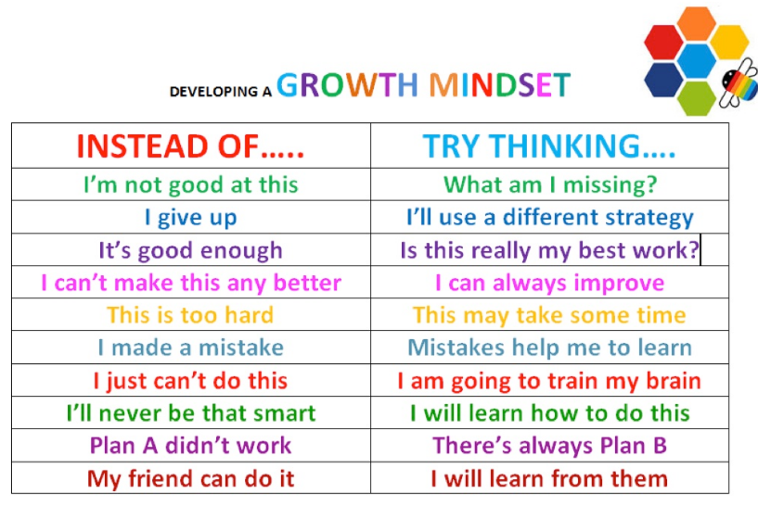
Growth Mindset

Slide 4
Topics This Year:
Autumn 2023- ‘Discover’. Stone Age, Bronze Age & Iron Age
Spring 2024- ‘Explore’. Extreme Earth (Volcanoes, Earthquakes, Tsunamis etc)
Summer 2024- ‘Create’. Weird & Wonderful (Environment/Plants)

Slide 5
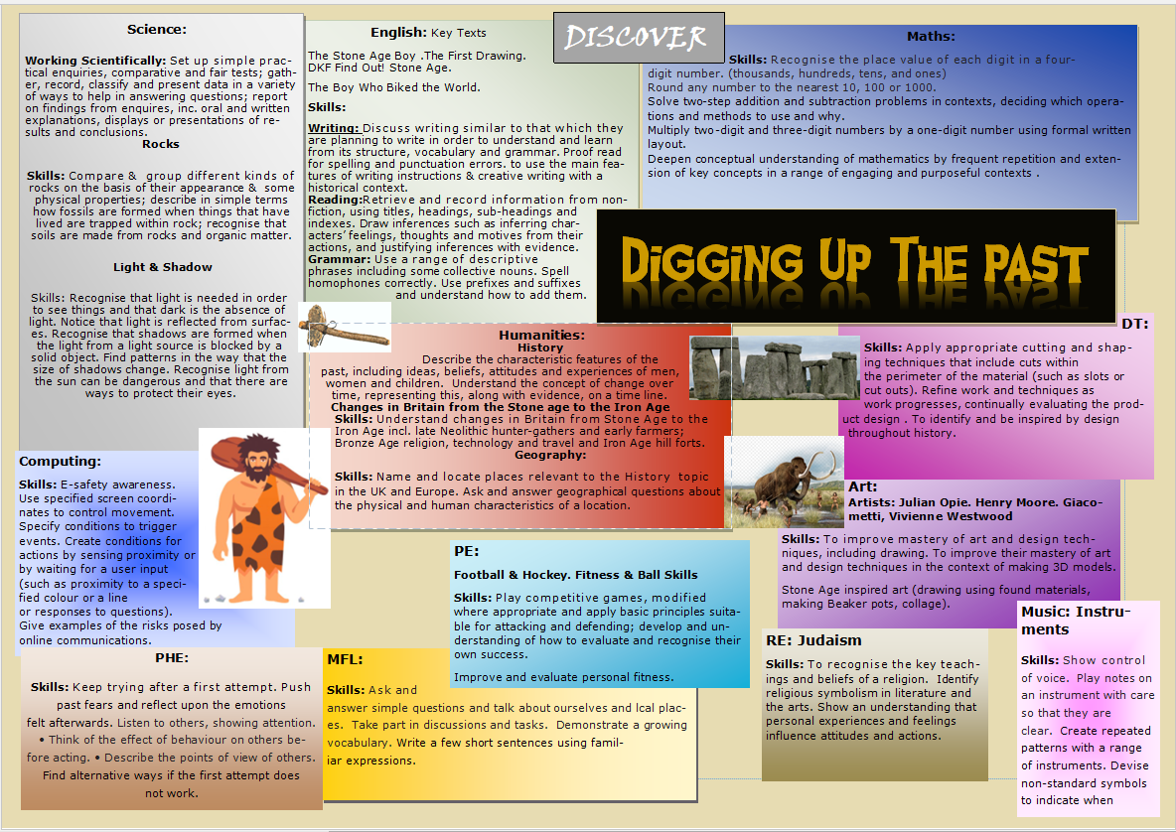

Slide 6
Class Timetable
Subjects other than Maths and English, which are daily;
Science
Art & Design /DT
PE
Humanities (History & Geography)
French- RE – Computing- Music-RHE
Wednesday is our PPA day and we are out of class either in the morning or afternoon, our PPA cover is either Woodland Learning with Mrs Harder or in class learning with Mrs Swann.

Slide 7
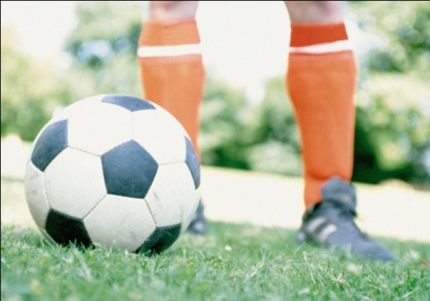
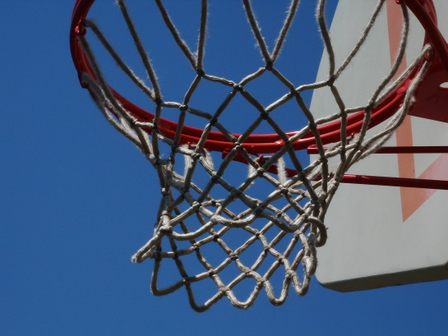



P.E.
All Children have PE on a Wednesday.
Rowan class’s other PE day is Thursday. Sycamore’s is Thursday.
ALL children to have their named PE kit in school at all times, as days can change.
Earrings must be removed or taped over.
Notes:
Need trainers – not plimsolls.
No need for shin pads/football boots – using soft balls and plastic hockey sticks.

Slide 8
Homework
In Year 3 and 4 the homework is;
Spellings, Times Tables and Reading. This is a requirement for the whole year. They are required to practice reading at least four times a week minimum, out loud, to an adult, signature required in reading record book).
The children will also be given a homework grid with 9 options. They are expected to complete 2 pieces that they choose each half term.
All children have weekly Times Tables and Arithmetic tests. They are expected to practice their Times Tables at home to improve their fluency.

Slide 9
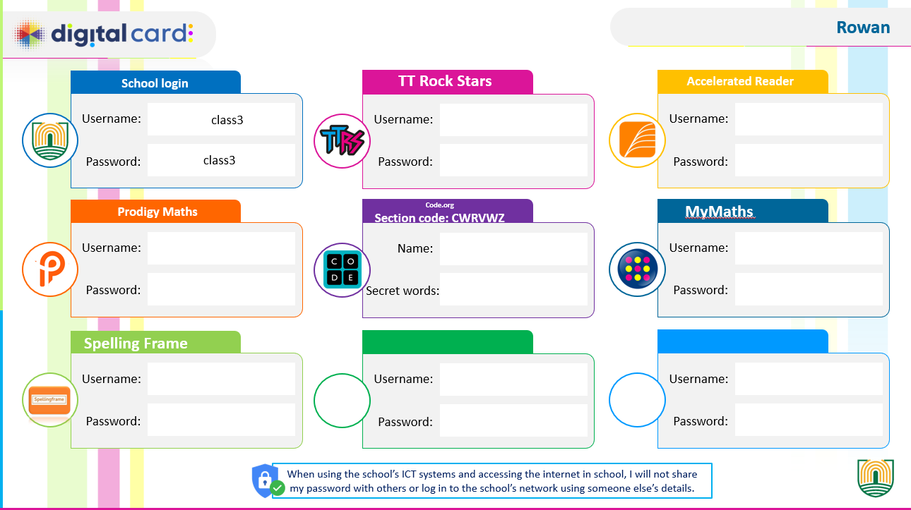
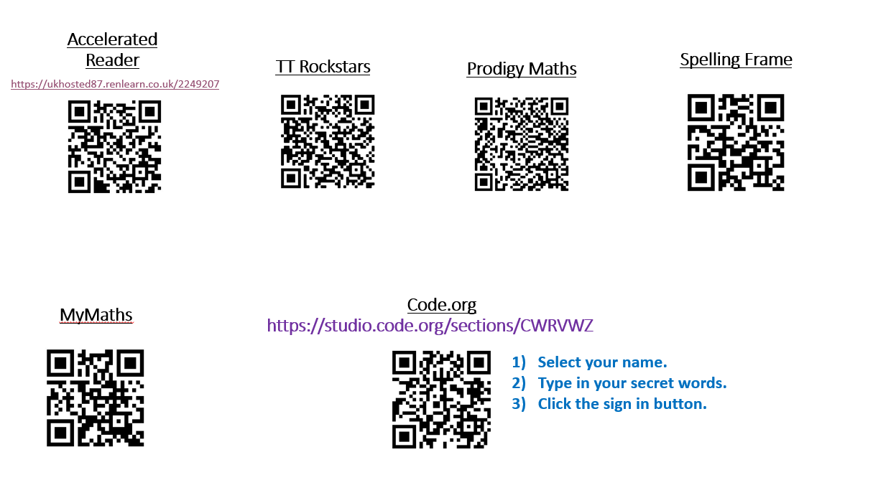
Each pupil will have their own digital card. This will be laminated and stored in their classroom trays. Staff will save an electronic copy in their class file on the system allowing the office staff access.
Teachers will take responsibility for populating these digital cards with usernames and passwords. Please take care to ensure that passwords are copied across accurately from the relevant database.
There are some learning platforms which some children may not have or require access to. Please leave these blank.

Slide 10
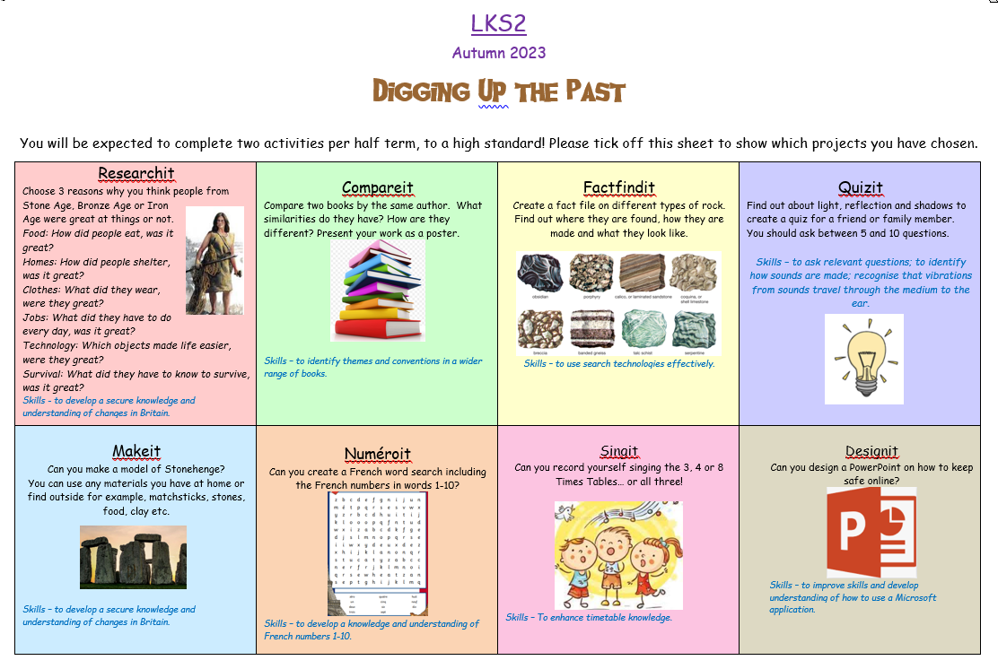

Slide 11
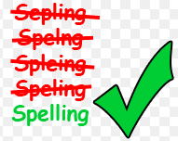
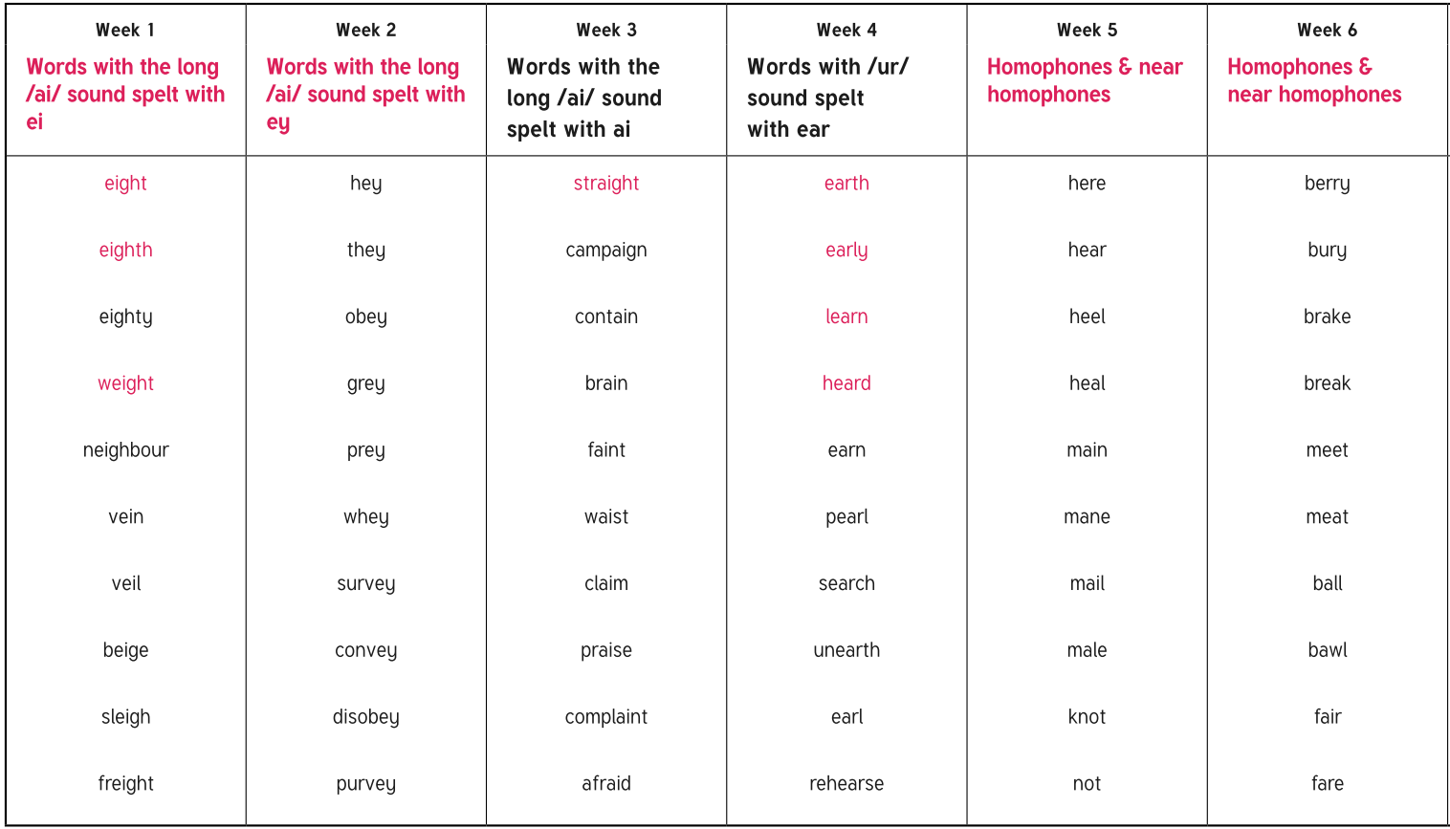
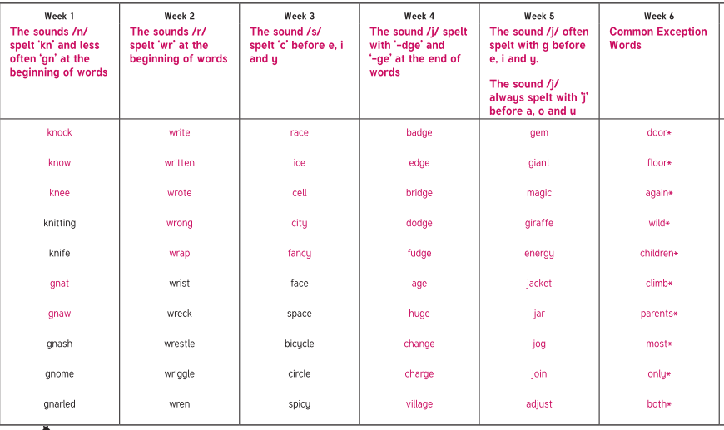
Spellings in Rowan Class
Spelling will be handed out on a Friday and then the children will be tested on the following Friday.
Children have been split into groups (Group A/ Group B) and the spellings for the half term can be found on the class page of the website.
Children will be given a log in for spelling frame where they can practise
their spelling, this is NOT compulsory, some children find this resource helpful. https://spellingframe.co.uk/
High Frequency Words (HFW)
Year 2 list
Year 3 and 4 list
Statutory requirement rules
Example words

Slide 12
Spellings in Sycamore Class
Spelling will be handed out on a Wednesday and then the children will be tested on the following Wednesday,
Children have been split into groups (Group A and Group B) and the spellings for the half term can be found on the class page of the website.
Children will be giving a log in for spelling frame where they can practise
their spelling, this is NOT compulsory, some children find this resource helpful. https://spellingframe.co.uk/

Slide 13


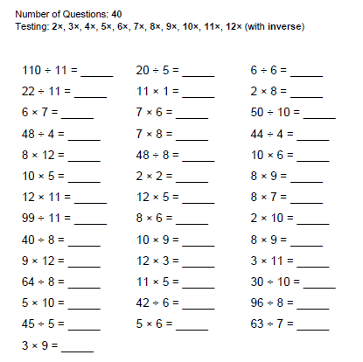
Times Tables
Please ensure your child is learning their Times Tables, the children will be doing a weekly timetables test on a multiplication grid. They will initially have 15 minutes to fill out as much as they can, this is to show their personal progression throughout the year. This will decrease to 10 minutes later in the year, also with a mixed up grid.
Children will be given a log in for Timetables Rockstars which they can use to help them practise their timetables. this is NOT compulsory and not part of the test, some children find this resource helpful to practice https://play.ttrockstars.com/auth/school/student
If they do not want to use this way to help practice there are alternative options below.
There are a lot of Times Tables games online (I have attached some links which may help) and we will also
practice weekly in class.
  Games / apps
    http://www.topmarks.co.uk/maths-games/7-11-years/times-tables
    http://resources.woodlands-junior.kent.sch.uk/maths/timestable/
    http://www.teachingtables.co.uk/
  Songs
    Percy Parker
    (App or CD http://www.percyparker.com/singyourtimestables/index.html)

Slide 14

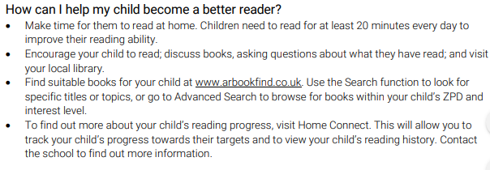
Accelerated Reader

Slide 15

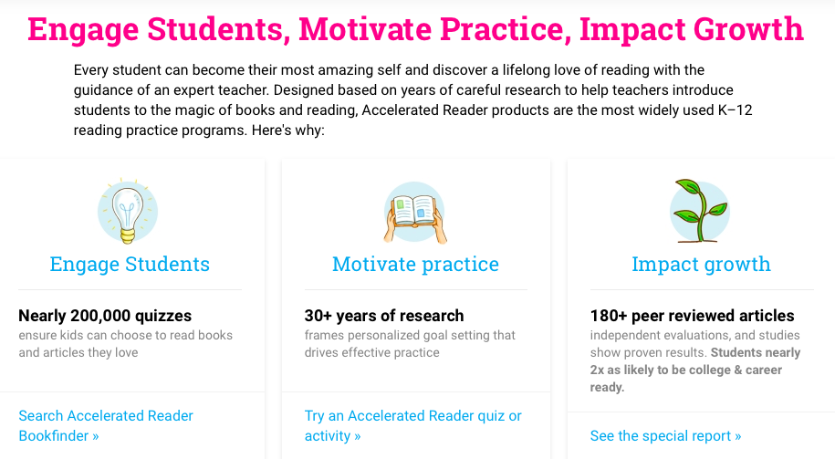
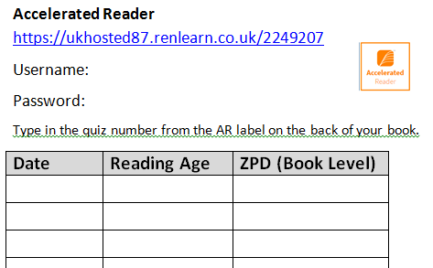
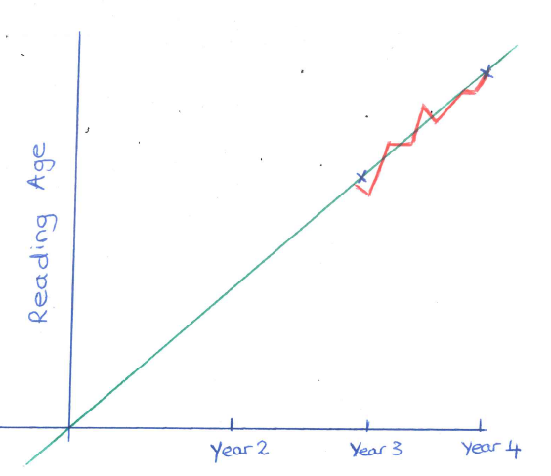
https://www.renaissance.com/products/practice/accelerated-reader-360/

Slide 16
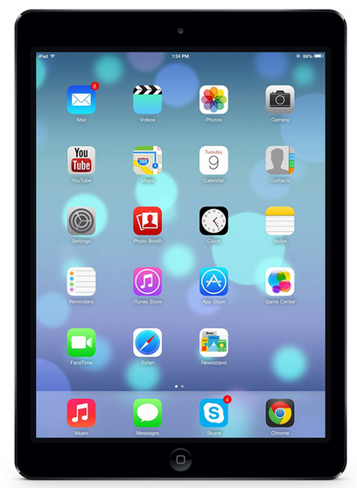

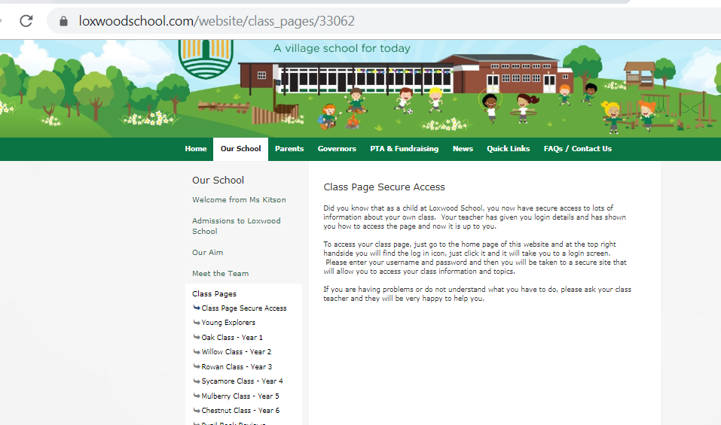
Loxwood School page
School website
  Dates
  Topic Web
  Homework
  Spellings
  Useful links
  Photos

Slide 17
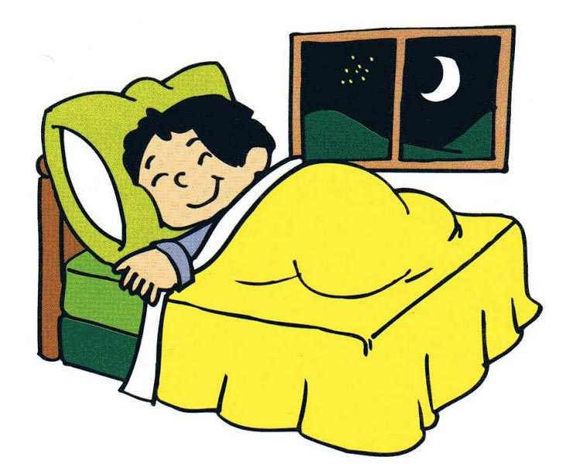
How can you help your child over this busy year?
SLEEP
BREAKFAST
SNACK for snack time (fruit or vegetables only) & Water, this is important as the day is long.
HOMEWORK
INDEPENDENT/ORGANISED
ALL UNIFORM NAMED.

Slide 18
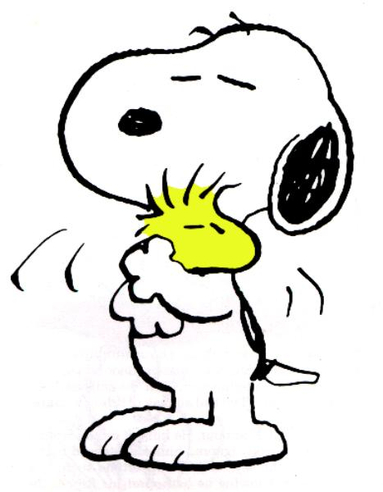
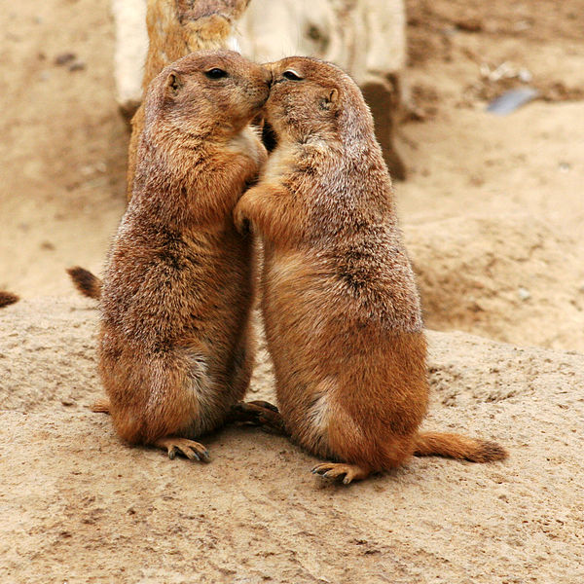
Emotional Well-Being
We are sure that the children's emotional well-being is of paramount importance to us all. We are extremely aware of emotional well-being in children, these are the years they become more independent and improve their self esteem with help and guidance. If a child in our care is not acting their usual self, or is withdrawn from the class or their friends, we will always take the time to reassure them that we are here to help. If you feel that your child might be affected by something at home, such as a bereavement (be it pet or human) or arguments with siblings etc, please take the time to briefly inform us, as it might help us to help them.

Slide 19
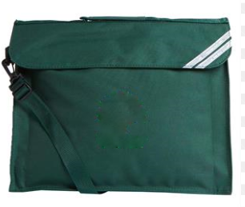
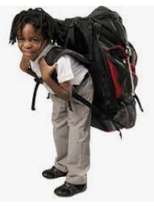
Please can you ensure that your child brings a book bag to school, not a rucksack.
Rucksacks for Loxwood School are for years five and six only.
Loxwood school bags are available or green book bags can be bought for about £5 on Amazon or M&S etc.

Slide 20

Questions?
Please feel free to ask any further questions you may have.

