Slide 1


Welcome to
Loxwood Primary School

Slide 2

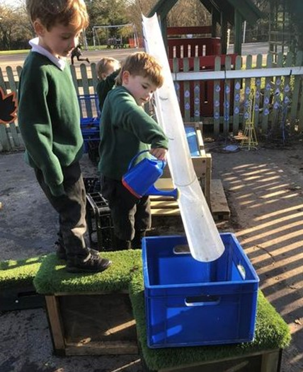
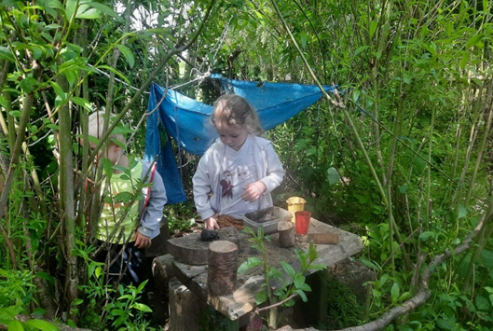
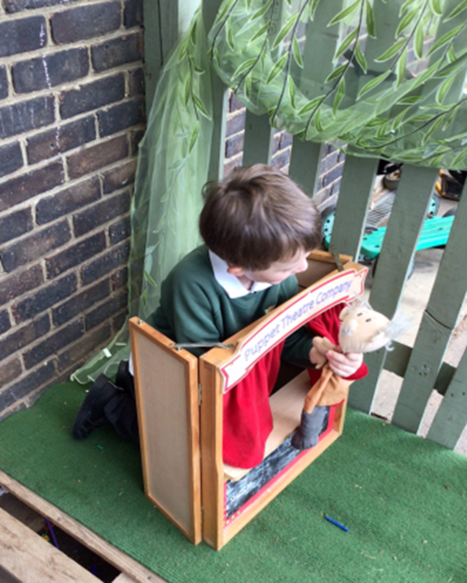
Thank you for choosing Loxwood Primary School

Slide 3
What to Expect This Evening
  Meet the Reception team and key staff.
  Learn what to expect in Reception and how to prepare for September.
  Find out about transition arrangements and starting school.
  Explore the school and classroom environment.
  Ask questions and meet other Reception families.
  Discover how we will work in partnership to support your child's learning, wellbeing and development.
t

Slide 4
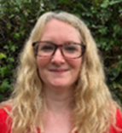
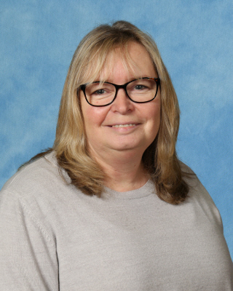
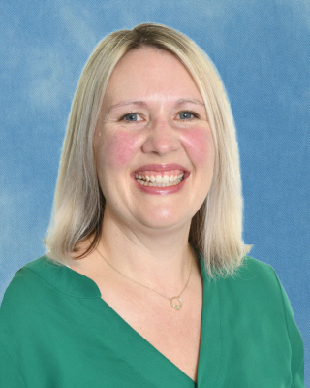
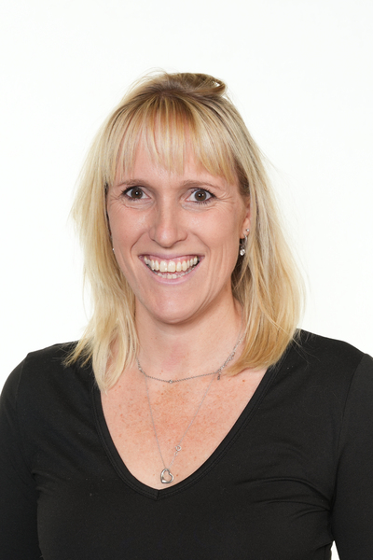
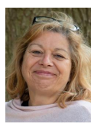
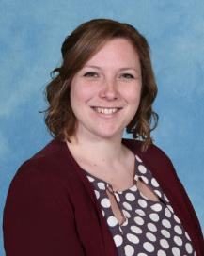
Mrs Donnelly
Reception Teacher
Mrs Coupe
Reception Assistant Teacher
Mrs Mellors
Headteacher
Miss Price
Deputy Headteacher & SENDCO
Mrs Best
Receptionist
Mrs Harder
Woodland Learning Teacher

Slide 5
Information Pack & Next Steps
📧 Information Pack (sent via email next week)
You will receive:
  Parent Handbook
  Permissions Form (please return to school)
  Information about ordering milk through Cool Milk
  Information about our new school meals provider, ISS – Feeding Hungry Minds, will be shared with families over the coming months. This will include details about menus, ordering arrangements and everything you need to know before your child starts school in September.
📂 To Take Home This Evening
You will receive:
  'This Is Me' Booklet and guidance
  Your child's individual transition timetable
  Your child's school house colour
✔️ What We Need Back
Please complete and return:
  Permissions Form
  Tapestry Registration Form
  'This Is Me' Booklet (by the date provided)
These documents help us get to know your child and ensure they have the best possible start to school.

Slide 6

Google Classroom
👨‍👩‍👧‍👦 Building a strong partnership between home and school is key to helping your child feel happy, settled and successful in Reception.
We use Google Classroom to:
  Share important updates and reminders
  Celebrate learning and achievements
  Post photographs and class news
  Share newsletters and key information
  Keep you informed about what your child is learning
💬 We encourage families to check Google Classroom regularly and use it as a starting point for conversations about learning at home.
⭐ Google Classroom will continue to be used throughout your child's time at Loxwood, providing a simple and effective way for us to stay connected and share your child's journey with you.

Slide 7
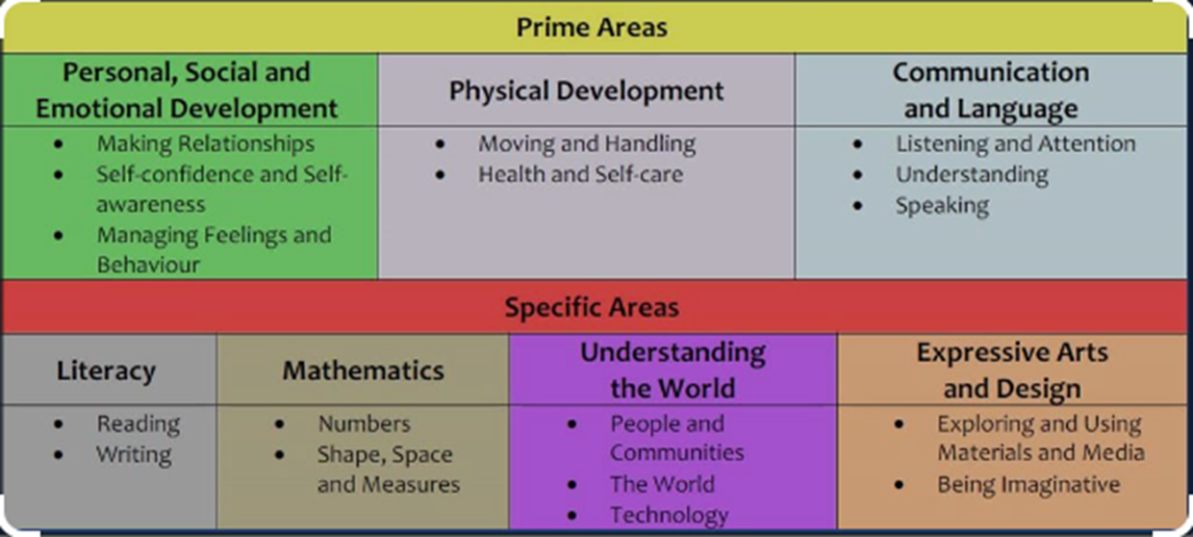
How Children Learn in Reception
In Reception, children learn through seven interconnected areas of learning and development. These areas work together to help children become confident, curious and independent learners.
  Prime areas: the essential skills children need to successfully engage with the world
  Specific areas: the building blocks of reading, writing, maths, and other foundation subjects

Slide 8
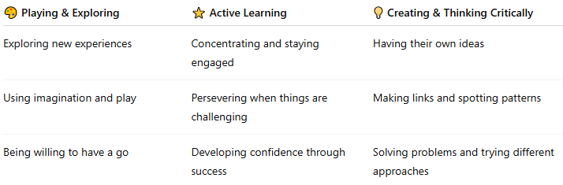
Characteristics of Effective Learning
These describe how children learn, helping them become confident, resilient and independent learners.
🌱 Why is this important?
In Reception, we encourage children to be curious, resilient and independent. These learning behaviours are the foundation for future success in school and beyond.

Slide 9
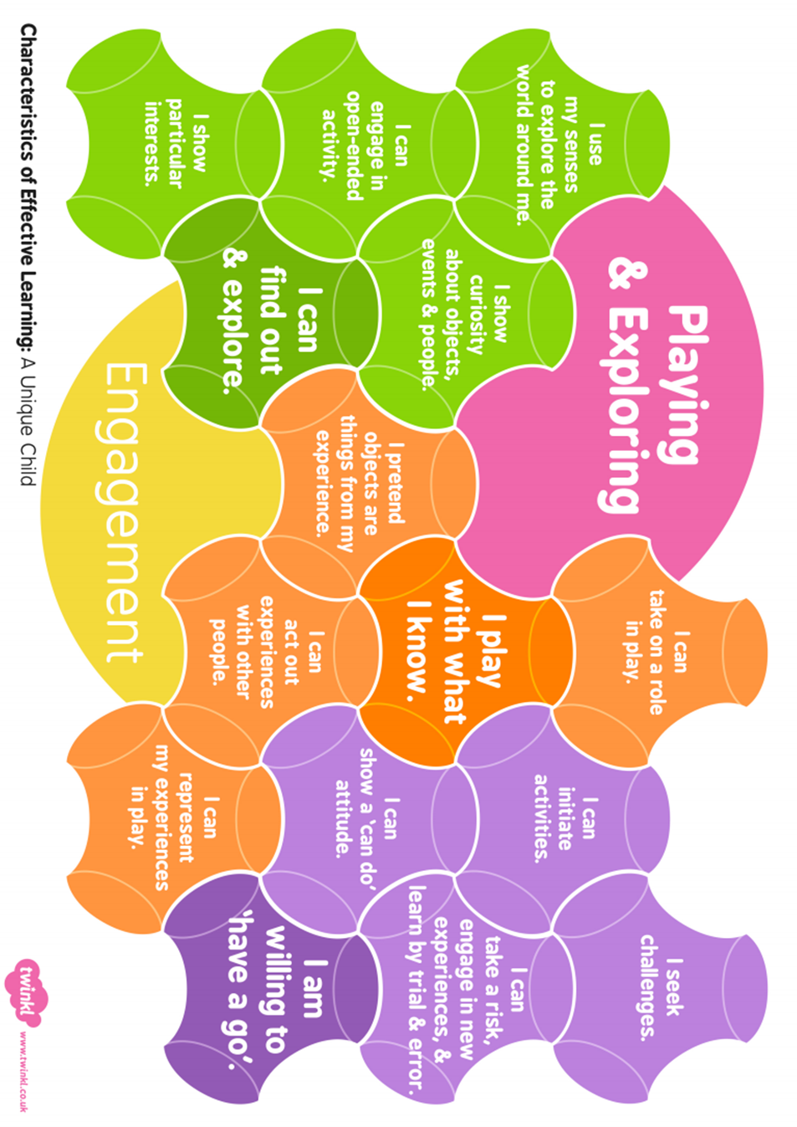
Characteristics of Effective Learning

Slide 10
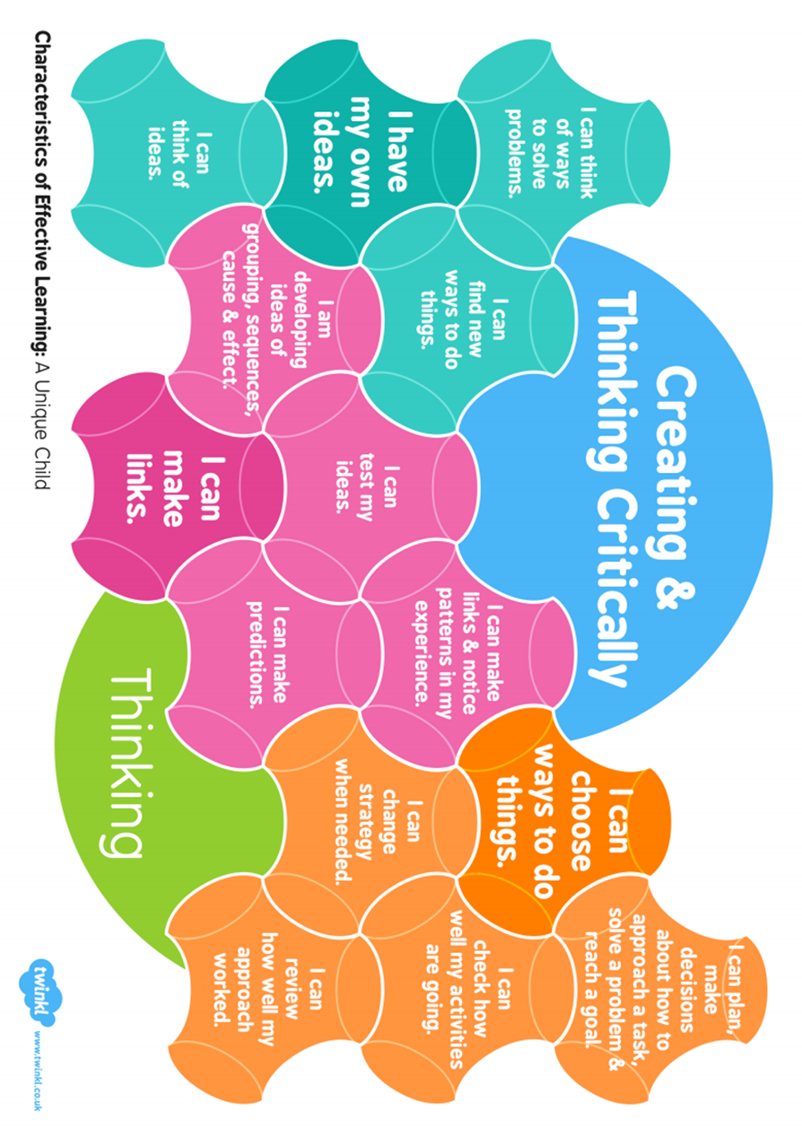
Characteristics of Effective Learning

Slide 11
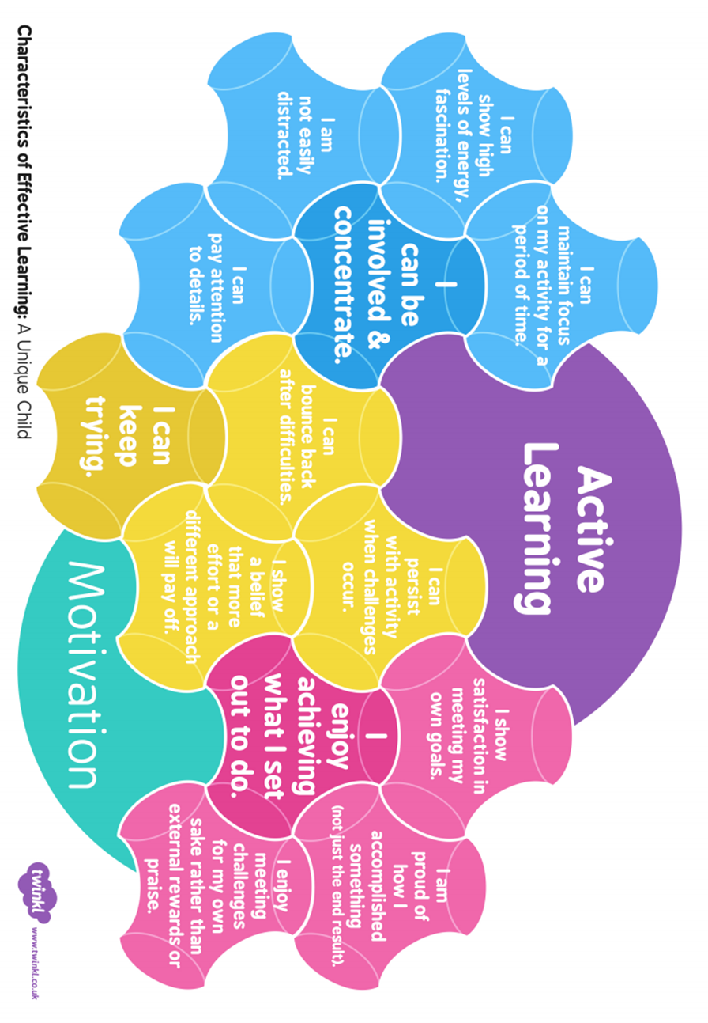
Characteristics of Effective Learning

Slide 12



Helping Your Child Be School Ready
There are a few simple skills you can practise over the summer to help your child feel confident and independent when they start school.
🍴 Lunchtime Skills
We will support children during the settling-in period, but practising at home can make a big difference.
  Encourage your child to:
    Use a knife and fork
    Open lunchboxes, containers and packets
    Use drinks bottles independently
⭐ Remember: Every child develops at their own pace. We will work together to ensure your child has the very best start to school.
🚻 Toileting
  Use the toilet and wash hands independently
  Let us know if your child needs additional support
👕 Dressing Independently
  Practise putting on coats, shoes and clothing independently
  Choose easy-to-manage items such as Velcro shoes and elasticated waistbands
  Please avoid belts where possible

Slide 13

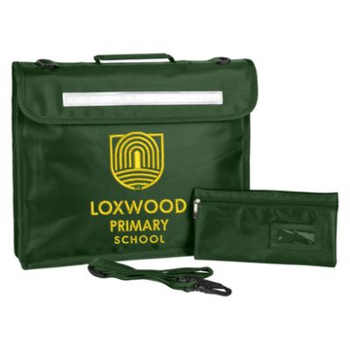
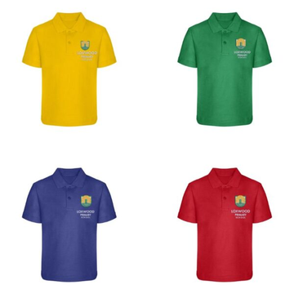
What will My Child Need From Day One?
To help your child settle in smoothly, please ensure they bring the following items to school from their first day:
✅ A named refillable water bottle (with a sports lid)
✅ A named school book bag
✅ A PE bag to keep at school, containing:
PE kit (including a T-shirt in their house colour)
A spare change of clothes for messy play and outdoor learning
✅ A named pair of wellies to keep at school
🏷️ Please label everything clearly – named items are much more likely to find their way back home!
🚫 Please do not send toys, teddies or other personal items to school, as these can easily get lost or become a distraction during the school day.
🌟 Ready for Learning
Having these items from the start helps your child feel prepared, independent and ready to enjoy all the exciting experiences Reception has to offer.

Slide 14

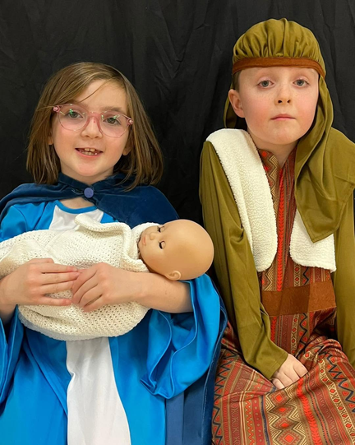
Get Invovled in School Life!
We believe that children thrive when school and home work together. There are lots of ways to be involved in your child's learning journey:e are always happy to help.
📖 Support Learning at Home
  Read with your child every day and complete their Reading Record
  Attend parent workshops (e.g. Read Write Inc. Phonics)
🎉 Join Our School Community
  School trips and special events
  Christmas Nativity
  Christmas Fair
  Summer Fun Day
  Assemblies and Sports Days
  Celebration Assemblies
📢 Stay Connected
  Read our weekly newsletter, Up to the Minute
  Visit our website: www.loxwoodschool.com
  Follow us on Facebook and Instagram
🚪 Open Door Policy
We value strong relationships with our families. If you have a question, concern or simply want to share something important, please come and talk to us—w
Together, we can make your child's start to school a happy, successful and memorable one! 🌟🏫💚

Slide 15
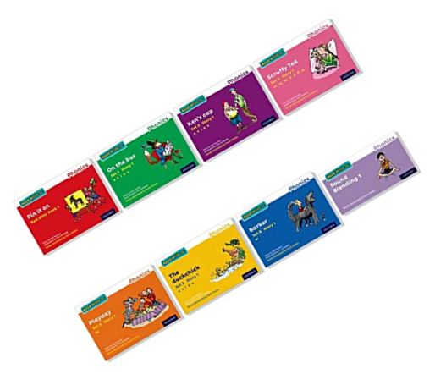
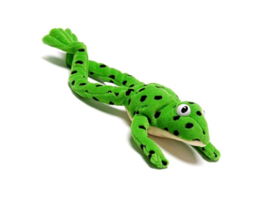
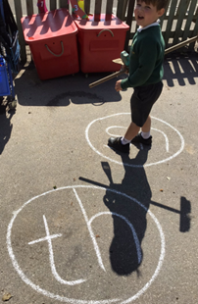
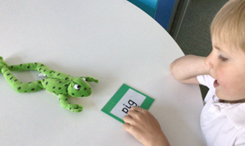
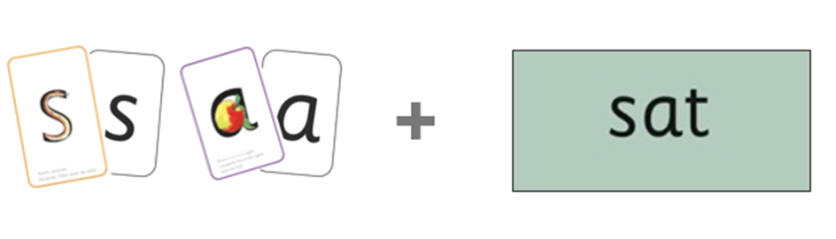
Get Invovled in School Life!
At Loxwood Primary School, we use Read Write Inc. Phonics, a government-approved programme that helps children learn to read and write confidently from the very start of their school journey.
The programme teaches children to:
  Learn letter sounds
  Blend sounds to read words
  Read with increasing fluency and confidence
  Develop early writing skills
👨‍👩‍👧 Parent Workshop
We will hold a Read Write Inc. workshop in the Autumn Term
to explain how the programme works and share ways you can
support your child at home.
📖 A little reading practice every day makes a big difference! 🌟

Slide 16

Important Dates
🎉 Stay and Play Sessions
14th & 16th July 2026
A chance for your child to visit the classroom, meet staff and begin to feel familiar with their new environment.
🏡 Home Visits
2nd, 3rd & 4th September 2026
We look forward to meeting your child in a familiar setting and learning more about them before they start school.
🚀 Starting School
7th, 8th or 9th September
🕘 Small-group session
9:00am – 12:00pm
10th & 11th September
👫 All children attend
8:35am – 1:30pm (including lunch)
From 14th September
🎒 Full-time attendance begins
8:35am – 3:05pm
Every child settles differently. If your child would benefit from a longer staggered start, please speak to Mrs Donnelly and we will be happy to discuss this with you.

Slide 17


Slide 18
Any Questions? 💬
Thank you for joining us this evening.
We are excited to welcome you and your child to the Loxwood Primary School family and look forward to working together throughout their Reception journey.
Get in Touch
If you have any questions, concerns or would simply like to discuss anything further, please don't hesitate to contact us.
📧 messages@loxwoodschool.com
📞 01403 752207
🌟 We look forward to seeing you again soon at our Stay and Play sessions!
Together, let's make your child's start to school a happy, confident and successful one. 💚🏫✨

