Slide 1
Meet the Team

Slide 2
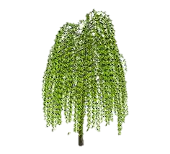
Welcome to Year 1 and 2
2022-23

Slide 3
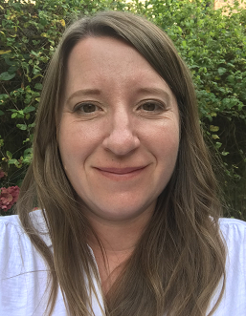
Willow Class Team
Hello I am Mrs Rolland, Willow Class’ teacher. Mrs Hounsham is our Classroom Assistant.
Mrs Harder and Mrs Swann will be teaching in our class on Wednesdays to cover my Planning Preparation and Assessment time.
We are all really looking forward to working with you and your children this year.

Slide 4
Oak Class Team
Hello I am Mrs Donnelly. Mrs Coupe is our Classroom Assistant.
Mrs Harder and Mrs Swann will be teaching in our class on Wednesdays to cover my Planning Preparation and Assessment time.
We are all really looking forward to working with you and your children this year.

Slide 5
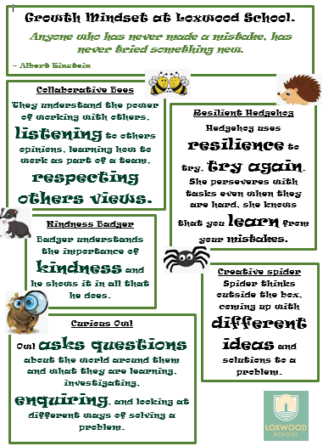
Whole School Behaviour

Slide 6
Growth Mindset
We are going to be working on improving Growth Mindset with the children. This links into our new School Values of Resilience, Collaboration, Curiosity, Creativity and Kindness.

Slide 7
Year 1 and 2 Expectations
The children will be encouraged to become increasingly independent and organised as the year goes on, to enable them to be ready to progress by the end of the year. This is especially so for our Year 2 children who will then be moving to Key Stage 2 next year!
The children will continue to learn in different ways and will be given some choice in their learning and in how they challenge themselves.
There will still be lots of continuous provision available to the children and plenty of play-based learning, especially for our Year 1 learners. They will have access to learning outside and inside, so that we can aim to meet the needs of all learners.

Slide 8
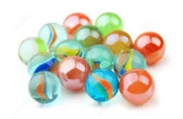
Rewarding ‘good’ choices
Children will be awarded house points for demonstrating our school values of resilience, collaboration, curiosity, creativity and kindness.
In Oak Class we collect pompoms and in Willow Class we collect marbles to earn our ‘Golden Time’ on a Friday. They are earned for all helping to do things like tidy up, all sitting quietly or walking sensibly around our school.

Slide 9
Your child needs…
Named water bottle every day please that is extra to the one in their lunch box.
Named Wellies (we will be going on walks around the school grounds throughout the year).
Weather appropriate named coat every day.
Named clothing, especially jumpers and cardigans!
Full & named P.E Kit. Trainers are allowed and are often more supportive than plimsolls but please only send in laced ones if they can do them up themselves!

Slide 10
Home Learning
Reading – as often as possible, 10 mins every day is desirable. We will remind children during the day to change their books but if in doubt send them in with their book ready to hand to the teacher in the morning.
Phonics/Spellings lists are on our Class Pages for you to work through at your own pace.

Slide 11
Reading and Phonics
Excitingly we are going to be moving over completely to ReadWriteInc Phonics and have just received lots of lovely books! These need to be sorted and we then need to check where each child is with their phonics learning. We aim to do this as soon as possible so that we can send home a suitable ReadWriteInc phonics book with the children who require one.
Phonics in school will be streamed across Years R, 1, 2 and 3 so that each child can be taught according to their needs. The children are put into groups according to the sounds they already know, so children focus on the appropriate sounds for their current need. (These groups are not static and are open to change). We assess their phonics regularly so that we can ensure that all children are in the correct group.
Staff are also going to be receiving extra ReadWriteInc training too!
This phonics book will be changed once a week by staff. It is to be kept in their plastic phonics folder in their book bag and bought to school each day as we will also be reading them in school.
Until we are up and running children will be taking home a free choice book from their book band colour.

Slide 12
Phonics in Year 1 and 2
At the end of Year 1 children undertake a Phonic Screen Assessment. This is a national assessment that happens in all schools. It is undertaken with their class teacher and takes about 10 minutes, 1-1 per child. Children are required to segment and blend words and non-words containing the phonemes that they have already been taught in school. This is something that is familiar to the children already. Children in Year 2, who did not achieve the required pass in Year 1, will retake the assessment also.
Children who passed their Phonic Screen in Year 1 and are also confident and fluent readers will be group reading and working on their comprehension skills.
We recommend that you try to read with your child at least 3 times a week for approximately 10mins. We appreciate family life is busy, but any time you dedicate to practising reading skills will be beneficial to your child’s development.
We would like you to record your child’s reading progress at home using new Reading Record Books. This doesn’t need to be every time that they read, but as often as you can. Your comments are so helpful for us, as they enable us to form a picture of what your child can do and what progress they are making. We will check the reading records as often as we can and reply to any queries as soon as possible. Sending it in in your child's hand in the morning is often helpful!

Slide 13
Phonics

Slide 14
Reading at school
At School
There are so many opportunities for reading at school every day, both inside and outside of the classroom. We aim to create a love of reading by sharing quality texts with the children and incorporating reading into areas of interest and play. Reading isn’t only done sitting with a book!
We assess the children's reading at school in many ways; group reading, paired reading, whole class reading and sometimes 1:1 reading. We record our assessments in school rather than in the home reading record and will share progress with you in the usual way during Parent Consultation Meetings. If you have any concerns or questions at any time, do feel free to come and have a chat.

Slide 15
Take a closer look at READING
Remember that sharing an experience with words doesn’t have to be with a book!
Developing a love of reading is most important. Reading to your child is as important as them reading to you.
We focus on word reading and comprehension. Talking about a book is just as important as reading it!
Become a reading volunteer or recommend someone who can! We would love to have you!
“Parental involvement in reading is a stronger influence on children’s achievement than factors such as family income, class and even parents’ education.” (Flouri and Buchanan, 2004)

Slide 16
Spelling
Please focus on reading and spelling these Common Exception Words at home at your own pace throughout the year.

Slide 17
KS1 SATs (Year 2)
The Key Stage 1 SATs officially assess your child’s Maths and English abilities. Although they include formal tests, they are done in a relaxed way; in fact, most children are not even aware they’re taking a test! The tests are used as a tool for teacher assessment.
They consist of two reading tests (long and short), two maths tests (arithmetic, mental reasoning), English grammar, punctuation and spelling (optional)
You may find this website helpful https://www.theschoolrun.com/ks1-sats-questions-answered

Slide 18
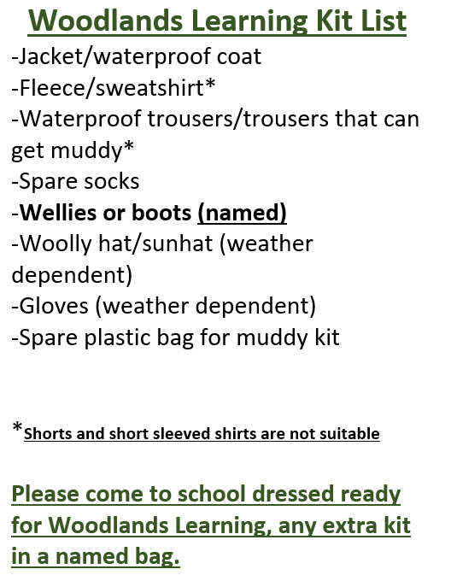
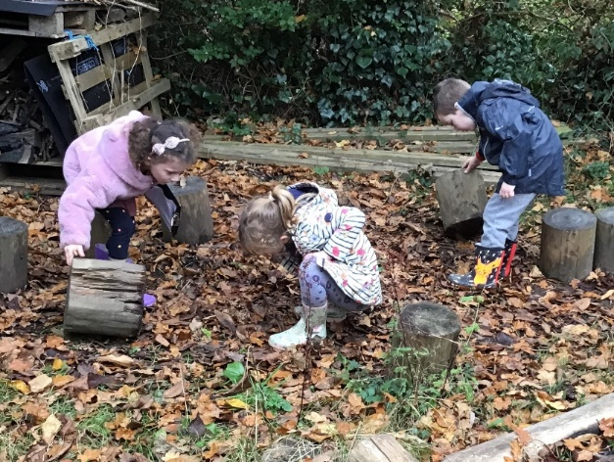
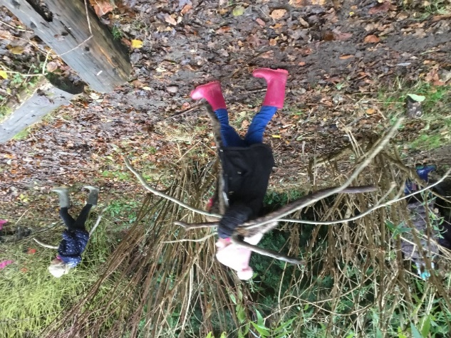

Slide 19
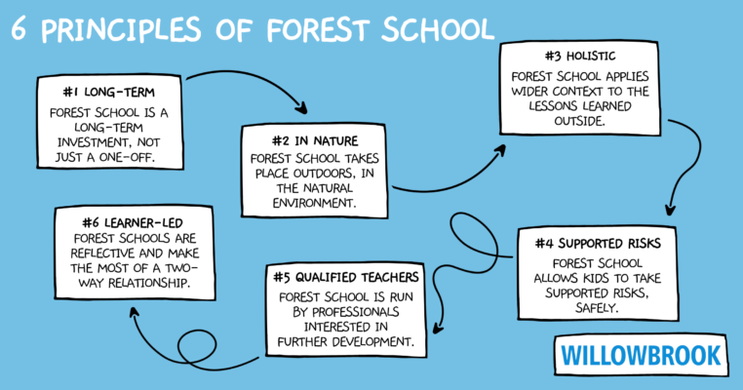
Woodlands Learning
We follows the ethos of Forest School and are supported by the work of the National Forest School Association

Slide 20
Woodlands Learning
Autumn Term Dates
OAK CLASS

Slide 21
Woodlands Learning
Autumn Term Dates
WILLOW CLASS

Slide 22
Keeping Up-to-Date
Remember to check…
The new school website and the Up to the Minute
Willow Class Webpage – You will find our Termly Topic Web and other important information.
Book bags – check for letters and forms to complete

Slide 23
Any questions? If you have any questions, please ask at school drop off or pick up. You can also email me at messages@loxwoodschool.com, addressing the emails to Mrs Rolland or Mrs Donnelly.

