Slide 1


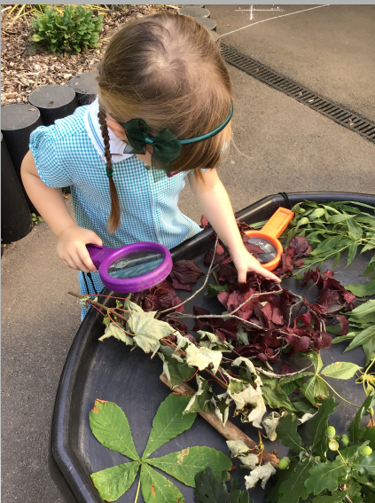
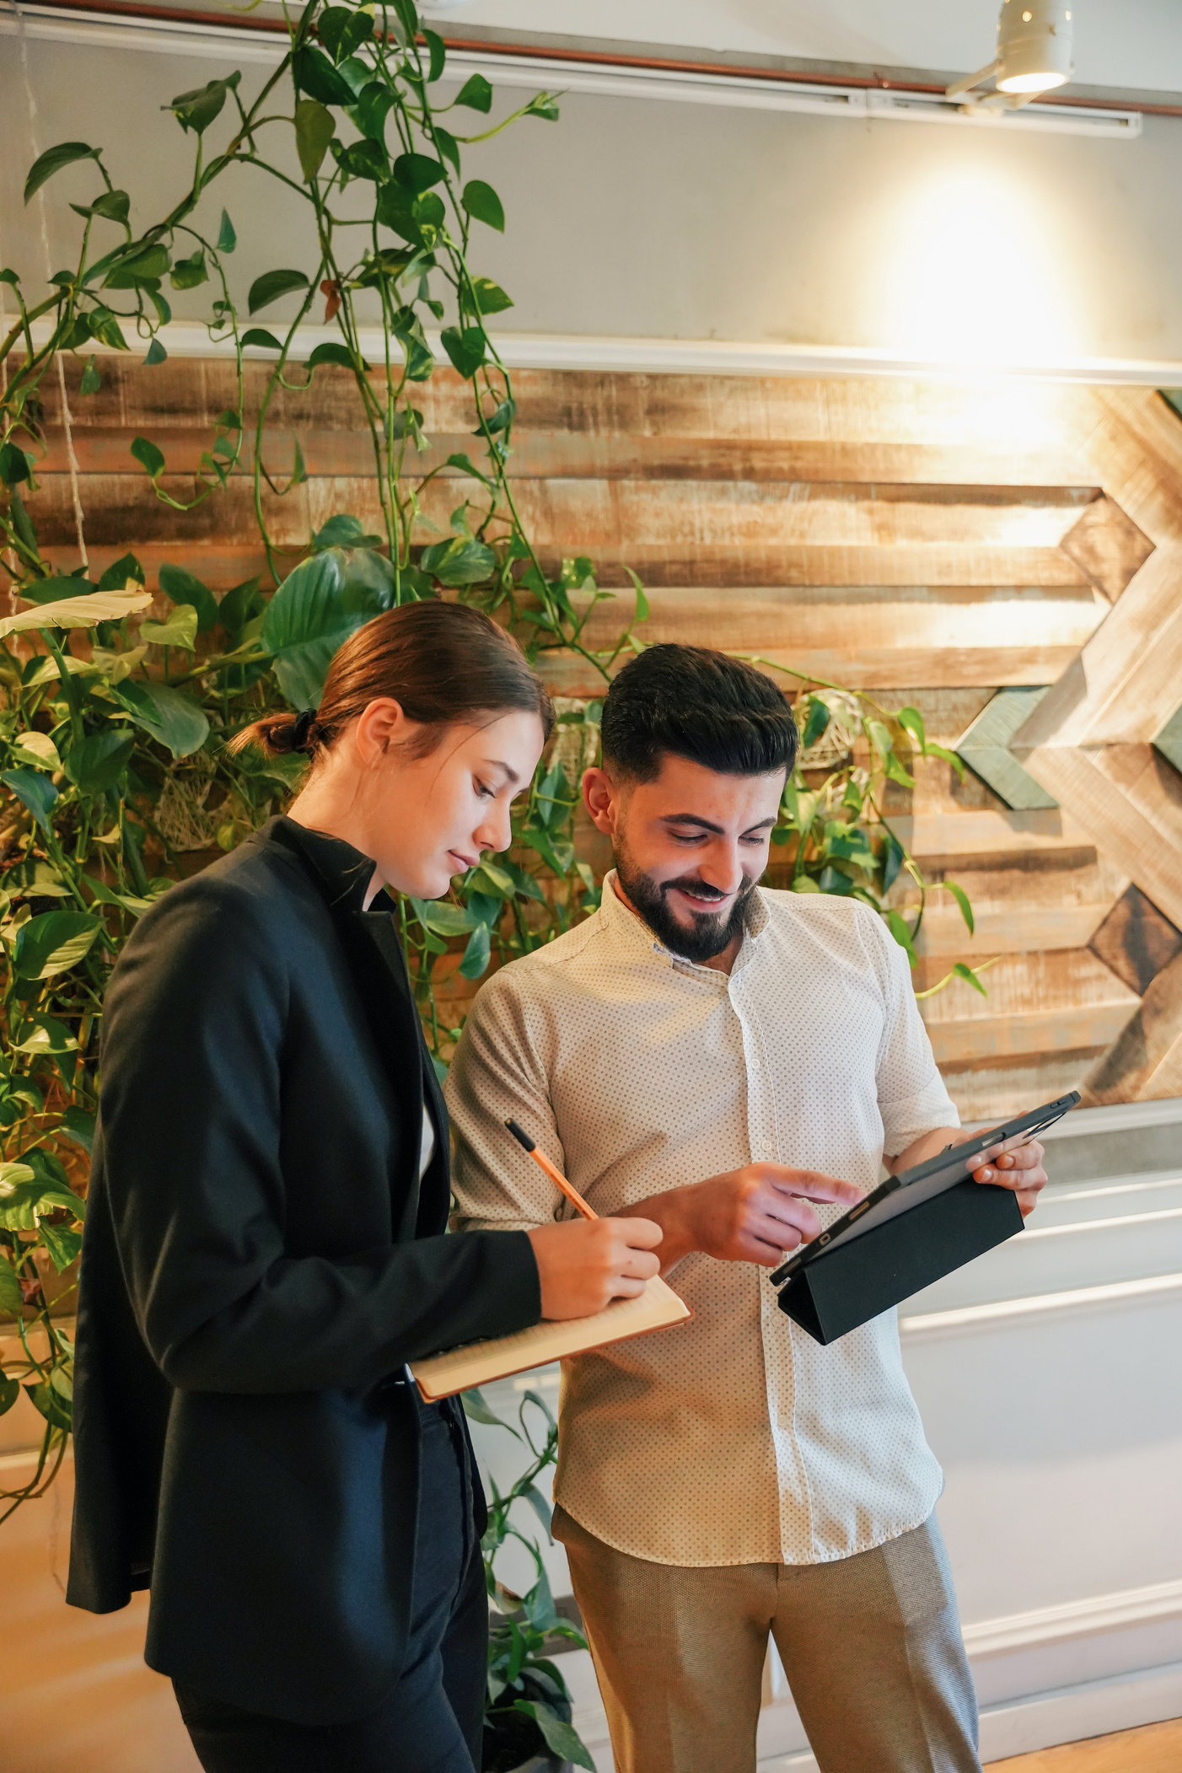


2025
WHY LOXWOOD?
https://www.loxwoodschool.com/web

Slide 2


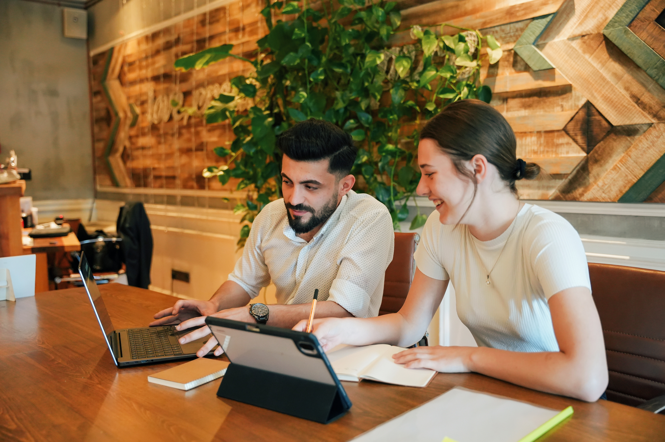
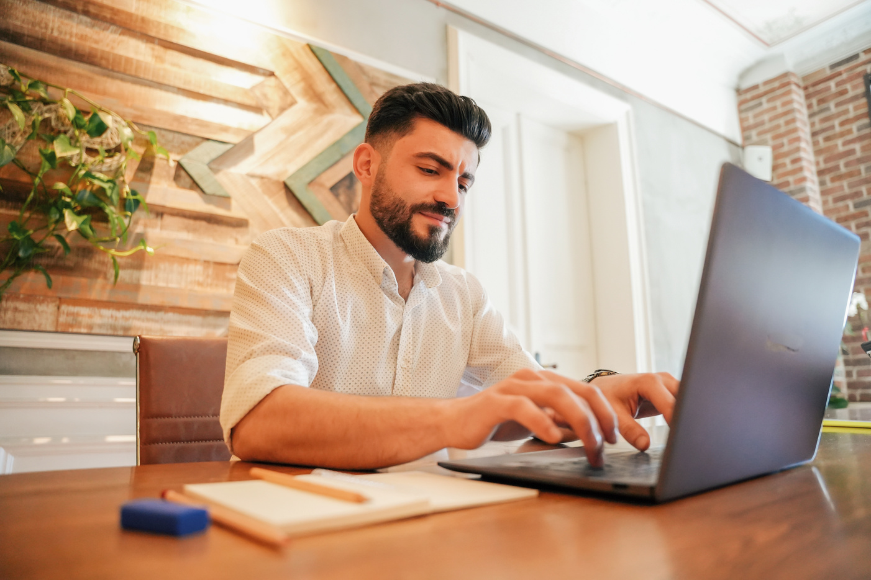
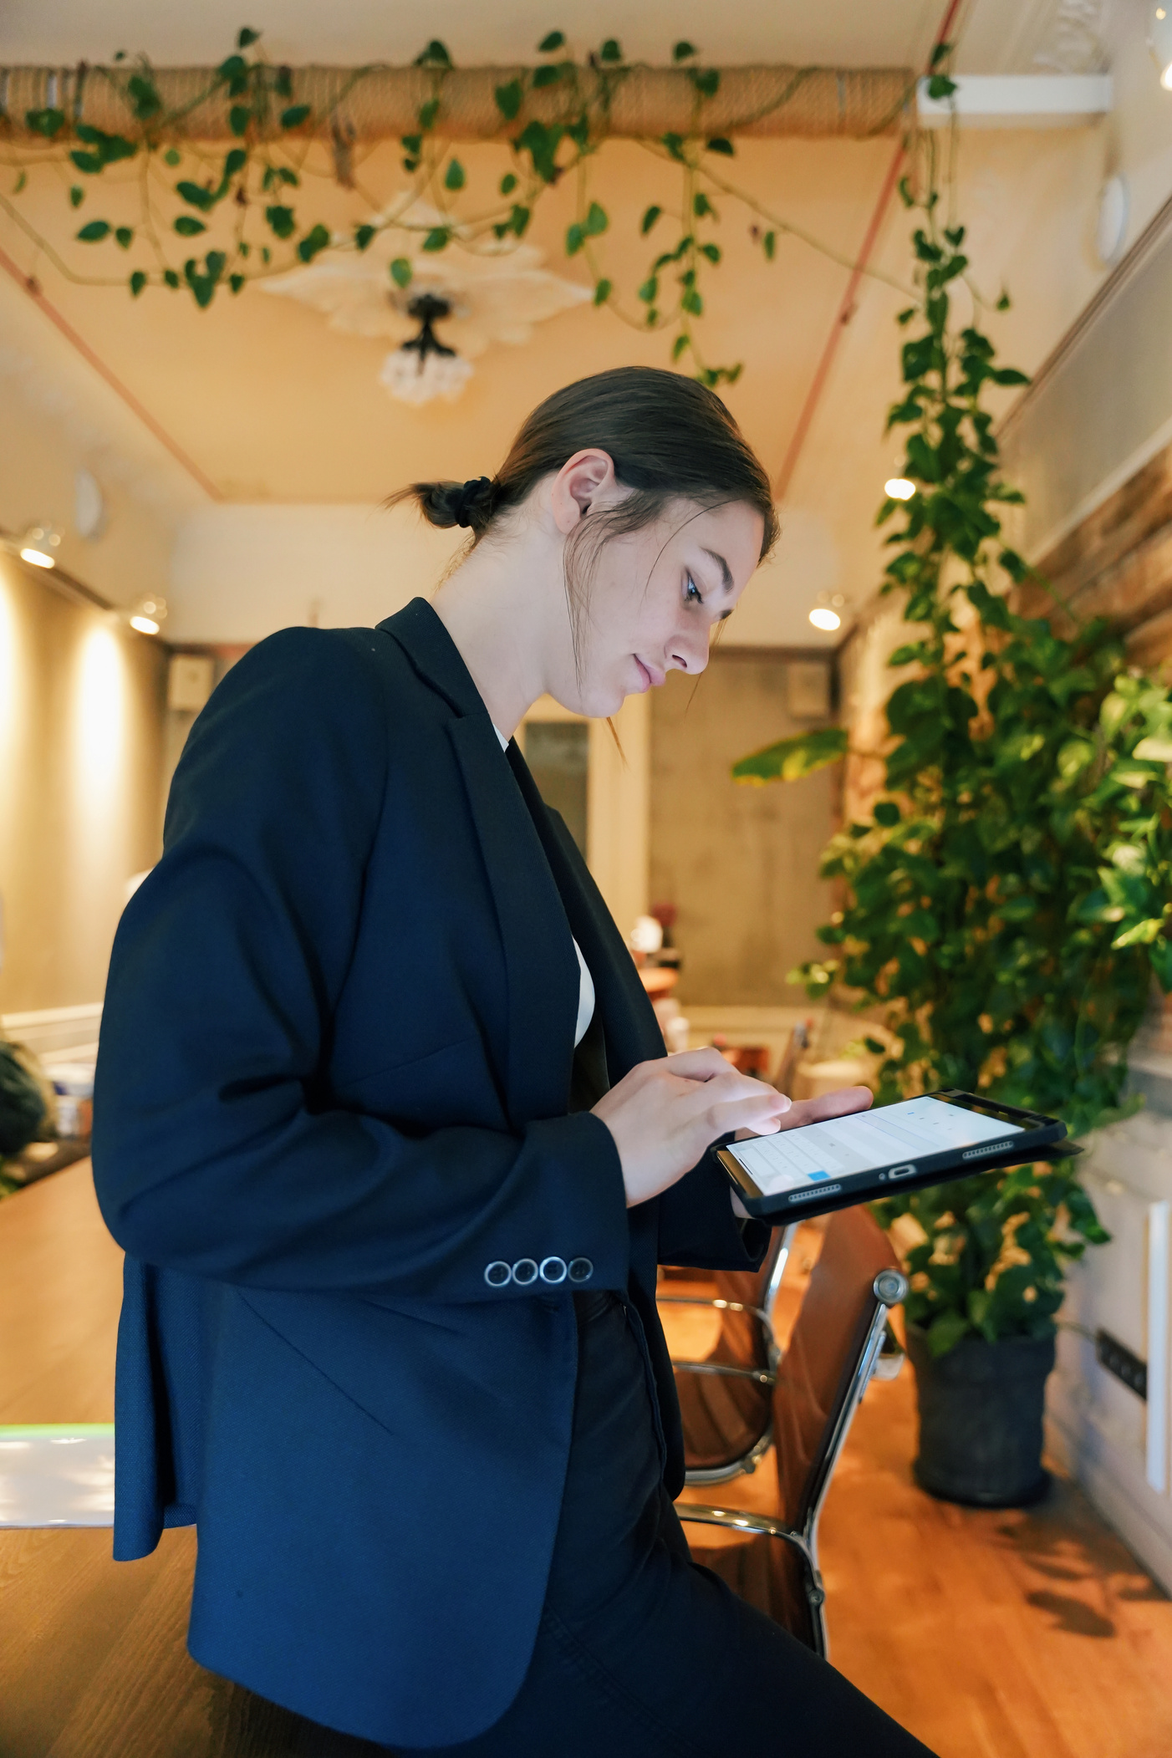
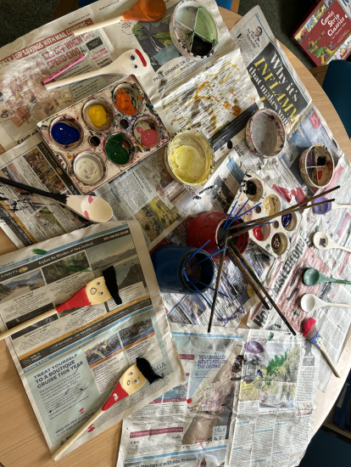
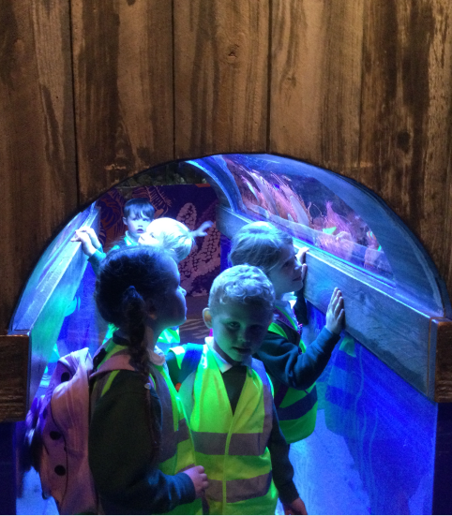
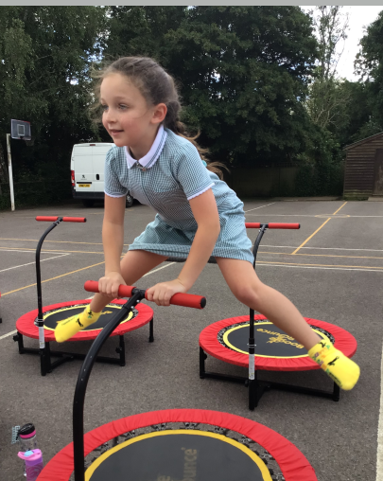
Our Curriculum is....
Current
Relevant
Fun
We use topics that are current to children’s lives and we utilise our beautiful outside area to enhance the learning.
Our topics are chosen to engage and motivate children. Our yearly trips are a great way to bring learning to life, such as the reception trip to the Sea Life Centre .
Happy children make happy learners.

Slide 3
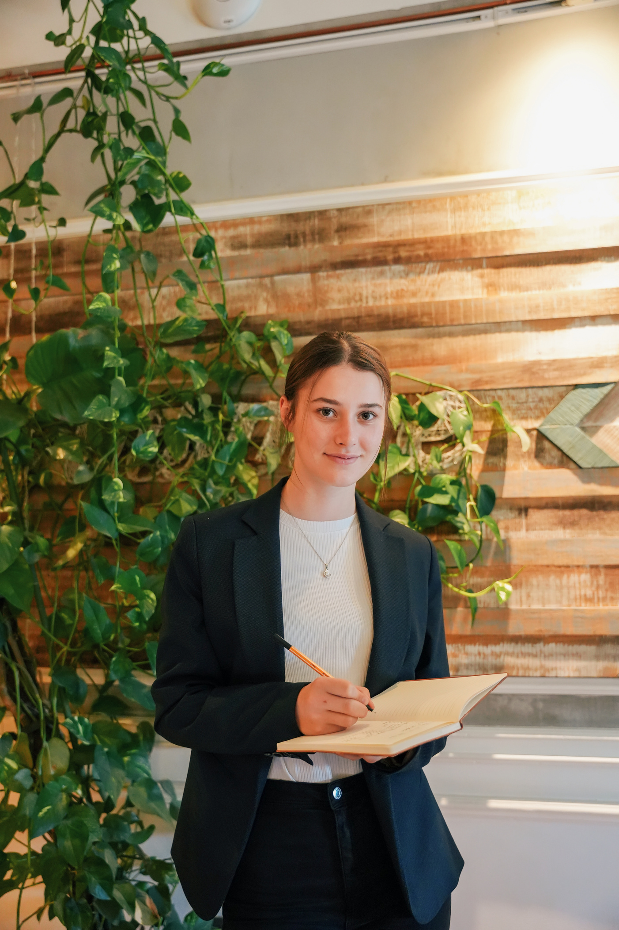
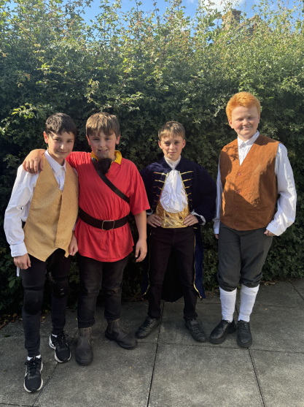
Loxwood’s Life List
Experiences beyond the curriculum include;
01
Visiting the canal
02
Enjoying a pantomime
03
Going on a residential in year 6
04
Performing on stage
05
Learning to swim
06
Camping on the field
07
Supporting a charity

Slide 4







Our Values
Kindness
Kindness is at the heart of everything we do.
Curiosity
We like children to ask questions about the world around them.
Respect
We teach children to respect themselves, those around them and the environment.
Independence
We prepare children for secondary school and beyond.
Resilience & Growth Mindset
We encourage children to make mistakes in a safe environment and to have the confidence to try again.

Slide 5
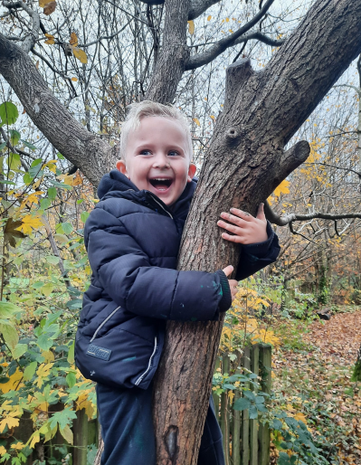
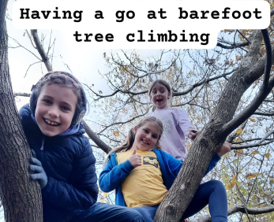
We use our extensive grounds and local environment to bring the children’s learning to life. In addition to every class taking part in woodland learning every other week, each class will spend time learning outside, making their lessons focused, real life and most of all exciting. We have a specialist teacher who teaches the children new skills, such as cooking and knife skills, as well as confidence, independence and physical strength. We also have a pond. Our school is a fun place to be!
WOODLAND LEARNING

Slide 6

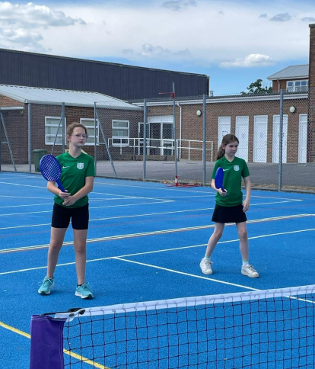


Sports
We love sport and are proud to have achieved the Platinum Sports Award for another year. The children get to try a wide range of sports, including attending events such as the Weald inclusive sports event. We have a sports specialist teacher who teaches across the school every Wednesday.

Slide 7

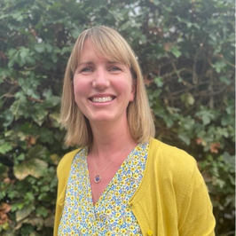
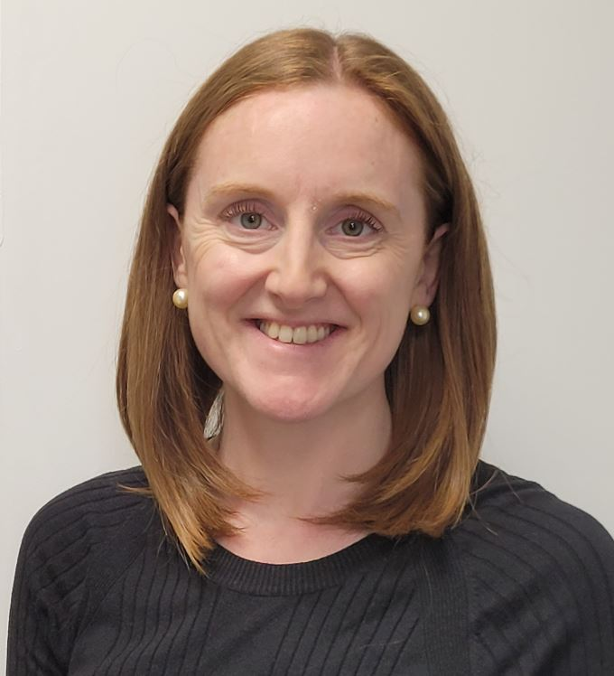
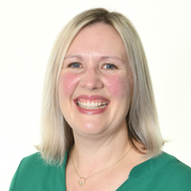
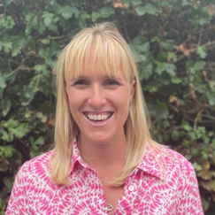
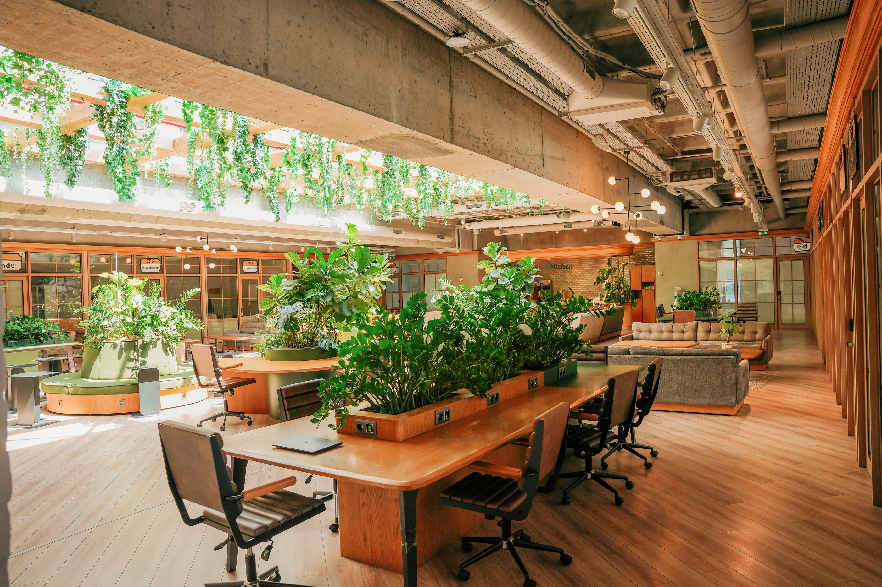
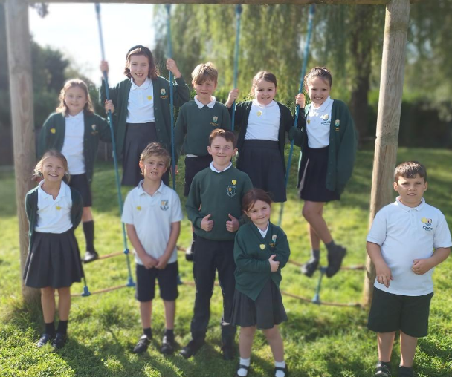
Well-being Team
We have a large team of staff and children who actively promote and support well being at Loxwood.
Mrs Swann - Learning Mentor, Wellbeing Ambassadors Lead and Mental Health Lead
Mrs Green – Emotional Literacy Support Assistant (ELSA)
Mrs Mellors - Mental Health Lead and Mental Health First Aider
Miss Price – Special Educational Needs Coordinator
Wellbeing Ambassadors Team of children

Slide 8
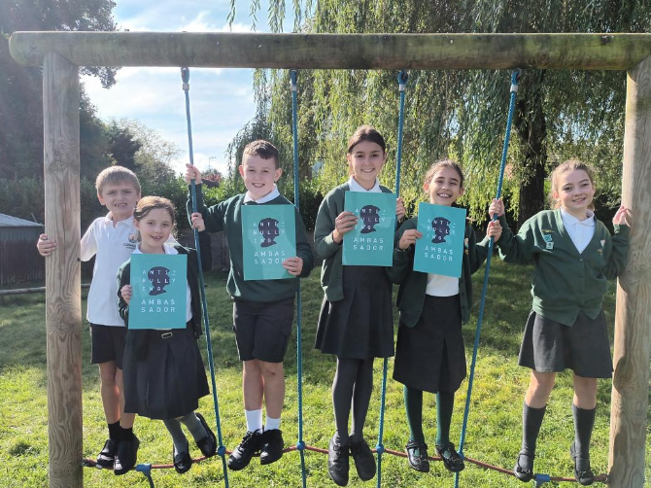

ANTI-BULLYING AMBASSADORS
Mrs Swann leads the anti-bullying ambassadors team, they are trained by the Diana Award and actively work towards key badges throughout the year. They help to support key weeks such as anti-bullying week and on the playground. They help to write and review our antibullying policy. They help to promote our values.

Slide 9
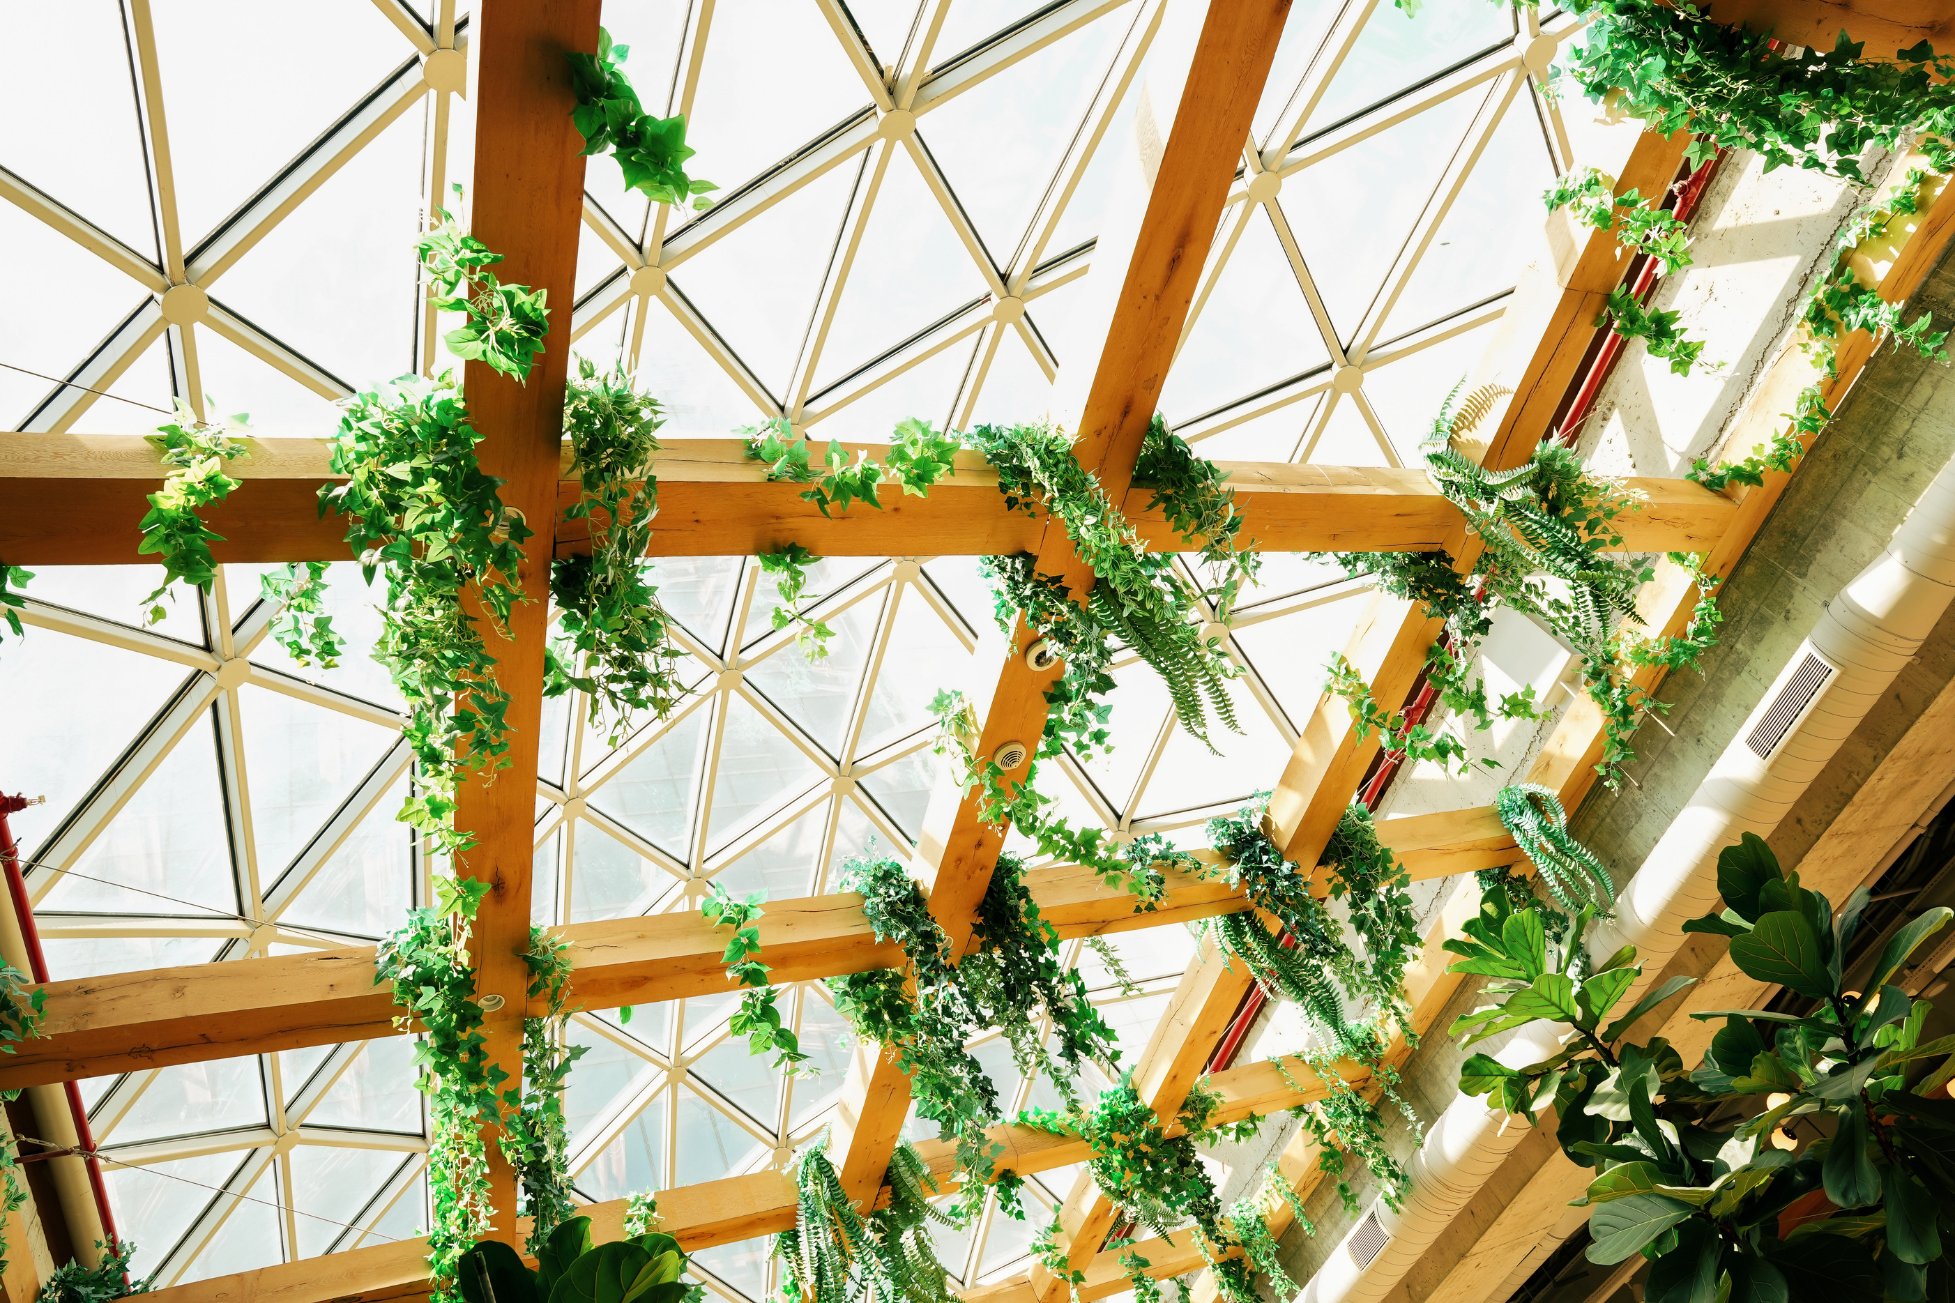



OUR WRAPAROUND CARE (WOODPECKERS)
Breakfast Club
After School
7.30 - 8.30
Breakfast & games
3.15 -5.30
Snack & drink
Games, chill, outside games, cooking, colouring.

Slide 10
WE ARE A SMALL RURAL PRIMARY SCHOOL SITTING AT THE HEART OF A BEAUTIFUL VILLAGE
Where we value every child individual.
Where every member of staff knows every child’s name.
Where every class has a teaching assistant.
Where children can make life long friends.
Where every child and parent becomes part of the Loxwood family.
Where we love learning outdoors in our beautiful grounds.

