Slide 1


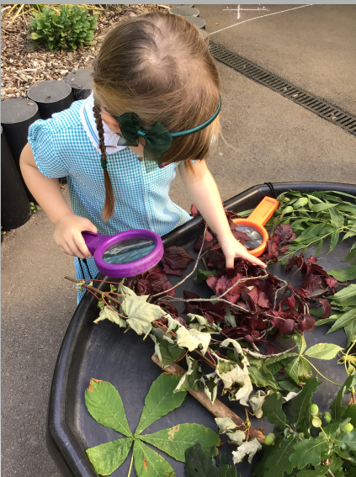
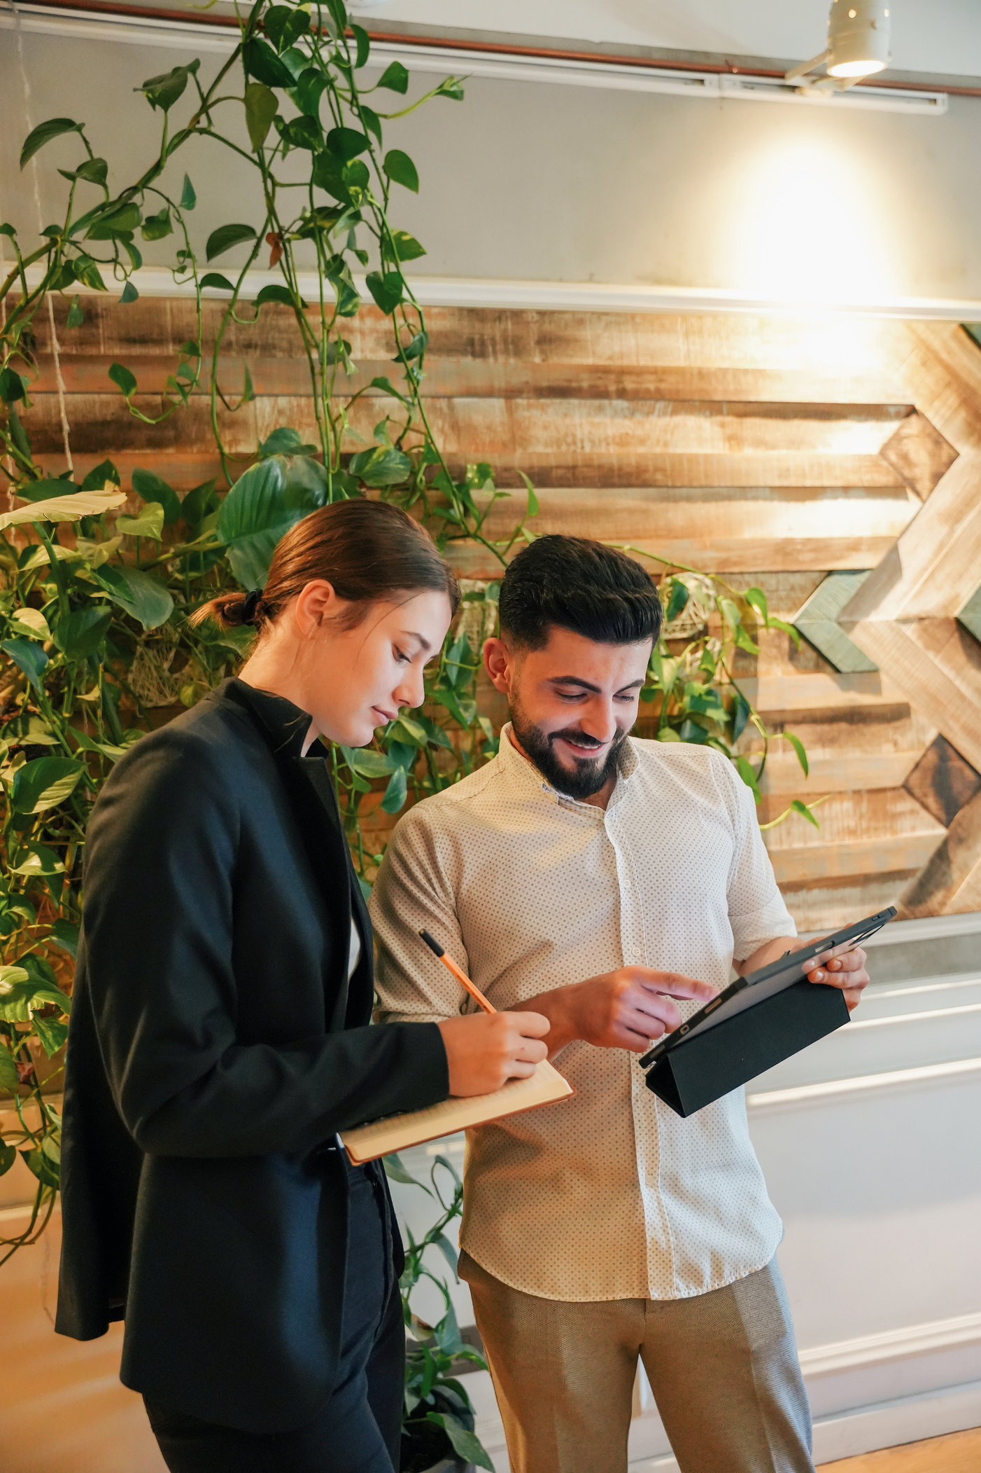


2024
WHY LOXWOOD?
https://www.loxwoodschool.com/web

Slide 2


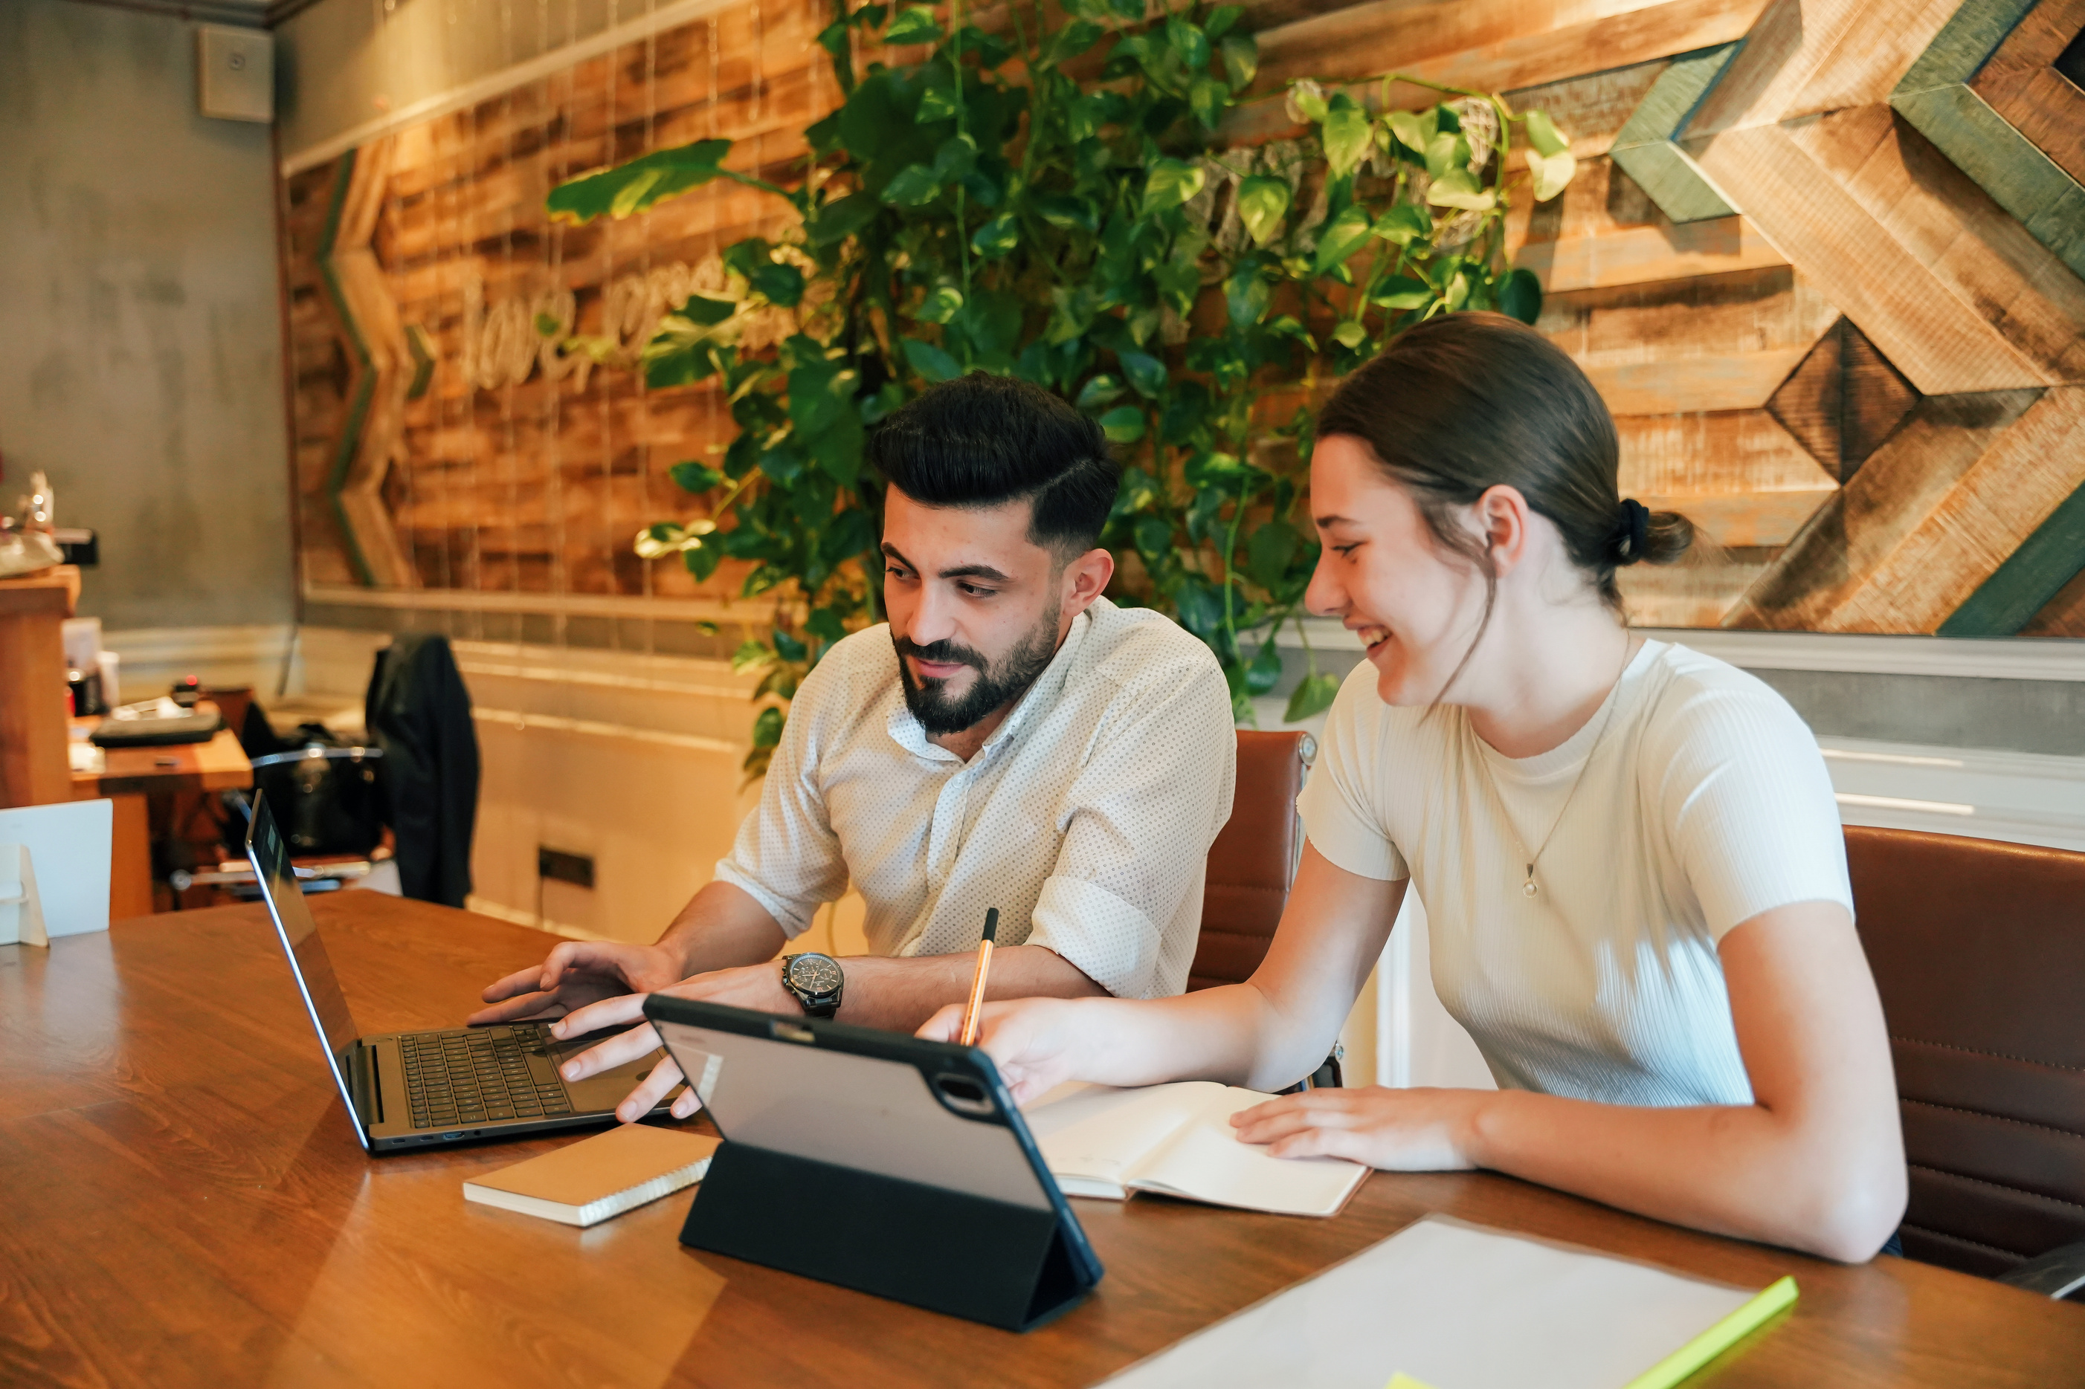

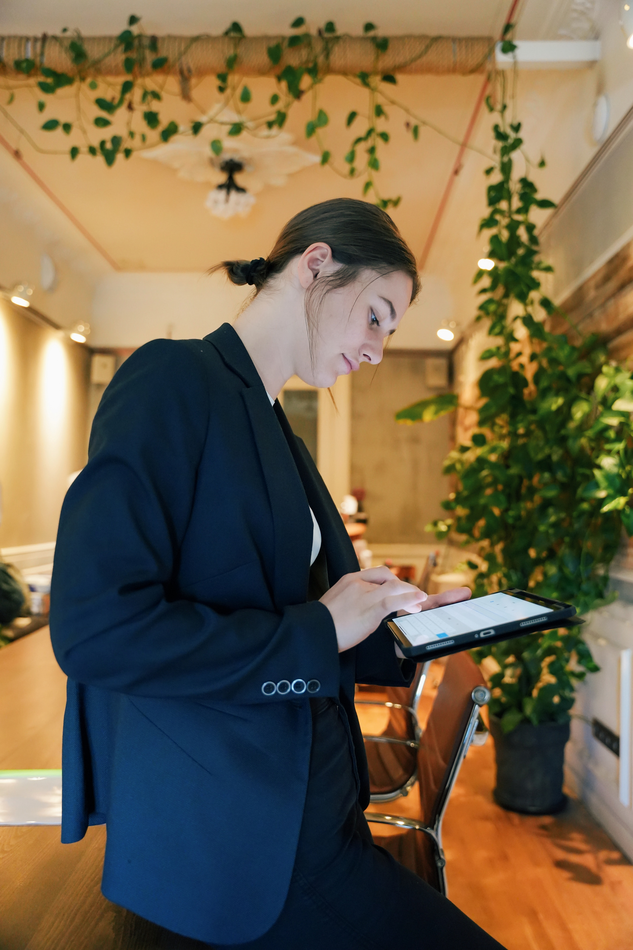
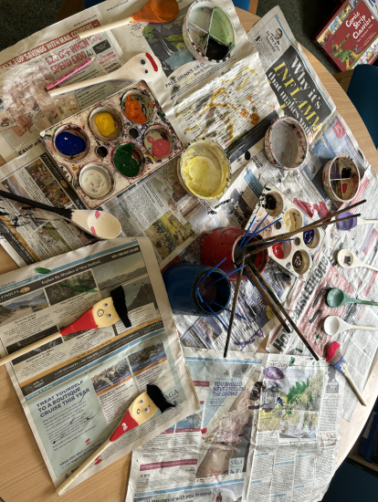
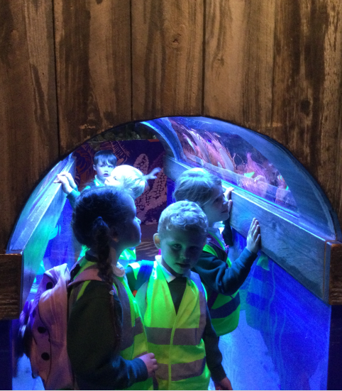
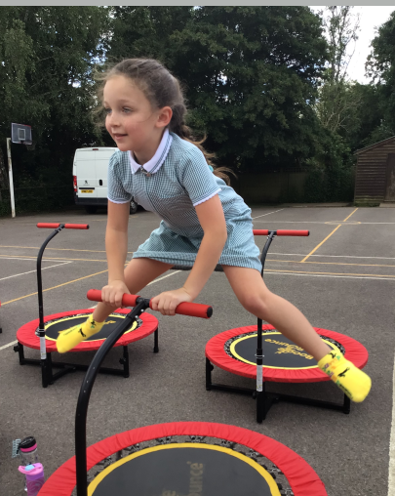
Our Curriculum is....
Current
Relevant
Fun
We use topics that are current to children’s lives and we utilise our outside area.
Our topics are chosen to engage and motivate children. We go on trips every year.
Happy children make happy learners.

Slide 3
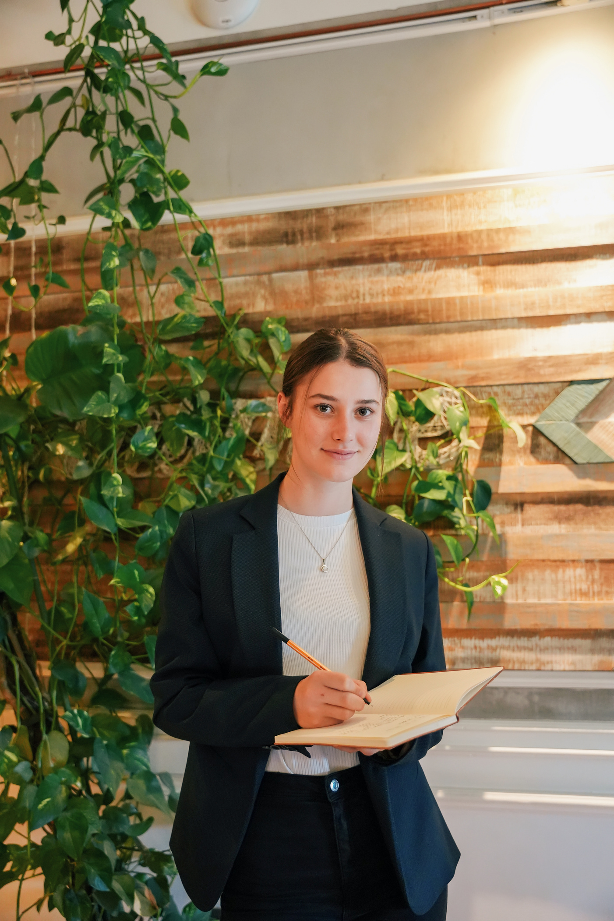
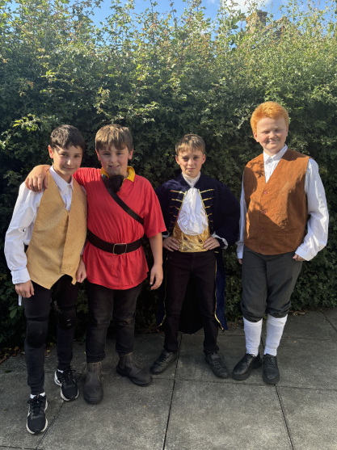
Loxwood’s Life List
01
Visit the canal
02
Enjoy a pantomine
03
Go on a residential
04
Perform on stage
05
Learn to swim
06
Learn a language
07
Support a charity

Slide 4






Our Values
Kindness
Kindness is at the heart of everything we do.
Curiosity
We like children to ask questions about the world around them.
Respect
We teach children to respect themselves, those around them and the environment.
Independence
We prepare children for secondary school and beyond.
Resilience & Growth Mindset
We encourage children to make mistakes in a safe environment and to have the confidence to try again.

Slide 5
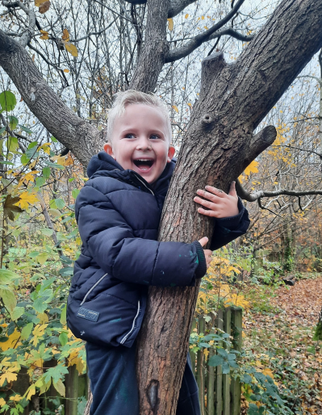
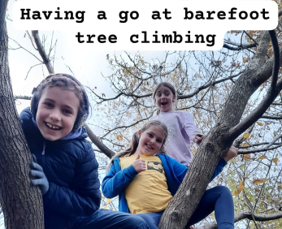
The children go into the woods every other week. We have a specialist teacher who teaches the children new skills, as well as confidence, independence and physical strength.
WOODLAND LEARNING

Slide 6

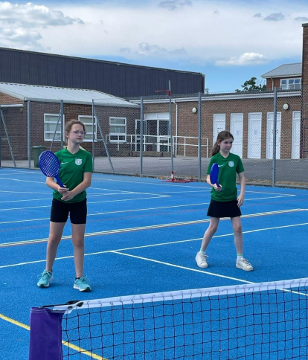


Sports
The children get to try a wide range of sports, including attending events such as the Weald inclusive sports event. We have a sports specialist who teaches every Wednesday. We are proud to have received the Platinum Sports Award.

Slide 7

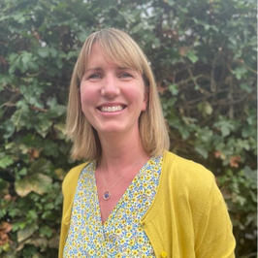
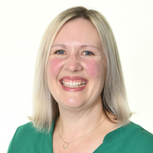
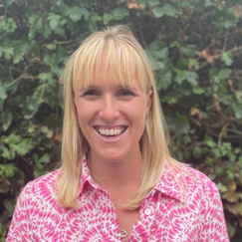

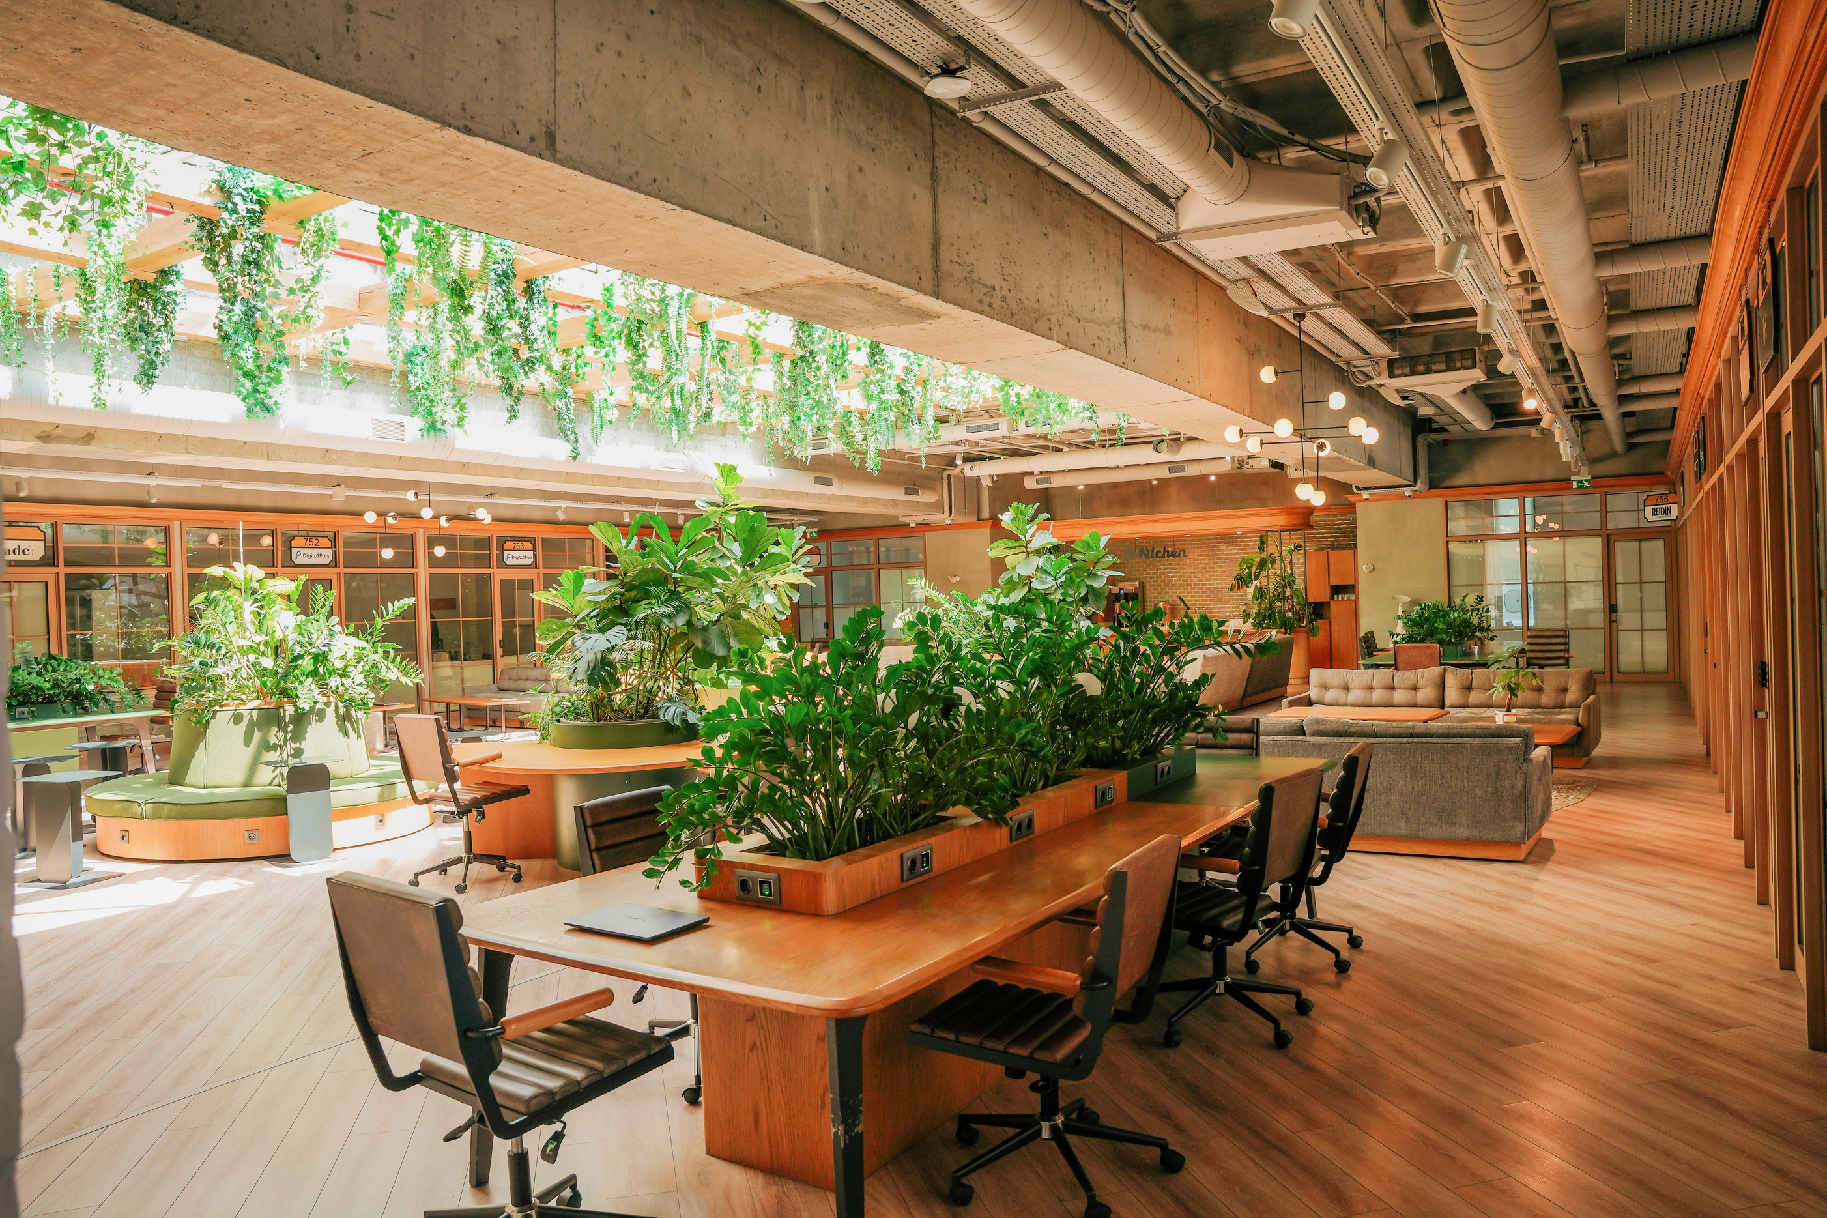
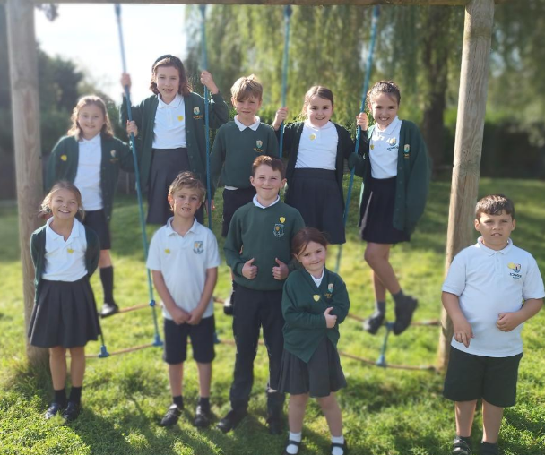
Well-being Team
Mrs Swan- Learning Mentor
Mrs Green - ELSA
Mrs Mellors - Mental Health Lead
Miss Price - SENDCO

Slide 8
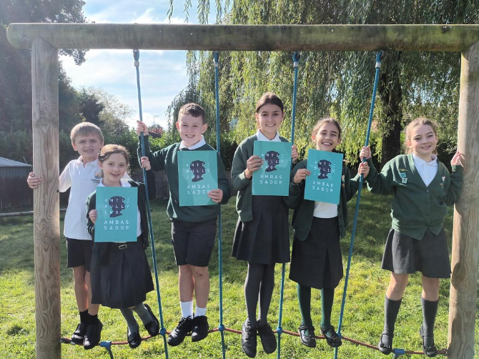

ANTI-BULLYING AMBASSADORS

Slide 9
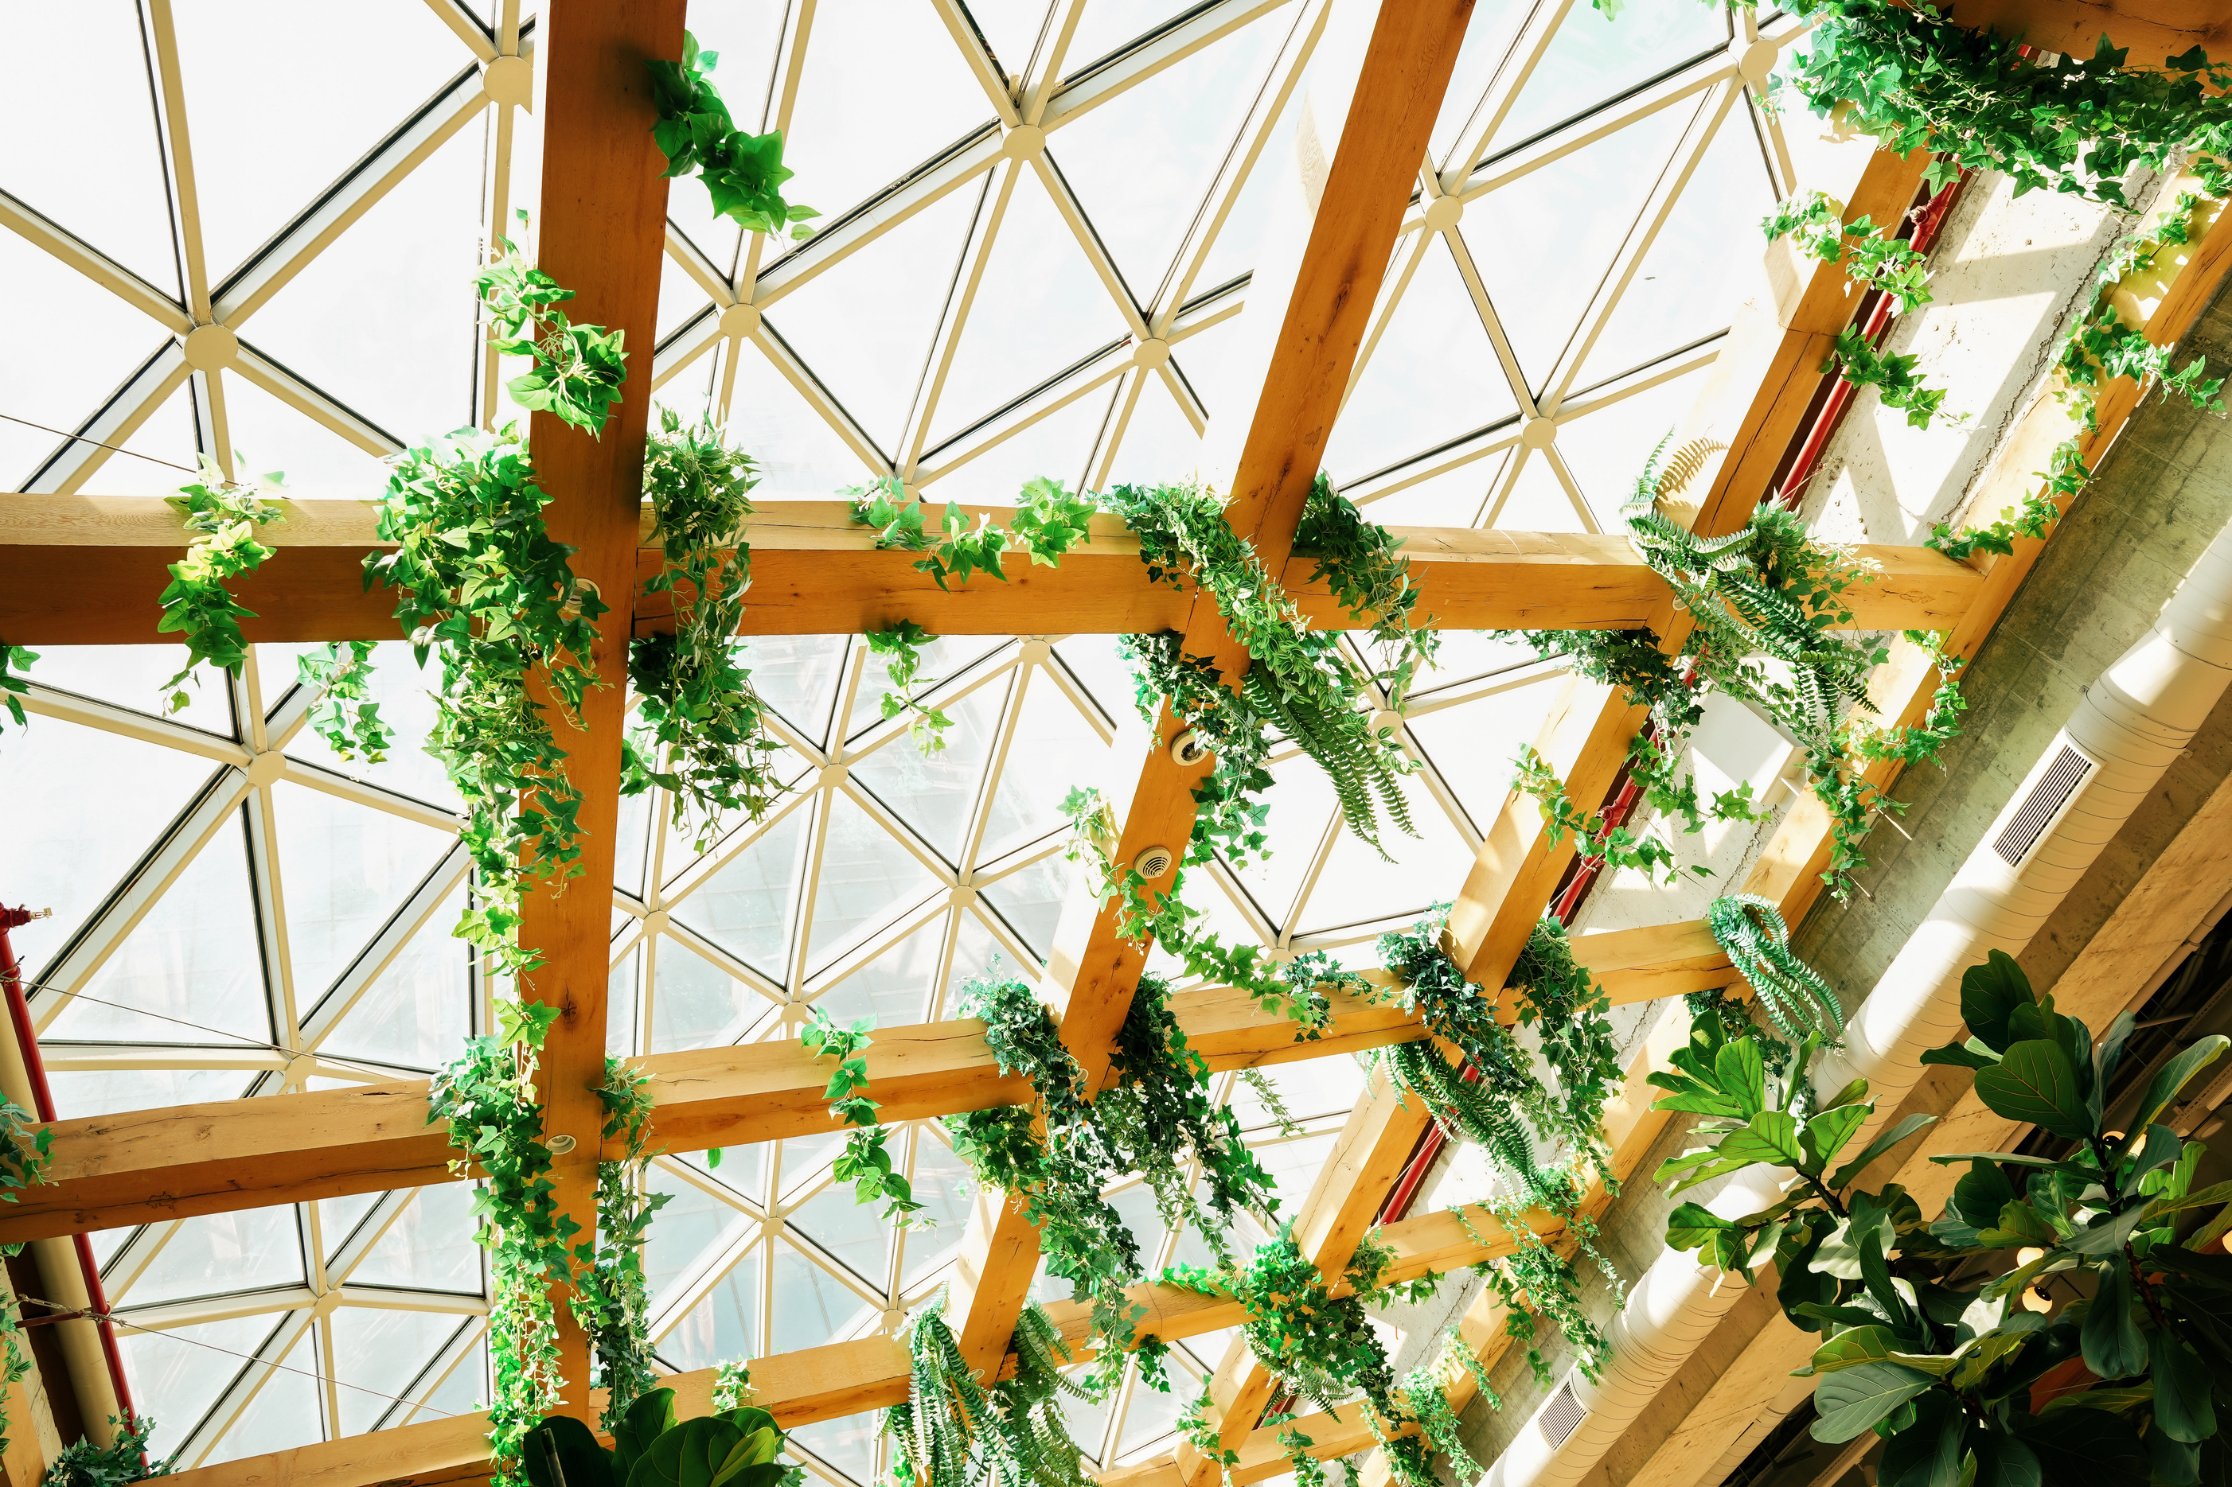



AFTER SCHOOL CLUBS & WRAPAROUND CARE (WOODPECKERS)
Breakfast Club
After School
7.30 - 8.30
Breakfast & games
3.15 -5.30
Snack & drink
Games, chill, outside games, cooking, colouring.

Slide 10

WE ARE A SMALL VILLAGE PRIMARY SCHOOL
Where we get to know every child.
Where we value staff and every class has a teaching assisstant.
Where children can make life long friends and be part of the Loxwood family.

