Slide 1

Meet the Team

Slide 2



Welcome to Willow Class and Cherry Class
2026 - 27

Slide 3
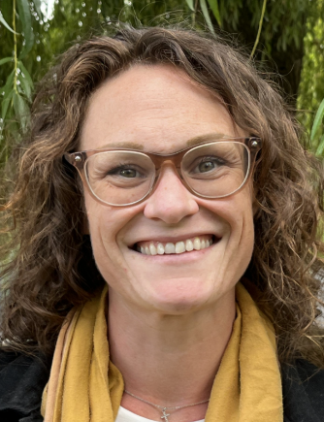
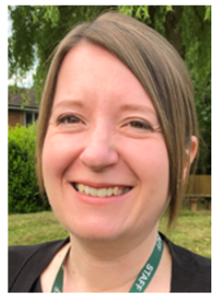
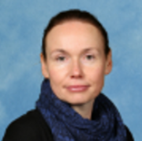
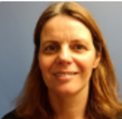
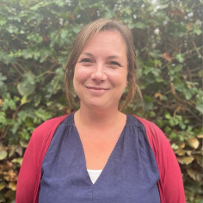
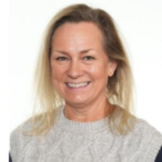

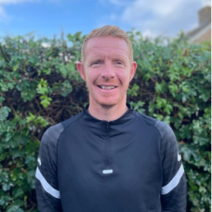
Willow Class Team
Mrs Rolland is Willow Class’ teacher. Miss Down is a student teacher in our class.
Mrs Crofts is our Assistant Teacher (Weds – Friday) and Mrs Lagan (Monday and Tuesday).
Mrs Harder and Mrs Simpson will be teaching in our class on Wednesdays during my Planning Preparation and Assessment time.
Mr Green is our Sports Coach and teaches us PE every Wednesday.
We are all really looking forward to working with you and your children this year.

Slide 4




Cherry Class Team
Mrs Milner-Darke is Cherry Class’ teacher from and Miss Rose is our Assistant Teacher.
Mrs Harder and Mrs Simpson will be teaching in our class on Wednesdays during my Planning Preparation and Assessment time.
Mr Green is our Sports Coach and teaches us PE every Wednesday.
We are all really looking forward to working with you and your children this year.

Slide 5
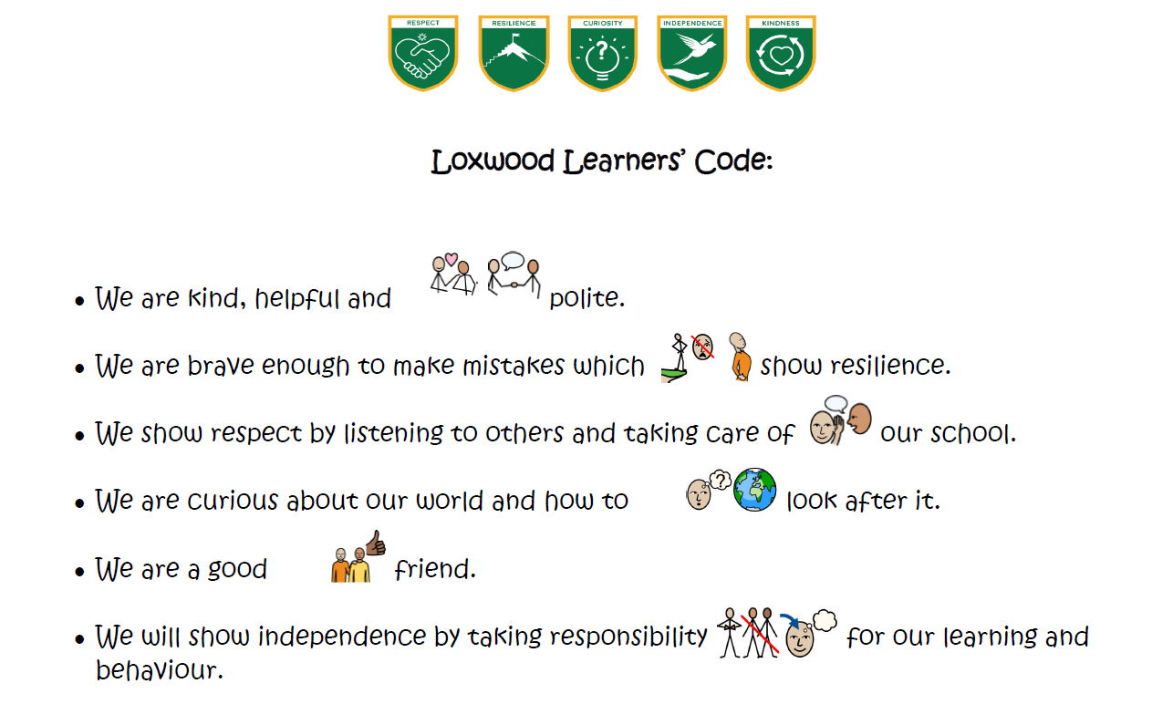
Whole School Behaviour

Slide 6

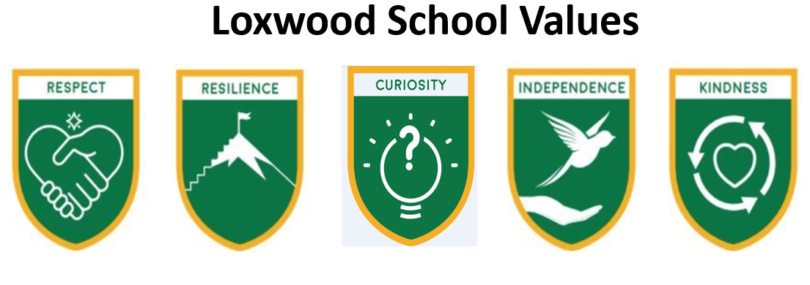
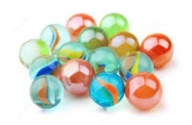
Encouraging positive choices
Children will be awarded house points for showing our school values. We have new tokens for children to collect.
Certificates linked to our values are awarded in Friday assemblies.
We collect marbles in Year 2 and stars in Year 1 to earn our ‘Golden Time’. These are awarded for all children working as a team, such as everyone helping to tidy up, line up quietly or walking sensibly through the school.

Slide 7


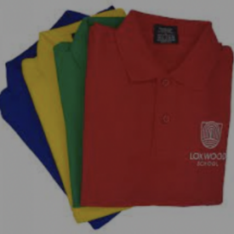

Your child needs…
A named water bottle every day that is extra to the one in their lunch box.
Named Wellies (we will be going on walks around the school grounds throughout the year and they are used for Woodland Learning).
A weather appropriate named coat every day.
All clothing to be named, especially jumpers and cardigans!
Full & named P.E Kit. Trainers are allowed and are often more supportive than plimsolls but please only send in laced ones if they can do them up themselves!

Slide 8

Cherry Class Expectations
The children will be introduced to the Key Stage 1 curriculum, building on the skills and experiences developed in Reception by continuing continuous provision inside and outside. However in year 1 they will be expected to complete focus tasks linking to the year 1 curriculum throughout the continuous provision.
In year 1 they will focus on their fundamental skills in writing, capital letters, finger spaces and full stops to support independence and confidence. The children will then begin to challenge themselves by using and to extend sentences.
Through Year 1, we will support them to become increasingly independent, resilient and confident learners, ready to take on new challenges and enjoy their learning.

Slide 9

Willow Class Expectations
The children will be encouraged to become increasingly independent and organised as the year goes on, to enable them to be ready to progress to KS2 by the end of the year.
The children will continue to learn in different ways and will be given some choice in their learning and in how they challenge themselves.
There will still be lots of continuous provision available to the children and plenty of play-based learning both inside and outside the classroom.

Slide 10

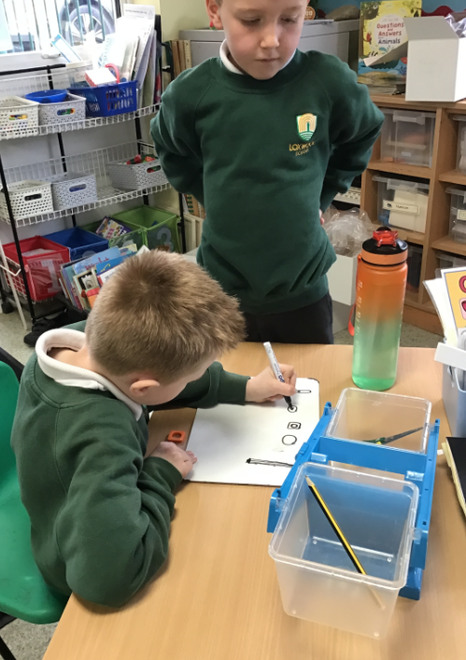
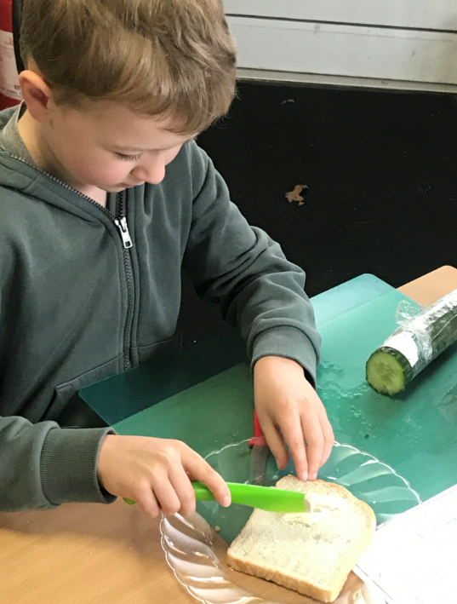
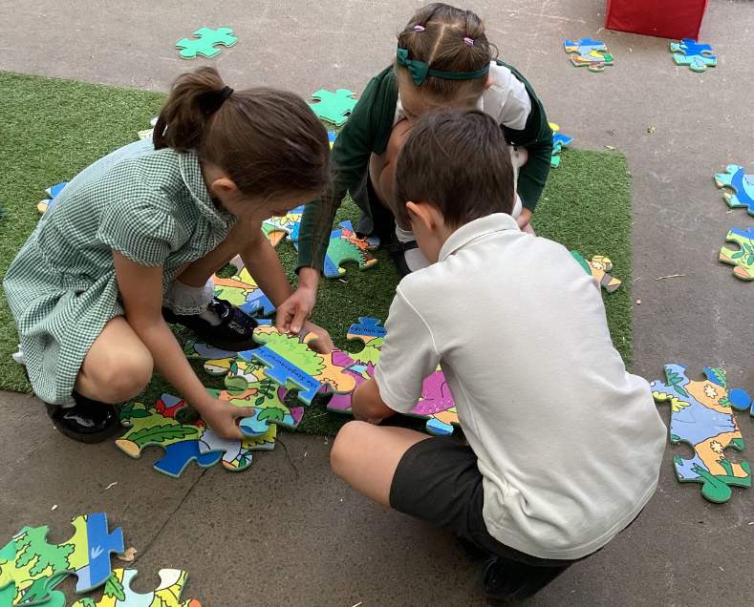
Learning at school
Each class will base their learning around a topic. Learning will be both inside and outside of the classroom and will happen in groups, pairs and individually. Learning will be both teacher directed and child lead. Some learning will be recorded in books, but sometimes through pupil voice or a photo being taken.

Slide 11


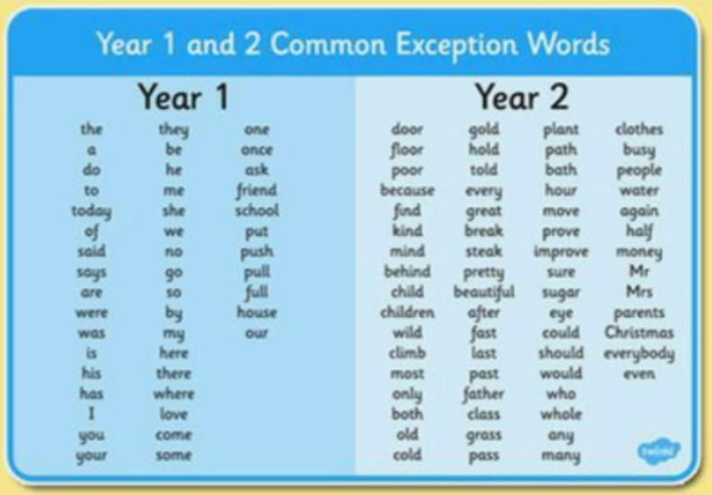
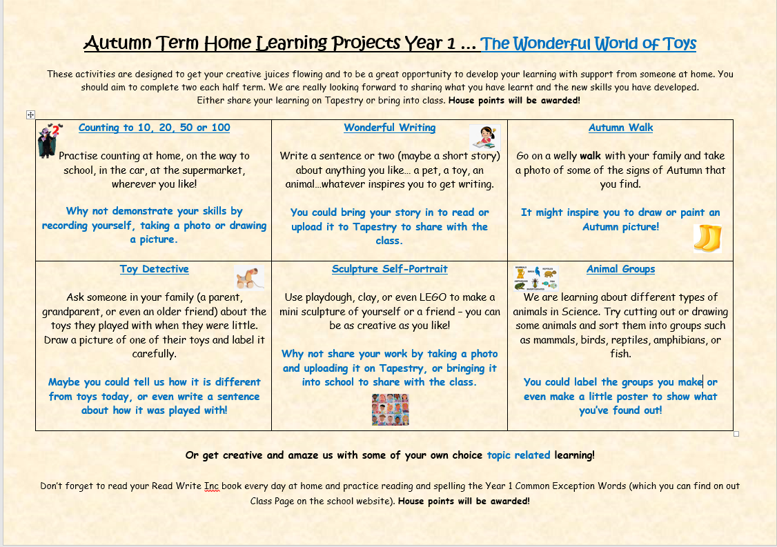
Home Learning
Reading – Most children will be bringing home a RWInc book in their reading folders, which will be changed by your child’s reading teacher once they have read the book three times in school. Some Year 2 Children will be choosing their own book from the classroom or taking an Accelerated Reader home.
Phonics and spellings lists are on our Class Pages for you to work through at your own pace. In Year 2 we assess their spelling at regular intervals and let you know which words to focus on.
Home learning Grid tasks can be uploaded to Tapestry or sent in to share in class in person. We will look at these as soon as possible in class and award house points.

Slide 12

Reading
We recommend that you try to read with your child five times a week for approximately 10mins. We appreciate family life is busy, but any time you dedicate to practising reading skills will be beneficial to your child’s development. This can also be sharing a book together with you reading to them, as this is a vital part of developing a love of reading and is also vital in helping to increase their vocabulary.
At Home
We would like you to record your child’s reading progress at home in their yellow reading log. This doesn’t need to be every time that they read, but as often as you can. Your comments are so helpful for us, as they enable us to form a picture of what your child can do and what progress they are making. We will check the reading records as often as we can and reply to any queries as soon as possible. Sending it in in your child's hand is often helpful. House points are awarded for reading at home and recorded reads add to our whole school total!
At School
We assess the children's reading at school in many ways; group reading, paired reading, whole class reading and sometimes 1:1 reading. We record our assessments in school rather than in the home reading record and will share progress with you in the usual way during Parent Consultation Meetings. If you have any concerns or questions at any time, do feel free to come and have a chat.

Slide 13


Reading
Children who have graduated from phonics in Year 2 will join the Accelerated Reader Programme, which is used in Key Stage 2. This will be once their reading is sufficiently fluent and they are reading speedily.
To find out more about how this programme works please come along to our parent workshop on Friday 15th October at 8.30am. Our English Lead Mrs Donnelly will explain how you can use the programme to support your child at home with their reading.

Slide 14

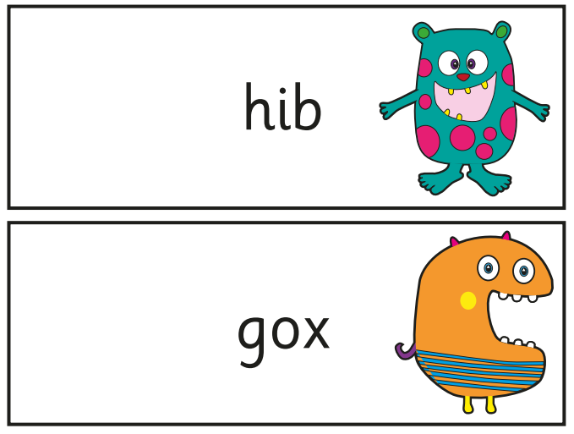
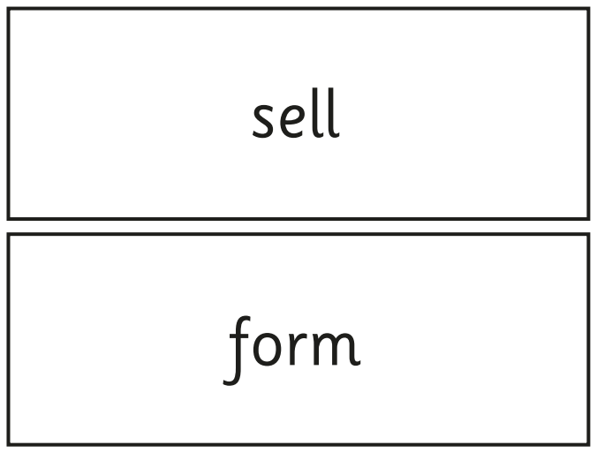
Phonics in Year 1 and 2
All children practise their sounds as part of the curriculum.
We follow the Read Write Inc scheme as a school.
Reception, Year 1 and 2 children are put into groups according to the sounds they already know, so children focus on the appropriate sounds for their current need. (These groups are not static and are open to change). We assess their phonics regularly so that we can ensure that all children are in the correct group.
At the end of Year 1 children undertake a Phonic Screen Assessment. This is a national assessment that happens in all schools. It is undertaken with their class teacher and takes about 10 minutes, 1-1 per child. Children are required to segment and blend words and non-words containing the phonemes that they have already been taught in school. This is something that is familiar to the children already. Children in Year 2, who did not achieve the required pass in Year 1, will retake the assessment also.
Year 2 children who have been assessed as having graduated from phonics will join a reading comprehension group to support their fluency, comprehension, spelling and grammar skills.

Slide 15
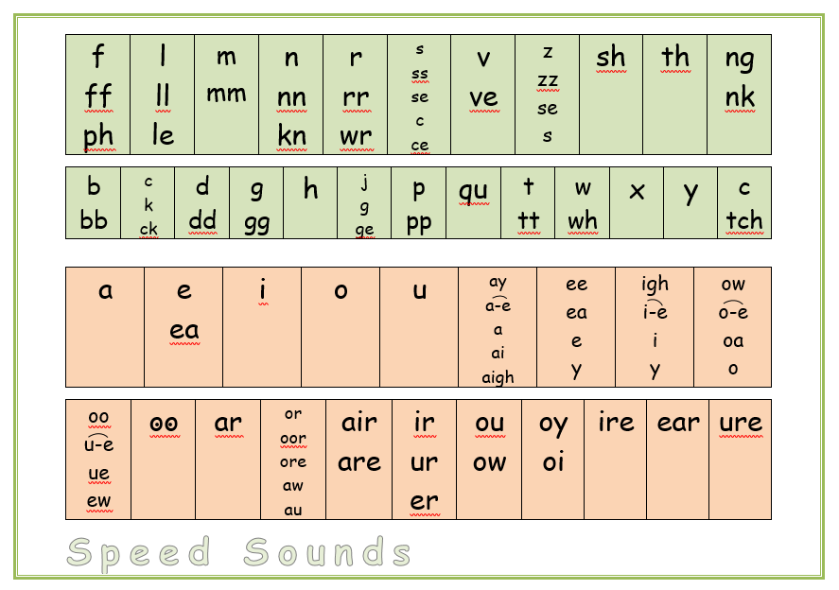
Phonics
Find me on the Class Page!

Slide 16

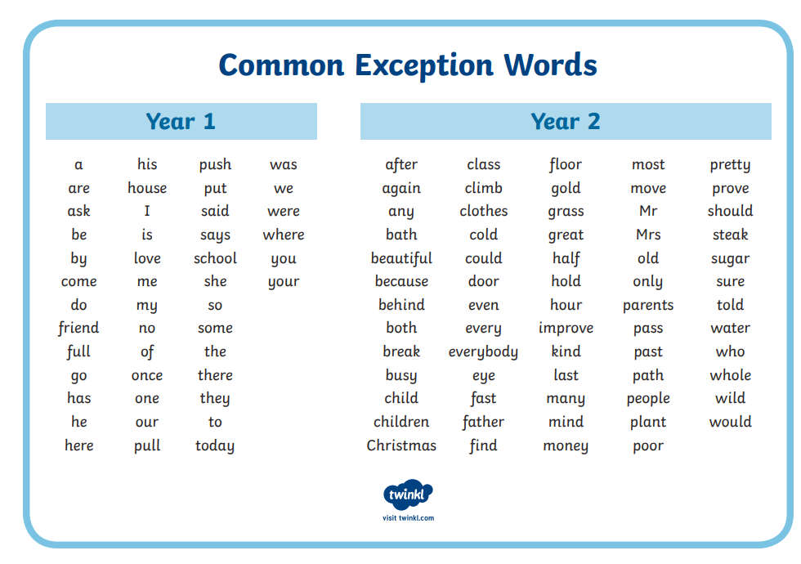
Spelling
Please focus on reading and spelling these Common Exception Words at home at your own pace throughout the year.
Find me on the Class Page!

Slide 17

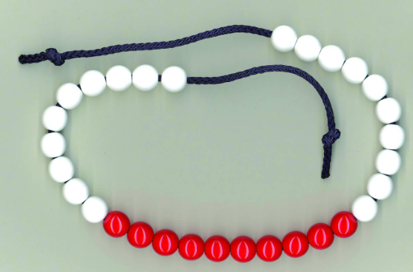
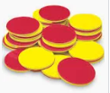
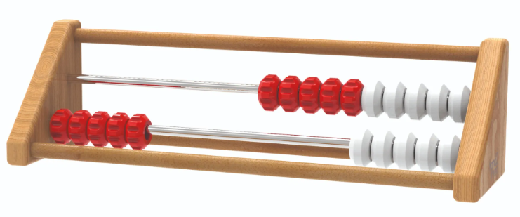
Mastering Number
Mastering Number is a national programme for children in Reception, Year 1 and Year 2. It helps them build strong foundations in maths by developing a deep understanding of numbers.
What happens in school?
Children take part in short daily sessions (10–15 minutes).
They use resources like bead strings, counters and rekenreks (a special counting frame) to explore numbers in different ways.
The focus is on confidence, fluency and understanding, not just getting answers quickly.
Why is it important?
It gives children a secure base for later maths, like addition and multiplication.
It helps prevent gaps in understanding.
It makes maths fun and engaging.
How can parents help?
Talk about numbers in everyday life.
Play counting and number games.
Encourage children to explain their thinking

Slide 18

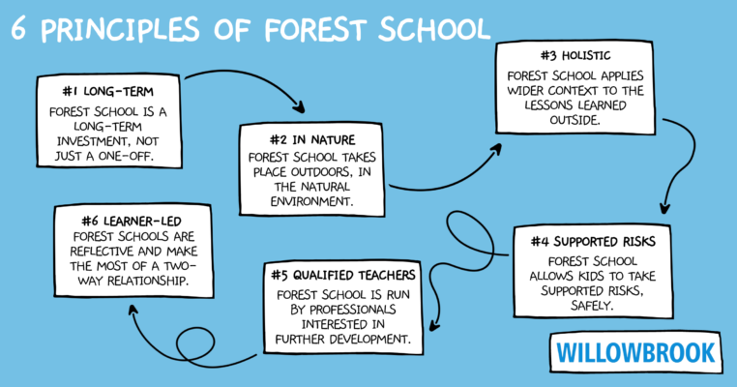
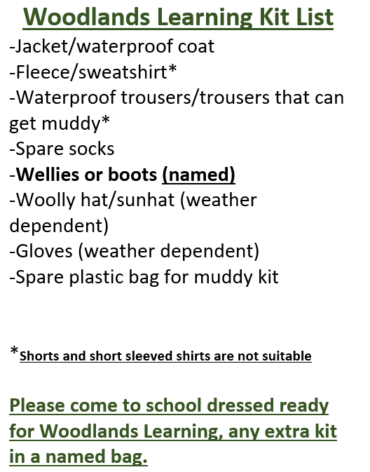
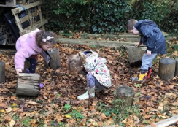
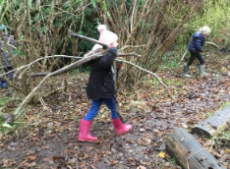
Woodland Learning

Slide 19
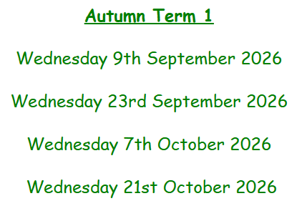
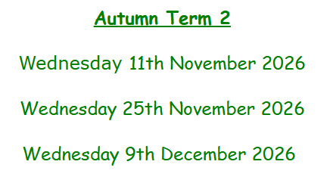
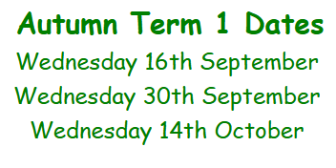
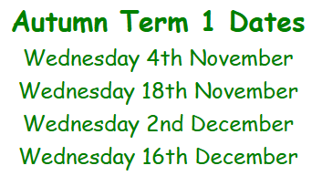

Woodland Learning Dates
Cherry Class – Autumn Term
Willow Class – Autumn Term
Find me on the Class Page!

Slide 20

Reminders…
Only one small key ring on book bags please (no rucksacks)
Toys to be left at home (unless there is an agreement with the class teacher to help with transition from home).
Please name wellies, clothing and water bottles so that we can get them back to you.
Correct uniform to be worn each day including socks and shoes.
Collect and drop off your child at the outside door to their classroom daily.
Messages can be left with the person on the gate in the morning.
Please let us know if someone different is collecting your child. Please email if there is a regular person collecting them. We will always ring you to ask if we haven’t been informed.

Slide 21

Keeping Up-to-Date
Remember to check…
Google Classroom
The school website and the ‘Up to the Minute’
Class Page – You will find our Termly Topic Web and other important information.
Book bags – check for letters and forms to complete

Slide 22

Any questions?
If you have any questions, please ask at school drop off or pick up. You can also email us at messages@loxwoodschool.com, addressing the emails to Mrs Rolland or Mrs Milner-Darke.

