Slide 1

‘Meet the Team’

Slide 2


Year 3 and 4
Rowan Class Sycamore Class
Miss Malins Mrs Oldfield
Mrs Mayne Mrs Zilz
Mr Green PE Teacher every Wednesday
Mrs Harder and Mrs Swann alternate PPA cover in both classes

Slide 3
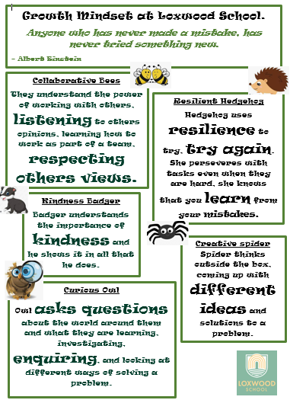
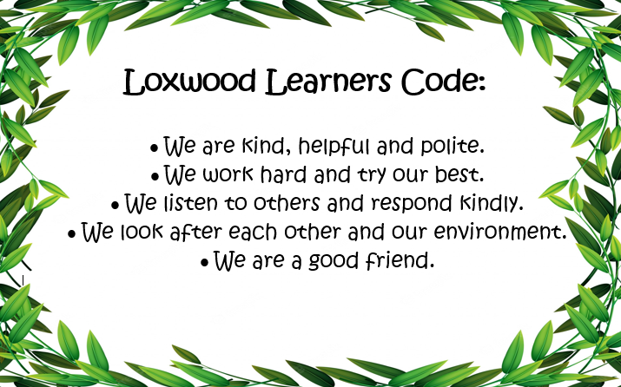
Whole School Behaviour

Slide 4
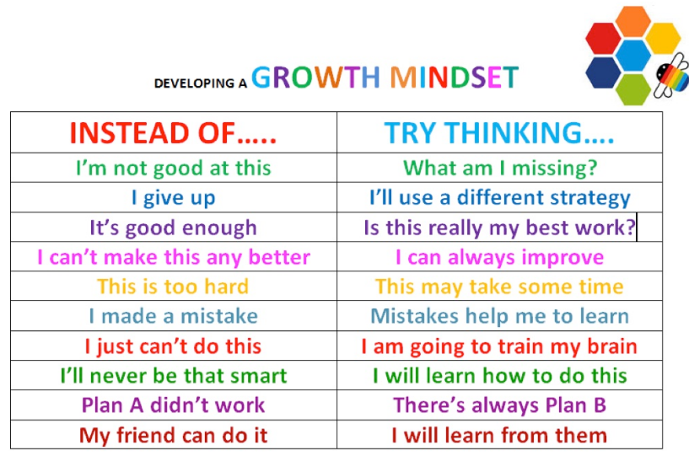
Growth Mindset

Slide 5
Topics This Year:
Autumn 2024- Year 3. Stone Age, Bronze Age & Iron Age
Year 4. The Ancient Egyptians
Spring 2024- Year 3. Romans & Extreme Earth (Volcanoes, Earthquakes, Tsunamis etc)
Year 4. Polar Regions
Summer 2024- Year 3. Plants(Environment/Plants)
Year 4. Habitats/ Environment

Slide 6
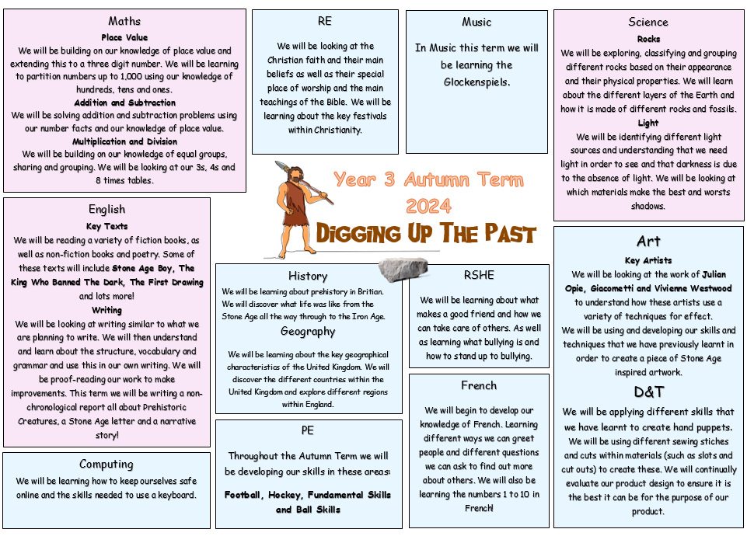

Slide 7
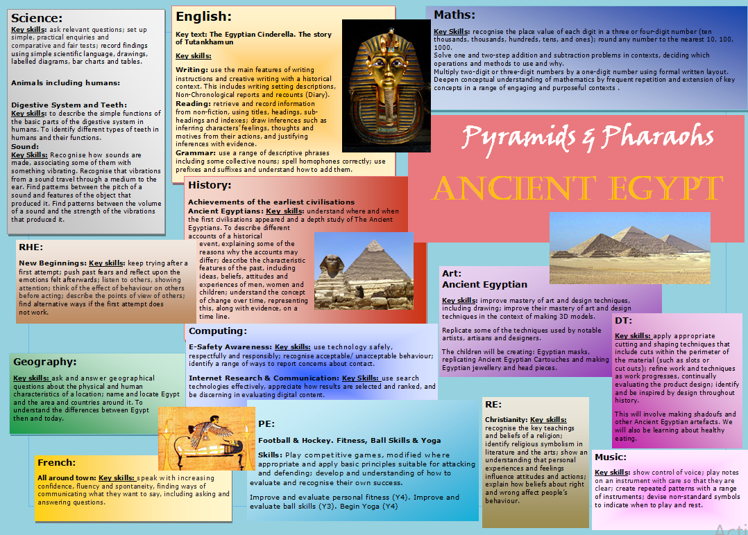

Slide 8
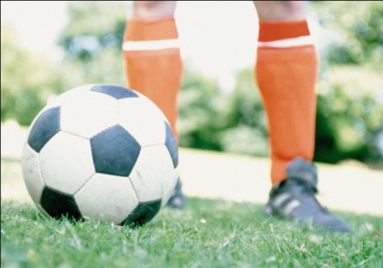
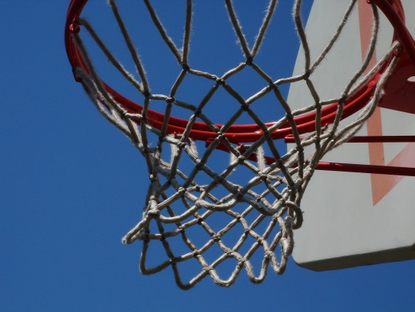



P.E.
All Children have PE on a Wednesday.
Rowan class’s other PE day is Tuesday. Sycamore’s is Thursday.
ALL children to have their named PE kit in school at all times, as days can change.
Earrings must be removed or taped over.
Notes:
Need trainers – not plimsolls.
No need for shin pads/football boots – using soft balls and plastic hockey sticks.

Slide 9
Homework
In Year 3 and 4 the homework is;
Times Tables and Reading.
This is a requirement for the whole year. They are required to practice reading at least four times a week minimum, out loud, to an adult, signature required in reading record book.
The children will also be given a homework grid with 9 options. They are expected to complete 2 pieces that they choose each half term.
All children have weekly Times Tables and Arithmetic tests. They are expected to practice their Times Tables at home to improve their fluency.

Slide 10
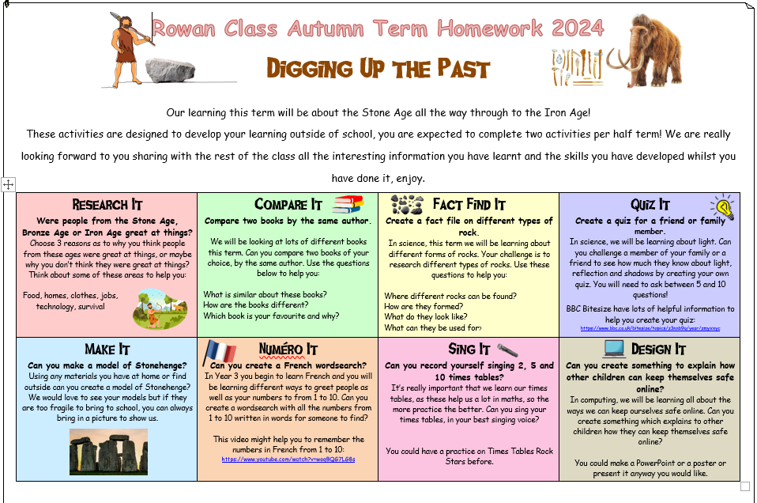

Slide 11
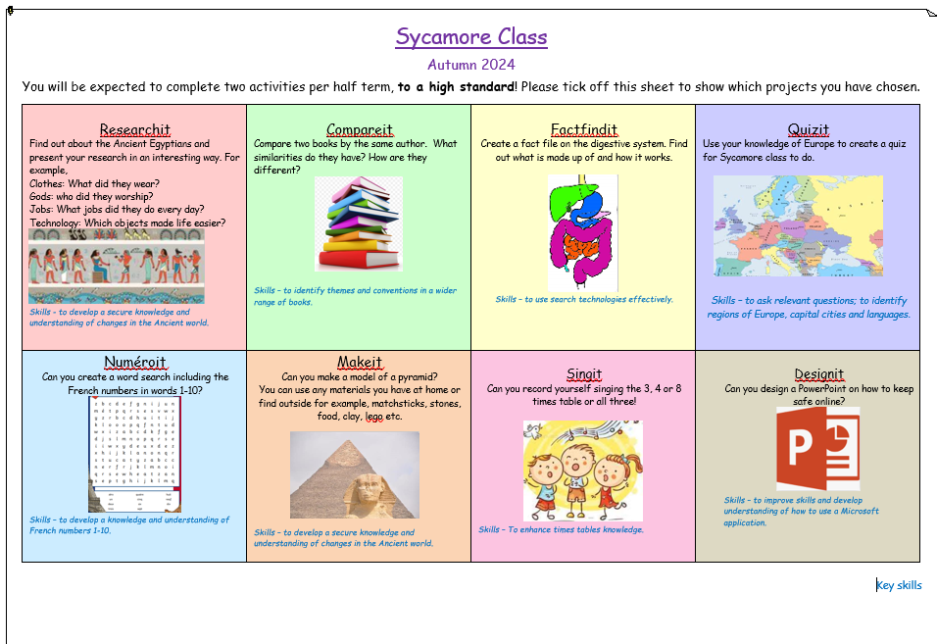

Slide 12
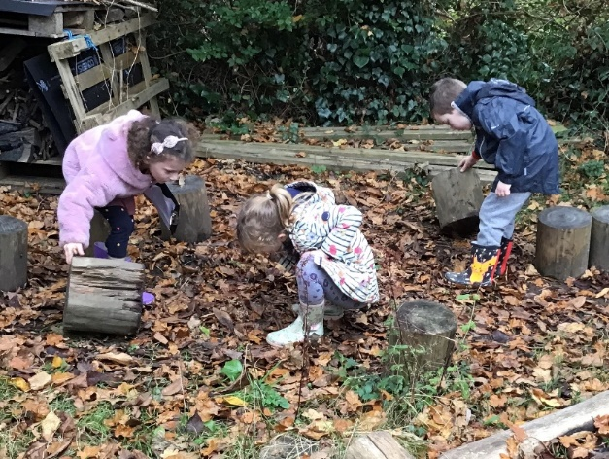
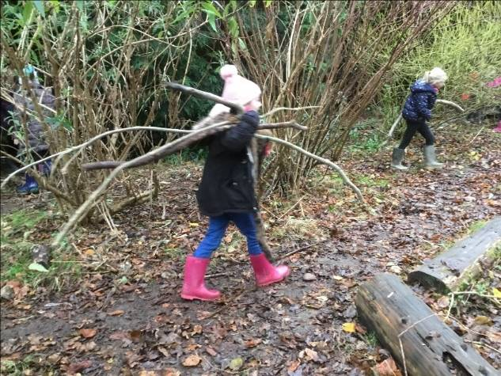
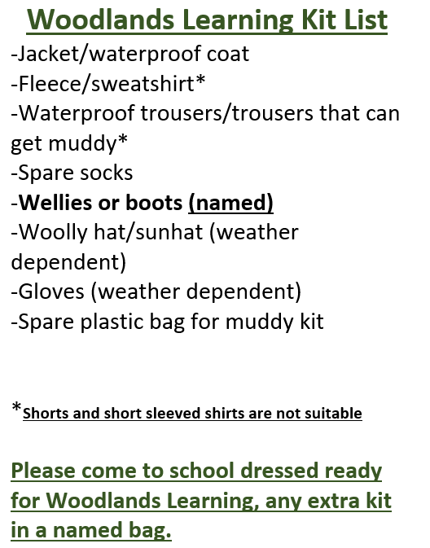
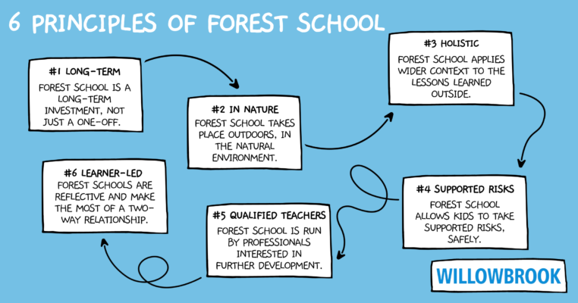
Woodland Learning
We follows the ethos of Forest School and are supported by the work of the National Forest School Association

Slide 13
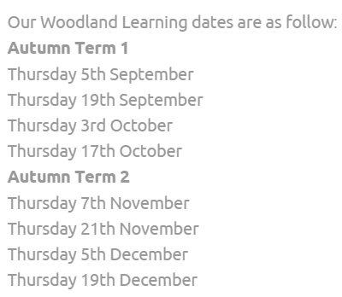
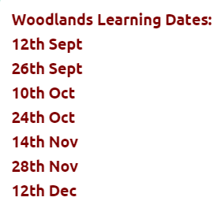
Year 3
Year 4

Slide 14
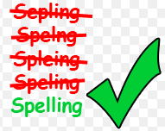
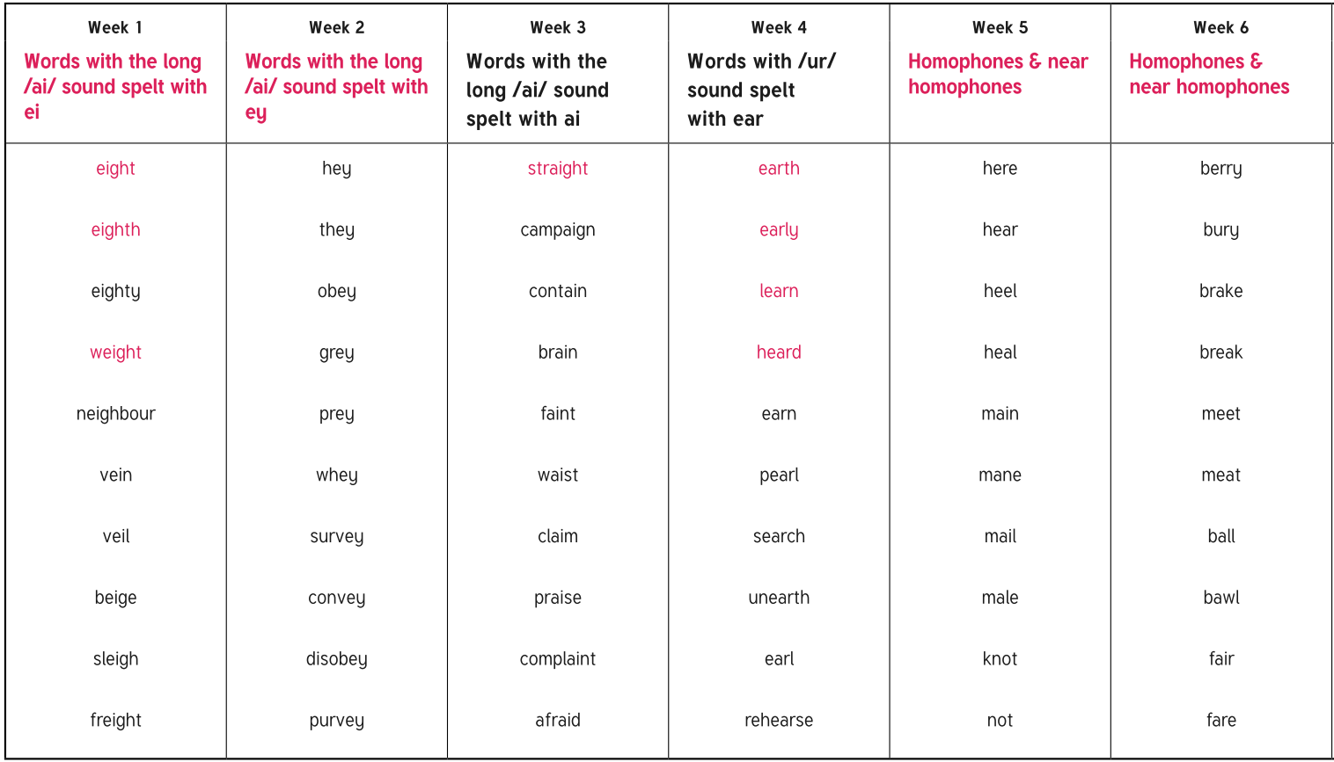
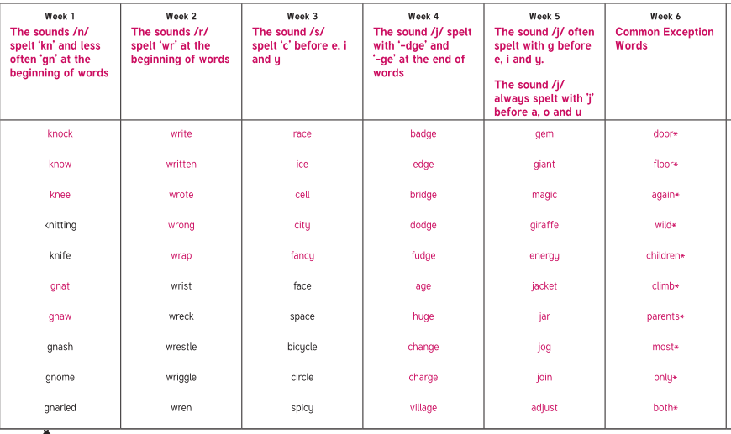
Spellings in the Juniors
Spelling will be no be tested formally. The children will be taught their spelling patterns and rules in class.
Year 4 will have their termly spellings, to practice if you wish too.
Some children in Year 3 and Year 4 need to continue to practice their CEWs

Slide 15
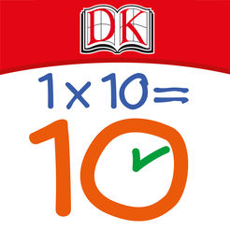

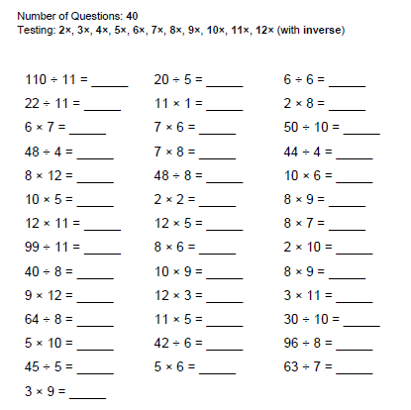
Times Tables
Please ensure your child is learning their Times Tables, the children will be doing a weekly timetables test on a multiplication grid. They will initially have 15 minutes to fill out as much as they can, this is to show their personal progression throughout the year. This will decrease to 10 minutes later in the year, also with a mixed up grid.
Children will be given a log in for Timetables Rockstars which they can use to help them practise their timetables. this is NOT compulsory and not part of the test, some children find this resource helpful to practice https://play.ttrockstars.com/auth/school/student
If they do not want to use this way to help practice there are alternative options below.
There are a lot of Times Tables games online (I have attached some links which may help) and we will also
practice weekly in class.
  Games / apps
    http://www.topmarks.co.uk/maths-games/7-11-years/times-tables
    http://resources.woodlands-junior.kent.sch.uk/maths/timestable/
    http://www.teachingtables.co.uk/
  Songs
    Percy Parker
    (App or CD http://www.percyparker.com/singyourtimestables/index.html)

Slide 16
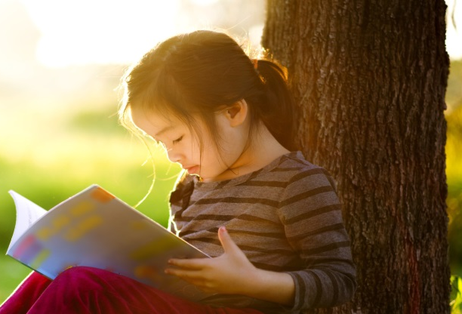
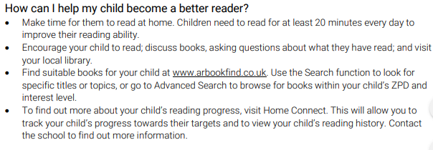
Accelerated Reader

Slide 17

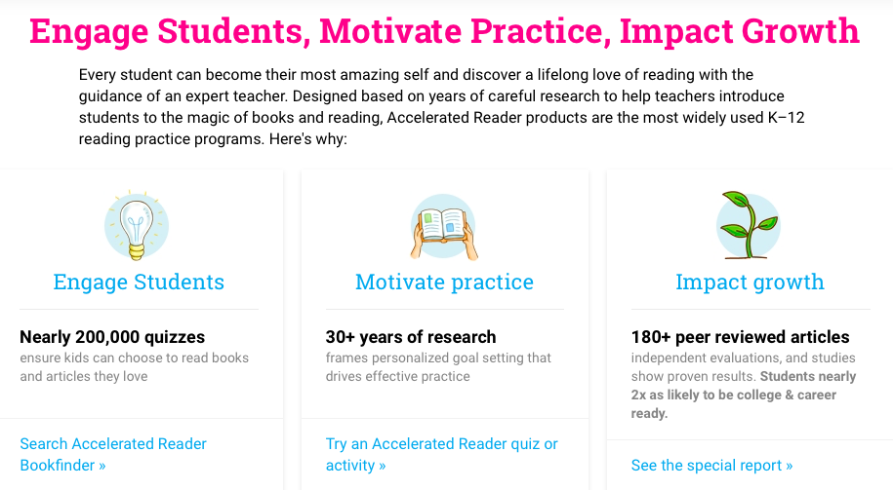
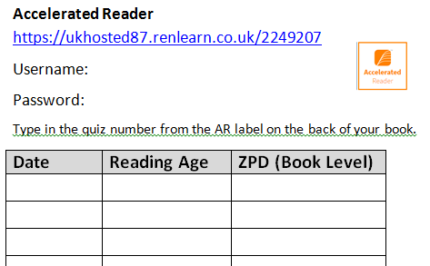
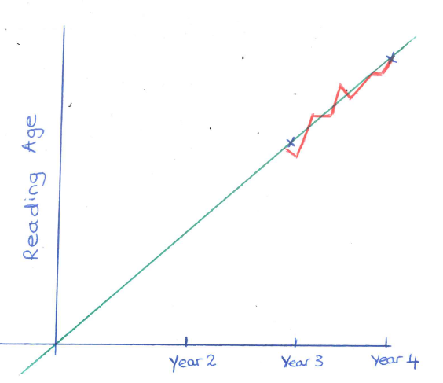
https://www.renaissance.com/products/practice/accelerated-reader-360/

Slide 18


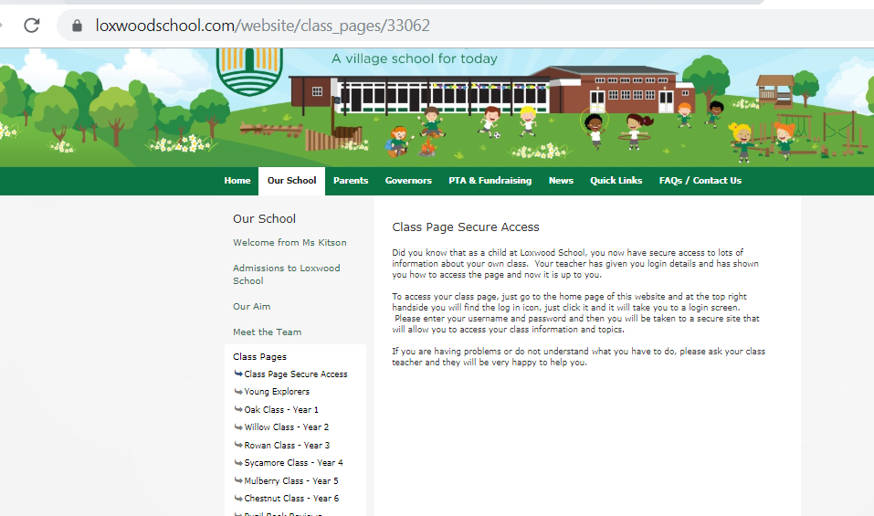
Loxwood School page
School website
  Dates
  Topic Web
  Homework
  Useful links
  Photos

Slide 19
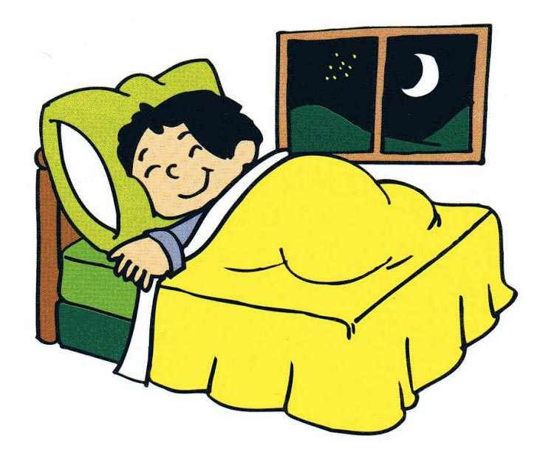
How can you help your child over this busy year?
SLEEP
BREAKFAST
SNACK for snack time (fruit or vegetables only) & Water, this is important as the day is long.
HOMEWORK
INDEPENDENT/ORGANISED
ALL UNIFORM NAMED.

Slide 20
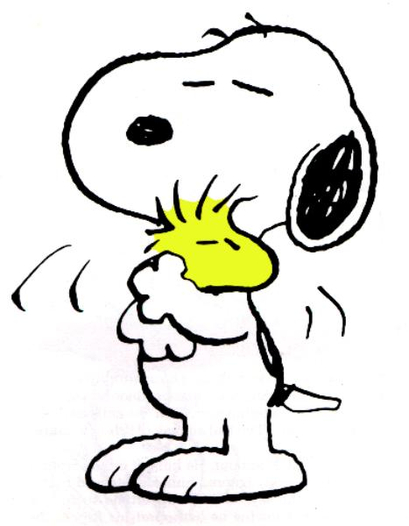
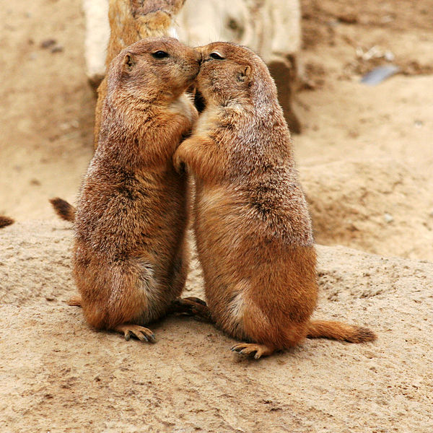
Emotional Well-Being
We are sure that the children's emotional well-being is of paramount importance to us all. We are extremely aware of emotional well-being in children, these are the years they become more independent and improve their self esteem with help and guidance.
If a child in our care is not acting their usual self, or is withdrawn from the class or their friends, we will always take the time to reassure them that we are here to help. If you feel that your child might be affected by something at home, such as a bereavement (be it pet or human) or arguments with siblings etc, please take the time to briefly inform us, as it might help us to understand why they are not themselves.

Slide 21
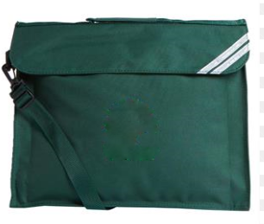
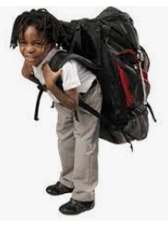
Please can you ensure that your child brings a named book bag to school, not a rucksack.
Rucksacks for Loxwood School are for years five and six only, as per the school uniform policy.
Loxwood school bags are available or green book bags can be bought for about £5 on Amazon or M&S etc.

Slide 22
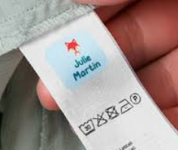
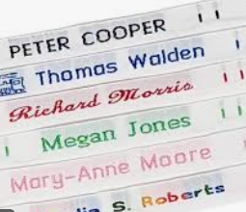
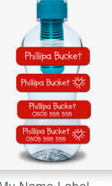
Naming.
Please ensure that all your child’s school things are named, as you can appreciate; it can be quite difficult trying to locate a particular green jumper or white school shirt.

Slide 23

Questions?
Please feel free to ask any further questions you may have.

