Slide 1
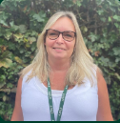
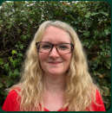
Oak class
Meet the Team
Mrs Donnelly
Class Teacher
Mrs Coupe
Learning Support Assistant

Slide 2
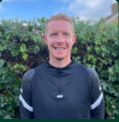
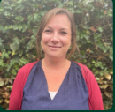
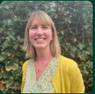
Mr Green
PE teacher
Mrs Harder
Woodlands learning teacher
Mrs Swann
Teacher and Learning mentor

Slide 3
Your child’s learning journey
We offer a free flow EYFS setting. The children can choose from a range of activities that cover the seven different learning areas.
We have inside and outside provision and your child is free to choose where they want to play and learn.
The door is open in all weathers and your child will be encouraged to wear coats, wellies, hats and gloves however please expect them to come home dirty or having to have changed their clothes- this is a sign that they have fully explored the setting that day.
Outside we have a sand pit, water play and a mud kitchen that the children are freely able to explore.
For directed learning your child may be called over to ‘do some jobs’ with myself or Mrs Coupe. These will be very short moments on their day- for example, a Maths task or a phonic task, to enhance their learning.

Slide 4
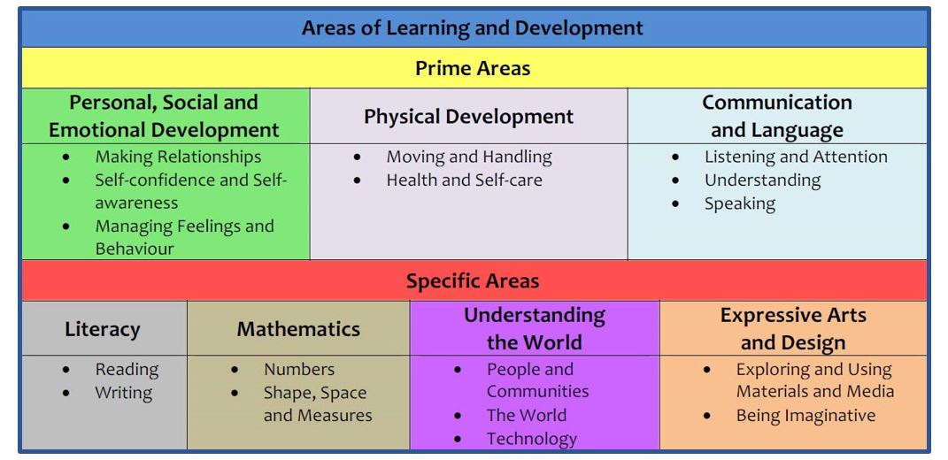
The Foundation Stage
Curriculum
Notes:
‘Discovery Time’ – ‘bump into philosophy’
Evidence – observations, photos, 1:1 and group work, whole class
Verbal Feedback
Individual levels and attention span
Post-it activity – write down one thing your child has achieved at home recently. (Evidence for WOW books).
VIDEO

Slide 5


More information about Areas of Learning and Characteristics of Effective Learning can be found in these guidance materials:
https://www.gov.uk/government/publications/development-matters--2
https://birthto5matters.org.uk/
Notes:
Address on handout
Gives an insight into working in Early Years.

Slide 6
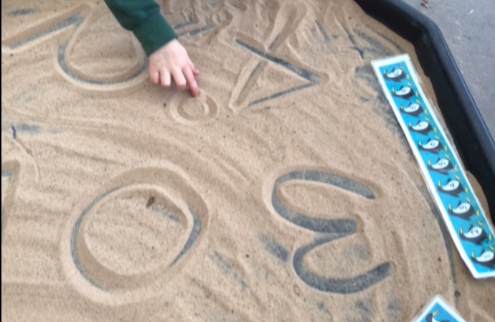
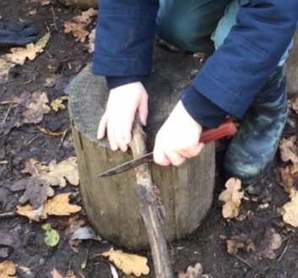

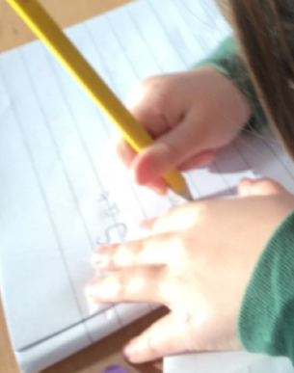
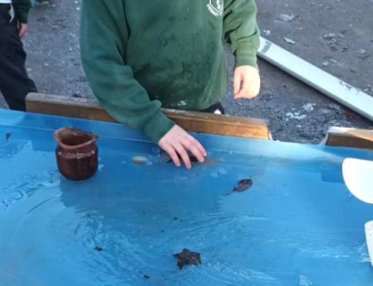
Tapestry
We use an online learning journal called Tapestry.
We record your child’s learning on there and share it with you at home.
If you do not yet have a Tapestry account for this school or you are having problems logging in, please let me know.
You can use Tapestry at home to show us things your child has been doing at home.
You can also respond to our uploads if you wish.
Early Years learning is about the whole child and we would love to see what your child is getting up to at home as well as in school.

Slide 7

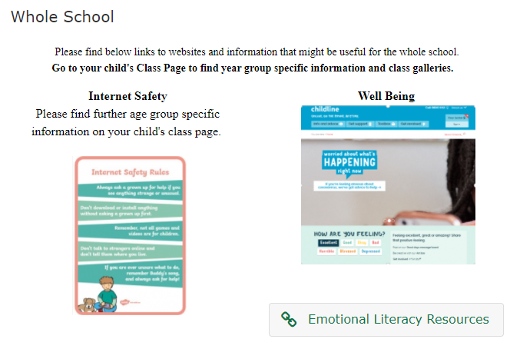

How we communicate with you?
School Website and our Oak Class webpage (found under the ‘Our School’ tab – ‘Class Pages’. Don’t forget to read the ‘Whole School’ information too.
The weekly newsletter: ‘Up to the Minute’
Termly Topic Web on the Website
We are really happy to answer quick queries at the classroom door but remember the children’s safety and settling into school is really important to us and we like to be in the class engaging with them.
Leave a message with the adult on the gate or email: messages@loxwoodschool.com. These messages always arrive promptly in the classroom.
Book an appointment or speak to us at the end of the day.

Slide 8
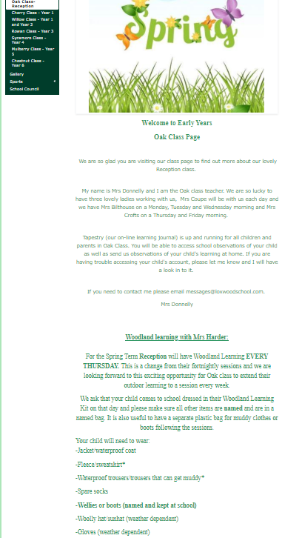
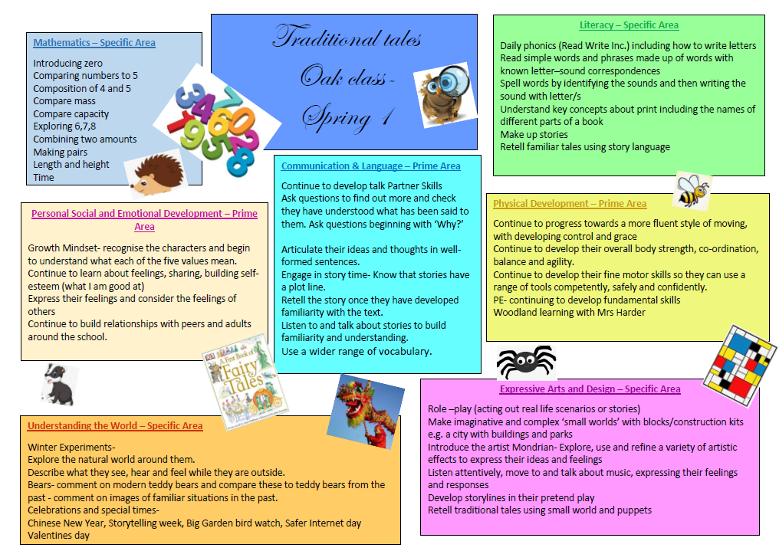
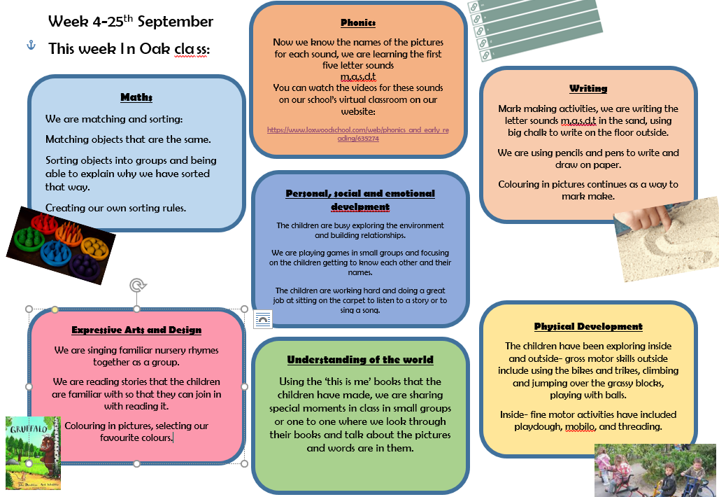
Our class page on the website
This page contains information about what your child is learning- topic web
A weekly guide to what activities and learning you child has been doing- this will appear after the initial few weeks of settling in.
RWI information and useful links
Woodlands learning information
Links to useful websites
Other useful information about our
class.

Slide 9
Woodlands learning
Your child is having a Woodlands Learning session every two weeks with Mrs Harder.
Outdoor learning and exploration really supports the Early Years curriculum so I am very excited about this opportunity for your child.
Your child will have Woodland Learning every other Thursday and it will be a morning session.
Can you please send your child into school wearing their Woodlands learning clothes on a Thursday.
Please, please, please make sure everything is named.

Slide 10
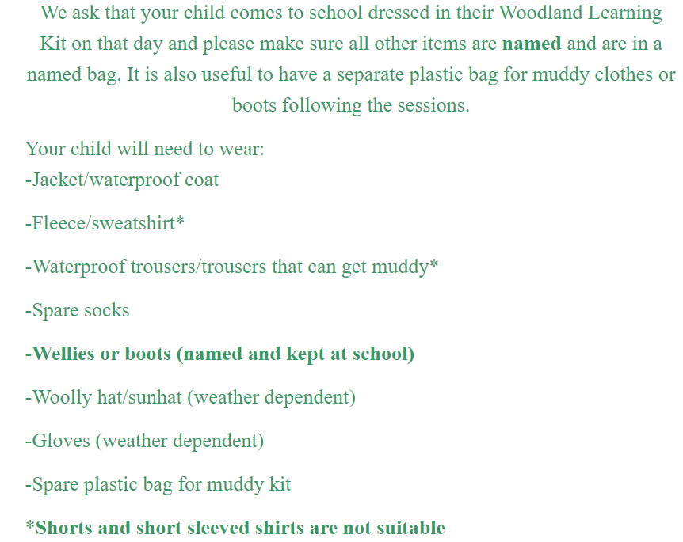

Slide 11

PE
Our PE day for this term will move around a bit so please make sure that your child has a full PE kit in school every day.
Please, please, please make sure everything is named so that if something does go missing , it can find it’s way back to you.

Slide 12


Snack and water bottles
We encourage the children to keep hydrated and so they need a NAMED water bottle in school every day.
The school provides a healthy fruit snack for your child every day. However, if you would like to send in an extra piece of fresh fruit or vegetables, please do in a NAMED container.

Slide 13
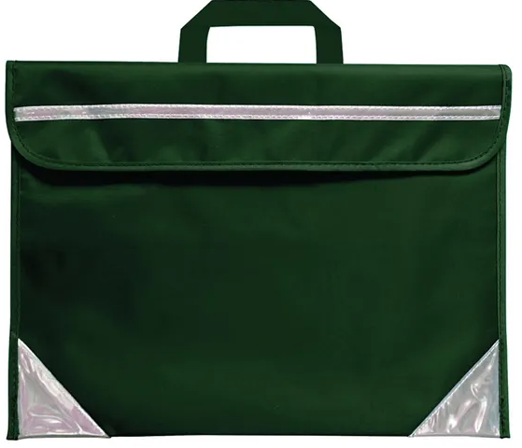
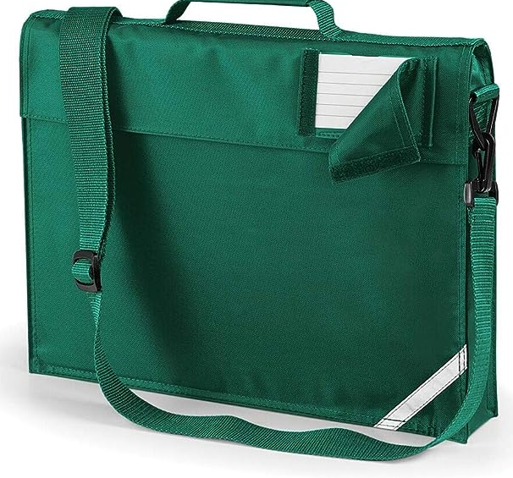
Book bags
As your child begins to bring reading books home as part of our phonic teaching and a library book from our school library, your child will need a green bookbag. This does not need to be a school logo one. It can be a plain green one. Please make sure you have named it.
Keyrings- you are welcome to put ONE keyring onto the bookbag to help your child identify which bag is theirs.
Bookbags must be bought to school every day once your child starts bringing home reading books and so it is good practise to start doing this now or as soon as possible.
Please don’t send a backpack/rucksack instead of a bookbag, our classrooms have limited storage space and backpacks take up too much room.

Slide 14

