Slide 1






MEET THE
TEAM
Year 3 & 4 2025-2026

Slide 2


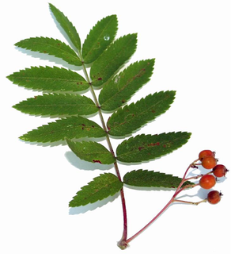
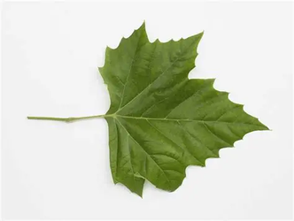
YEAR 3&4
Rowan Class
Sycamore Class
Miss Malins
Mrs Bilthouse
Mrs Crofts
Miss Smith
Mrs Zilz
Mr Green teaches both classes PE on Wednesdays for 5 half terms.
In Year 3 Mrs Harder and Mrs Swann will alternate PPA cover for half a day on Wednesday. Every other Friday afternoon will be covered by Miss Price to cover ECT time.
In Year 4 Mrs Harder and Mrs Swann will cover alternating Thursdays.

Slide 3

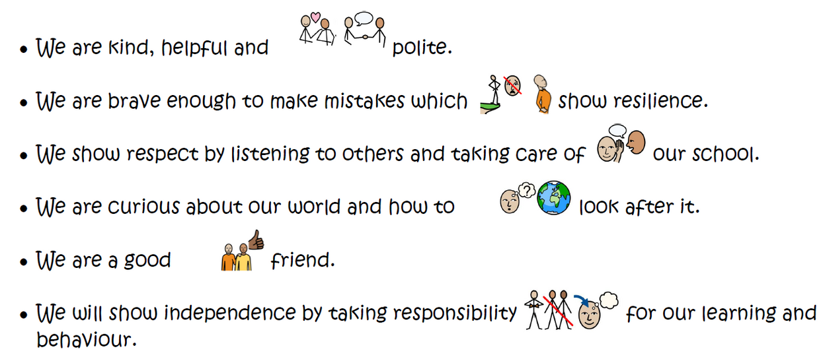
WHOLE SCHOOL BEHAVIOUR

Slide 4
WHOLE SCHOOL EXPECTATIONS
Please ensure that you and your child are following these whole school expectations:
  Uniform – must be named, the correct school shoes, hair is tied back, no nail polish, no jewelry.
  Snacks - need to be fruit or vegetables only for break times.
  Books bags - book bags only and minimal key rings that are an appropriate size.
  Toys - no toys in school due to them getting lost, stolen or broken.
  Pencil cases – not for Year 3 and 4.

Slide 5

YEAR 3 TOPICS
term | Topic
Autumn | Digging Up the past
Spring | Temples, tombs and treasures
Summer | Let it grow

Slide 6
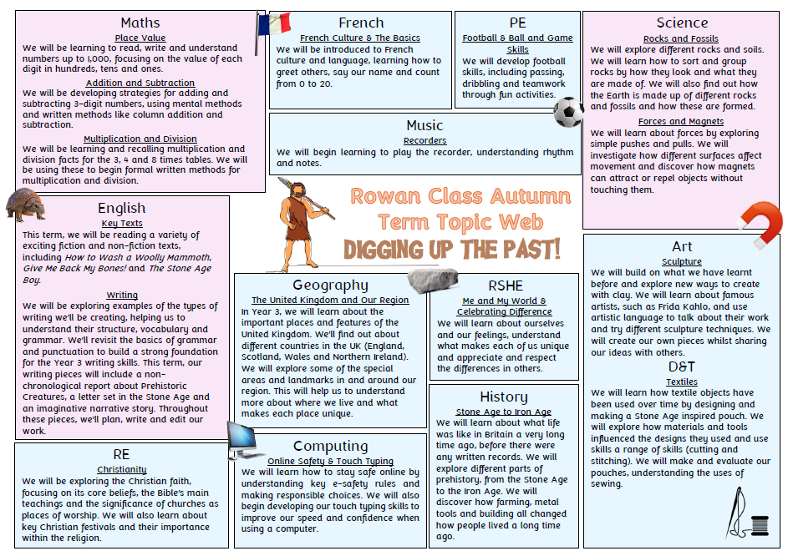

Slide 7
YEAR 4 TOPICS
term | Topic
Autumn | Tracks through Time
Spring | Groovy Greeks
Summer | Rotten Romans

Slide 8
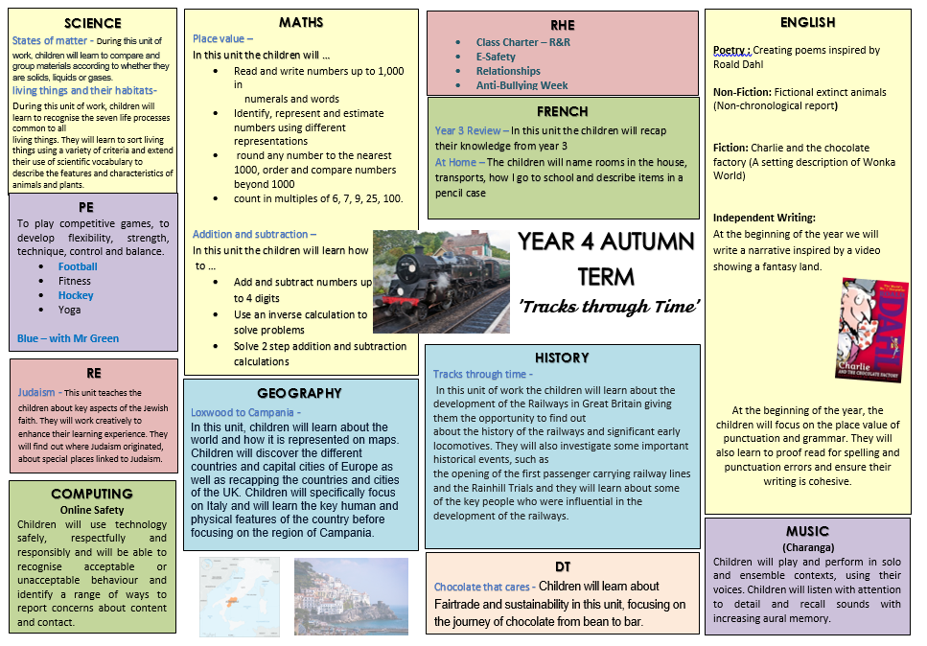

Slide 9

HOMEWORK
Spelling | Statutory spellings will be on the class pages on the website which children can practise at home if they wish to.
Times Tables & Arithmetic | Arithmetic will be tested on a Friday. Using Times Tables Rock Stars can be used to help them at home in preparation for the Year 4 multiplication test: https://ttrockstars.com/
Reading | We expect children to be reading at least 3 days a week and to be heard by an adult at least once a week.
homework grid | Each term, there will be a new ‘Homework Grid’ available on the class page of the school website. We encourage the children to do 2 pieces of homework per term but if they want to do more, they can!

Slide 10

ACCELERATED READER

Slide 11

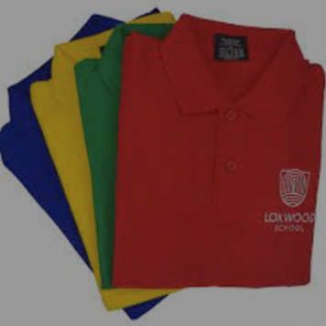
PE
While we have days that we will usually do PE, this often changes with the nature of primary schools so it is essential your child has their kit in school everyday.
Long hair must be tied up
Watches must be removed
No bracelets or necklaces
Earrings must be removed / covered up

Slide 12
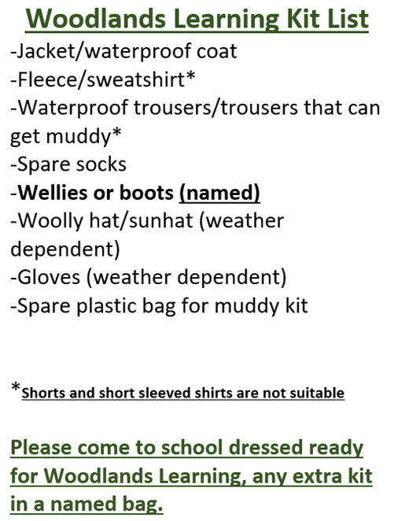
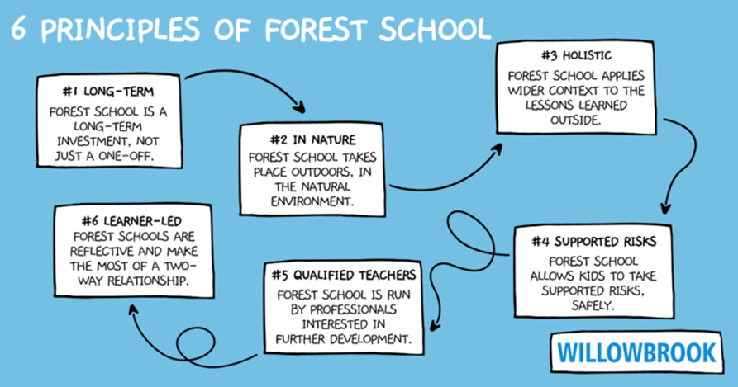
WOODLAND LEARNING
We follows the ethos of Forest School and are supported by the work of the National Forest School Association.

Slide 13
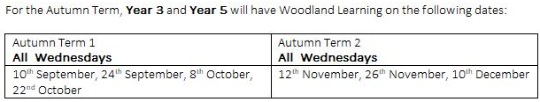
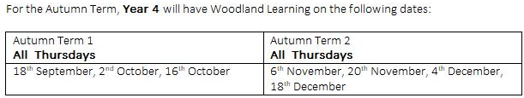
WOODLAND LEARNING AUTUMN DATES
Please note that the woodlands date has changed from the Wednesday 8th October to Thursday 9th October due to Year 3 Multiskills at the Weald.

Slide 14



GROWTH MINDSET
Independence
Our aim in Year 3 and 4 is to build independence, responsibility and prepare the children for Upper Key Stage 2.

Slide 15

THANK YOU
If you have any general questions, please feel free to email us via the office using messages@loxwoodschool.com.
We look forward to talking to you in more detail about your child during Parents’ Evening. The dates will be confirmed soon via the Up to the Minute.

