Slide 1





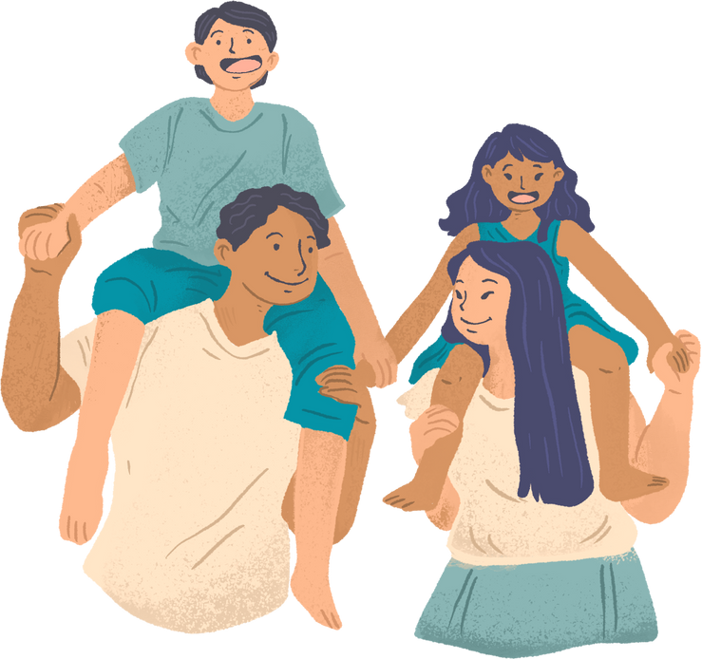


Early Help
Dedicated Schools Team
Supporting my Child to Emotionally Regulate

Slide 2
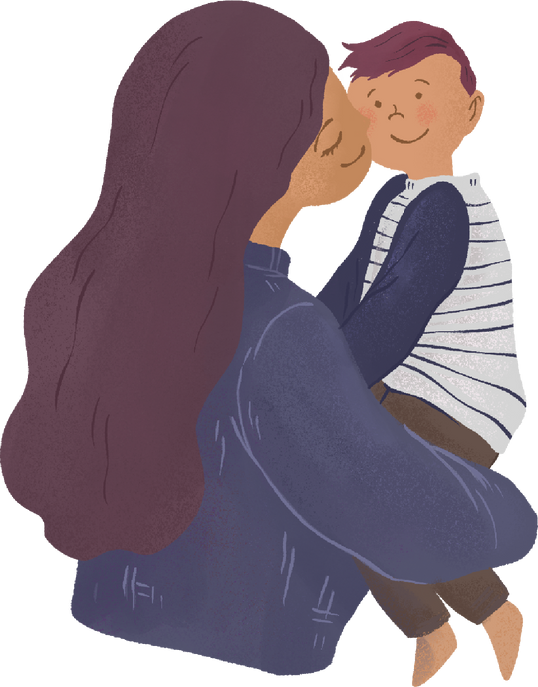
Welcome and Introduction
We are from the Dedicated Schools Team, Early Help. We provide support to all schools in West Sussex and work closely with all our educational partners to help them to support the children, young people and families in their school community.
The aim of this presentation is to:
Explore the importance of emotional regulation.
Understand what is developmentally appropriate.
See behaviour as a way of communicating.
Notes:
Emotional regulation looks different for everyone and impacts children depending on age and SEND needs; however, the principles are the same, recognising our emotions helps us understand how and why we feel certain ways. Labelling those emotions and talking about how they can make our body feel can help children understand and give them the tools they need to manage big emotions.
Behaviour is a way of communicating, especially in younger children and SEND children, when they aren’t able to communicate how they feel.
Children mirror behaviour, learning from those around them.
Introduce DST and what we do: support schools, children, and families across West Sussex. Non-judgemental – You have a toolbox and we our role is to help add tools to that toolbox to support you and your family.
Introduce yourself and your role. Be relatable – no manual for raising children. It’s a tough job.
Explain the aim of the workshop: understanding emotional regulation and supporting children.
Big behaviours often mean big feelings - behaviour is communication.
Reassure parents that emotional regulation is a skill learned over time. We ourselves are still learning to manage our own emotions.

Slide 3

Housekeeping
Ask questions
Listen to each other
Allow time to speak
Make these sessions a safe space
Only share what you feel comfortable sharing about yourself
Notes:
Safe, respectful space - no judgement.
Share only what feels comfortable.
Listen to each other and allow time for everyone.
We’re learning together - no right or wrong.

Slide 4
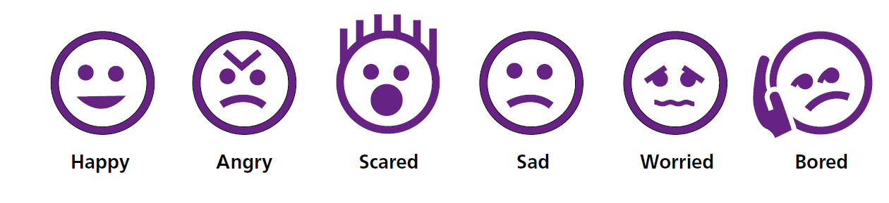
Steps to Emotional Literacy
Recognising and understanding emotions.
The first step to successful emotional regulation for your child is being able to recognise emotions in both themselves and others.
Naming emotions.
There are 6 key emotions that people have, and they are feeling; happy, sad, scared, angry, worried, or bored.
All other emotions are variants and different levels of these emotions.
Building empathy.
Recognising your child’s emotions and helping them to understand how others may be feeling. Talk to
your child about how other people may feel “how do you think Jonny feels after you pushed him?”
.
Notes:
In order to help your child to recognise the emotions of themselves and others, there are a number of things you can do:
• Label the emotions of characters in TV shows or films you watch with your child.
• Give a name to the emotions you are feeling so your child can learn what you look like when you are
feeling a particular way.
Use TV, books, and daily moments to name emotions in others. We assume our children know what these feelings are – but understanding and recognising these emotions is taught.
Model simple emotional language: “I’m feeling worried, I’m going to take a breath.”
Don’t forget to share when we feel happy too!
Praise empathy: “That was kind - you noticed she was sad.”
Help children build emotional vocabulary through repetition and modelling.
Looking at the 6 most recognised emotions discuss how anger is often the one that is the easiest to spot. Share anger iceberg model – often beneath this are lots of complex emotions e.g. frustration, fear, hunger – this is the same in adults as well as children. Understanding this can be key.

Slide 5
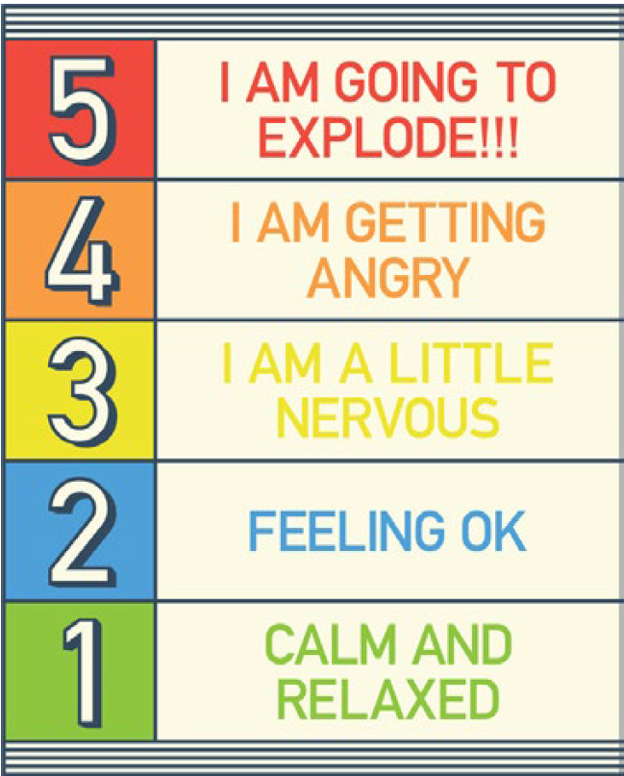
Emotional Regulation
Regulating our emotions is a skill that we are learning as we grow up. For example, when a child spills their drink, they may be distraught. As they grow up, they no longer become upset and instead learn to pick up the cup, clean up the mess and get a new drink.
We are all different, some people find it easier than others to regulate their emotions. It is also important to remember that at times everyone struggles to manage their emotions!
Behaviour is always telling us something. It is a way of our child communicating.
.
Notes:
There are different emotional regulation tools such as Zones of regulation.
Being able to recognise our emotions helps us understand how we are feeling and why our body feels different. Once we have the tools to identify how we feel, it is easier to regulate.
Modelling emotions can be supportive, demonstrating it is perfectly normal to feel different emotions, however, children mirror how we respond to our own emotions,
HandBrain Model & Regulation States
Explain the handbrain model to show what happens during big feelings. Model and ask parents to join in modelling. Explain that this again applies to both adults and children. It is a brain response. We can’t expect a rational conversation with someone who is dysregulated.
Talk about regulation zones used in school for consistency. Refer to this if the school have one. If time use clip from Inside Out - Inside Out: Guessing the feelings. - YouTube YOU DO NOT NEED TO SHOW THE WHOLE CLIP.
Use could use books like The Colour Monster to explore feelings at home.
Children learn to calm over time — it’s developmental.
Model calm behaviour - children borrow our calm. Link to slide referring to spilling a drink – How are you modelling this calm response?
Notice body language early as a sign of rising emotions. Are they pacing? Are their hands clenched?
Ask “How does your body feel?” to build awareness. Sometimes our heart beats faster, sometimes we feel sick/butterflies, sometimes our palms start to get sweaty or we hold our shoulders up. Explore these with our children.

Slide 6
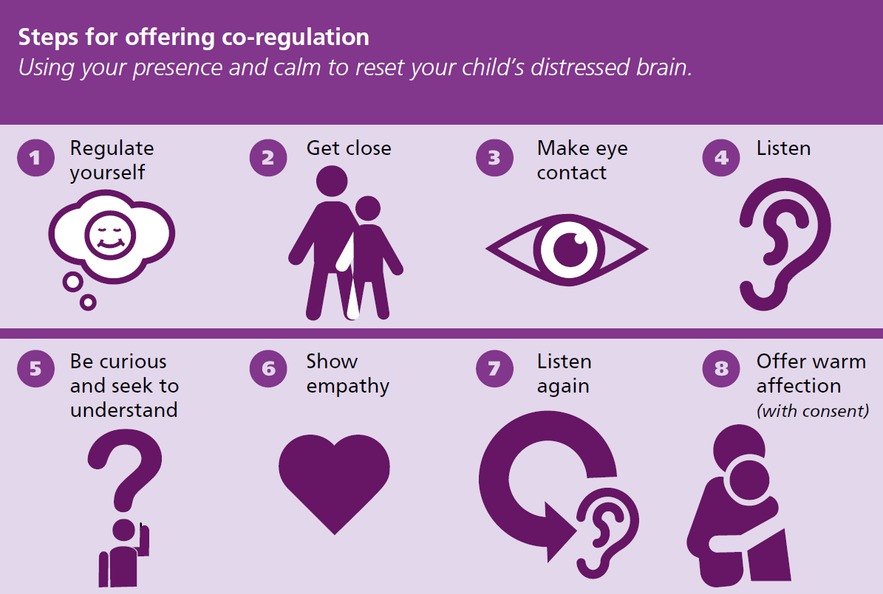
Co-Regulation .
Notes:
Copies of co-regulations for handout.
Explain coregulation - like soothing a baby. If you have ever tried to soothe a baby while you yourself felt tired, stressed, anxious – you will have noticed that it is almost impossible. Our children feel our emotions.
Share the ‘rush effect’ - adults can escalate without realising. “Put your shoes on – we need to go – we are going to be late” – Often we jump in and put their shoes on for them. Has anyone noticed that most meltdowns happen in the morning rush to work/school? If we are feeling rushed, stressed, overwhelmed…our children may be feeling that too.
Use curiosity: “I wonder what’s going on for you…”
Use empathy: “I can see that…” or “I understand that…”
Use appreciation before validation: “Thank you for telling me… that must feel hard.”
We often expect selfregulation too early - children need support first.
Try activities together to reconnect. Share examples of co-regulation activities such as blowing bubbles together, trying to throw pens into a cup or balls of paper into a bin, balancing an object on your head or between your bodies – You don’t have to invite them to do this – they will see you doing this and come to join when they are ready. You are offering an opportunity to shift the focus/distract.
Use closeness and affection when welcomed/consent.
Offer simple choices to give control.
Your presence is the strategy - you don’t need to fix the feeling.

Slide 7
Self-Regulation
There are many different strategies you can use to help your child learn to manage their own emotions. Here are a few examples:
• Sensory Strategies- There are lots of items that can be used to help your child manage their emotions by providing sensory input:
• Weighted items
• Fidgets and fidget toys
• Exercise balls (to bounce on)
• Massage
• Different smells
• Squeeze hugs (nice tight hugs)
• And many more!
Notes:
Try different things — every child is unique.
Keep strategies simple and repeatable.
Create a calm kit

Slide 8
• Breathing properly. One of the best ways to help manage emotions is to breathe correctly. This is known as diaphragmatic breathing (belly breathing). When belly breathing, the aim is for your belly to be further out than your chest when you breathe in. To practice belly breathing you can put one hand on your chest and one just above your belly button. When you breathe in you want the hand above your belly button to move out.
• Listen to music. Listening to music you enjoy can help keep your calm; it may also be used as a way to help you manage your emotions. When you are experiencing an extreme emotion (angry, terrified, about to burst) you could listen to calming music to help make you calm again. When you are feeling low, tired, or bored listening to upbeat music may help you to feel motivated or happier.
Notes:
Apps to support Emotional Regulation
https://www.smilingmind.com.au/
https://mindfulpowersforkids.com/
https://touchautism.com/app/calm-counter/
https://www.headspace.com/meditation/kids
https://dreamykid.com/
https://www.sesamestreet.org/
Breathing
Teach playful breathing: smell the flower, blow the candle.
Use Cosmic Kids or GoNoodle for guided breathing. If time share this example: GoNoodle Melting YOU DO NOT HAVE TO WATCH THE WHOLE CLIP.
Breathing can shift energy quickly - helps both upregulation and calming.
Practise when calm so it’s easier during big feelings.
Music can shift our energy – if they need to listen to some sad music and sit in the feeling – let them. If they want to listen to something upbeat and dance around the room to get out of the feeling they are feeling – let them. We can model this and again, you don’t have to invite them to join, they will if they want to.

Slide 9
• Activities you enjoy. Another way to manage emotions is by doing things you enjoy or that make you happy.
This could be colouring, drawing, dancing, singing, playing games, and much more.
• Time Away. It might be that you or your child needs some time away or time out to help
manage emotions.
This strategy should only be used when it is safe to do so.
Notes:
Try distracting with a different activity or to help adult with an “important job”.
Some children need to be active to regulate, trampoline, running on the spot, skipping.
Some children need space alone to regulate, tepee, den, quite area to chill out, away from everyone else.
Movement or Space
Some children regulate through movement - push/pull, trampoline, 5minute bursts.
Give responsibility tasks to redirect energy. We often do this in schools – Can you take this note to the office for me? This helps sometimes to shift the focus and allow the child a moment to remove themselves from the situation that may be causing them distress.
Some children need space - offer a den or quiet corner.
Let the child choose what helps them feel safe. Ask your children what they like to do? What makes them feel calm – perhaps it is playing with playdough or perhaps it is playing with water – put them in the bath early with some toys to play with.
Short bursts of connection can reset the whole day.

Slide 10
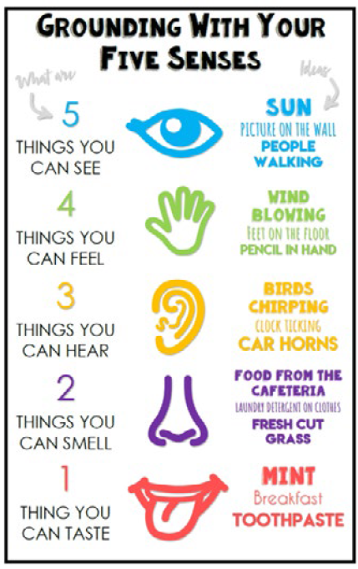
• Grounding Techniques.
Grounding techniques are particularly helpful when experiencing anxiety
as they can help you focus on your surroundings.
A common grounding technique is the ‘54321’technique.
This is shown in the image to the right.
Notes:
Copies of grounding senses handouts at the end.
Bring the brain back to the present using senses.
Use simple grounding like 54321.
No equipment needed — just noticing what’s around you.
Helpful for anxiety and overwhelm.

Slide 11
Resources and Useful Links
https://beaconhouse.org.uk/resources/
https://assets.ctfassets.net/crg4xfgy75fu/M8jCjwNv306SmY8QYbHD7g/d28628db6bd4fecbe16e57c6dbd49d85/create-zones-check-in-for-home.pdf
https://policyonline.nhslothian.scot/wp-content/uploads/2024/04/Finding-the-Calm-Emotional-Regulation.pdf
https://www.reachingfamilies.org.uk/
https://www.wspcf.org.uk/
•
Notes:
Print out links as part of handout.
Share useful links for parents to explore in their own time.
Refer back to that rush effect – How are you communicating with your child? Look at declarative language and share some examples – In 10 minutes I am going to put my shoes on so that we are ready for school or I notice that yesterday you got your shoes on really quickly and we got to the gate on time to walk in with your friend…
Encourage choosing one strategy to try this week. Can you tell me one thing from today’s workshop that you are going to add to your toolbox?
Invite questions and reassure parents they’re not alone.

