Slide 1
https://www.bigschoolcamp.co.uk/ Year 4 & 5 The Big School Camp
Wednesday 28th to Thursday 29th June 2023

Slide 2
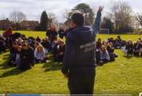
Big School Camp Video Links
https://www.facebook.com/watch/?v=896261558435526&extid=CL-UNK-UNK-UNK-AN_GK0T-GK1C&ref=sharing

Slide 3
The National Curriculum states:
Pupils should enjoy communicating, collaborating and competing with each other.
Pupils should be taught to:
Take part in outdoor and adventurous activity challenges both individually and within a team

Slide 4
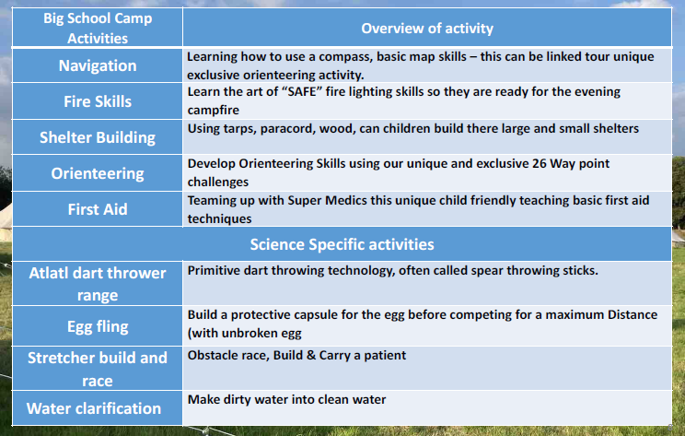
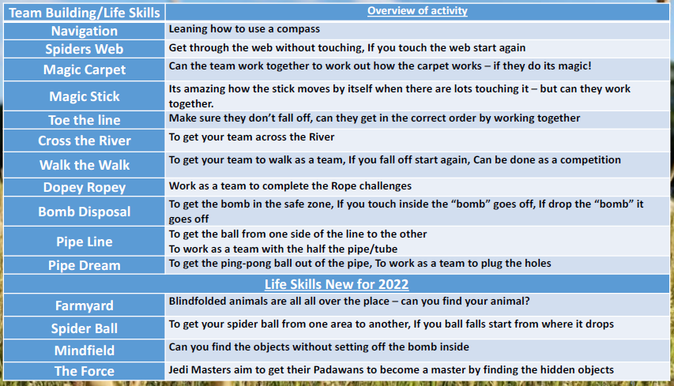

Slide 5
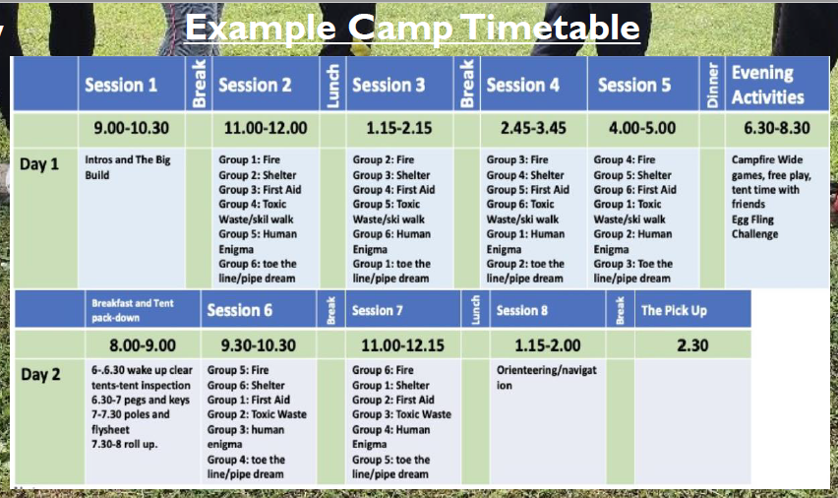
What would a ‘normal day’ look like?

Slide 6
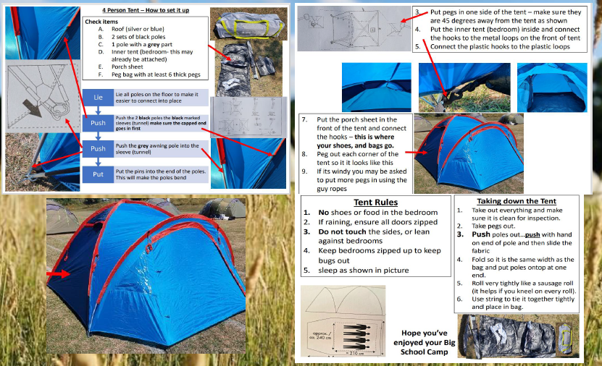

Slide 7
COSTS
We have costed the trip at £70.
The letter you have received today explains the deposit. It also gives deadlines for future payments. Payments can be made weekly or monthly if preferred.

