Slide 1

‘Meet the Team’

Slide 2


Year 3 and 4
Rowan Class Sycamore Class
Mrs Calvert Mrs Oldfield
Ms Daly Mrs Cook
Mr Green PE Teacher every Wednesday
Mrs Harder and Mrs Swann alternate PPA cover on Wednesday in both classes

Slide 3
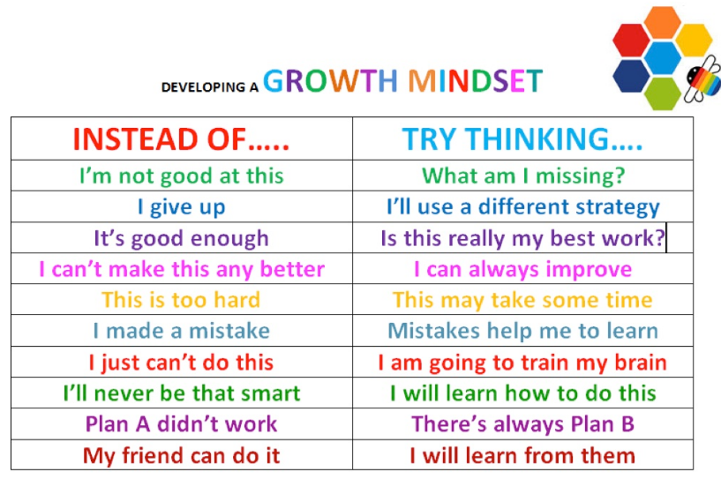
Growth Mindset

Slide 4
Topics This Year:
Autumn 2022- ‘Discover’. Pyramids & Pharaohs (Ancient Egypt)
Spring 2023- ‘Explore’. The Frozen Desert (Polar Regions)
Summer 2023- ‘Create’. Weird & Wonderful (Habitats)

Slide 5
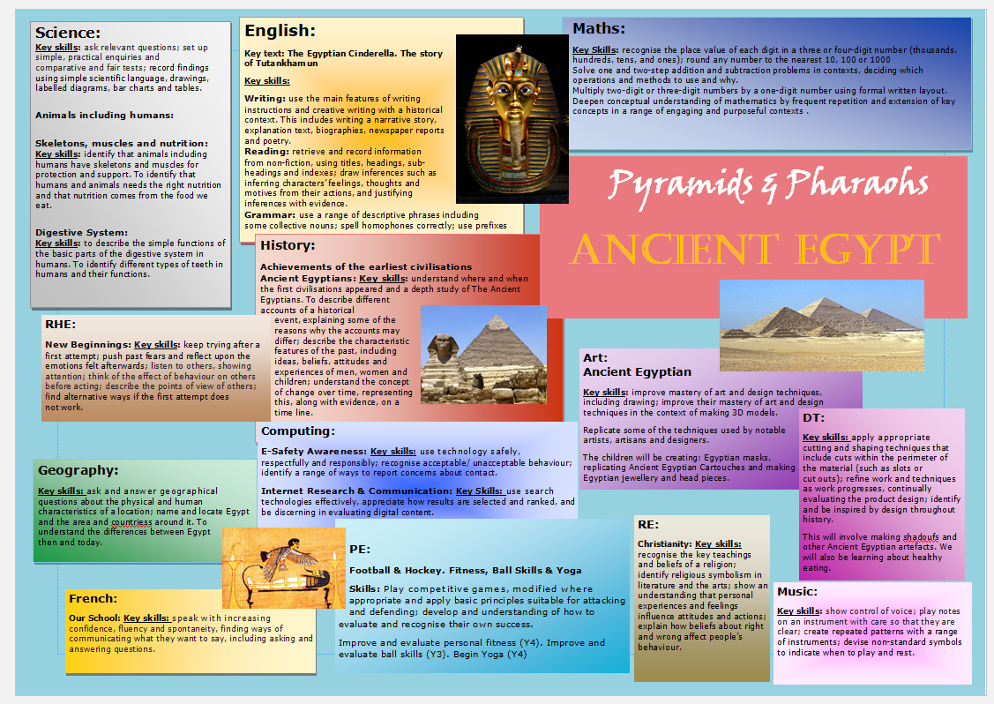

Slide 6
Class Timetable
Subjects other than Maths and English, which are daily;
Science
Art & Design /DT
PE
Humanities (History & Geography)
French- RE – Computing- Music-RHE
Wednesday is our PPA day and we are out of class either in the morning or afternoon, our PPA cover is either Woodland Learning with Mrs Harder or in class learning with Mrs Swann.
Rowan’s other PE day is Tuesday and Sycamore’s PE day is Thursday
Long hair must be tied up and earrings removed or covered for PE

Slide 7
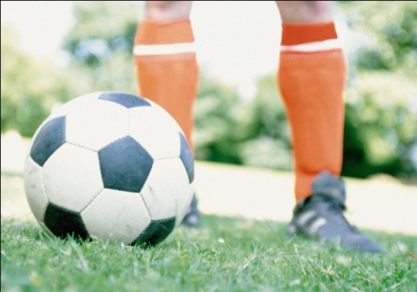
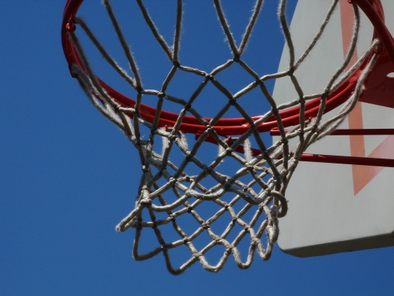



P.E.
All Children have PE on a Wednesday.
Rowan class’s other PE day is Tuesday. Sycamore’s is Thursday.
ALL children to have their named PE kit in school at all times, as days can change.
Earrings must be removed or taped over.
Notes:
Need trainers – not plimsolls.
No need for shin pads/football boots – using soft balls and plastic hockey sticks.

Slide 8
Homework
In Year 3 and 4 the homework is;
Spellings, Times Tables and Reading. This is a requirement for the whole year. They are required to practice reading at least four times a week minimum, out loud, to an adult, signature required in reading record book).
The children will also be given a homework grid with 9 options. They are expected to complete 2 pieces that they choose each half term.
All children have weekly Times Tables and Arithmetic tests. They are expected to practice their Times Tables at home to improve their fluency.

Slide 10
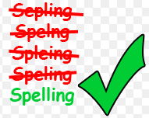
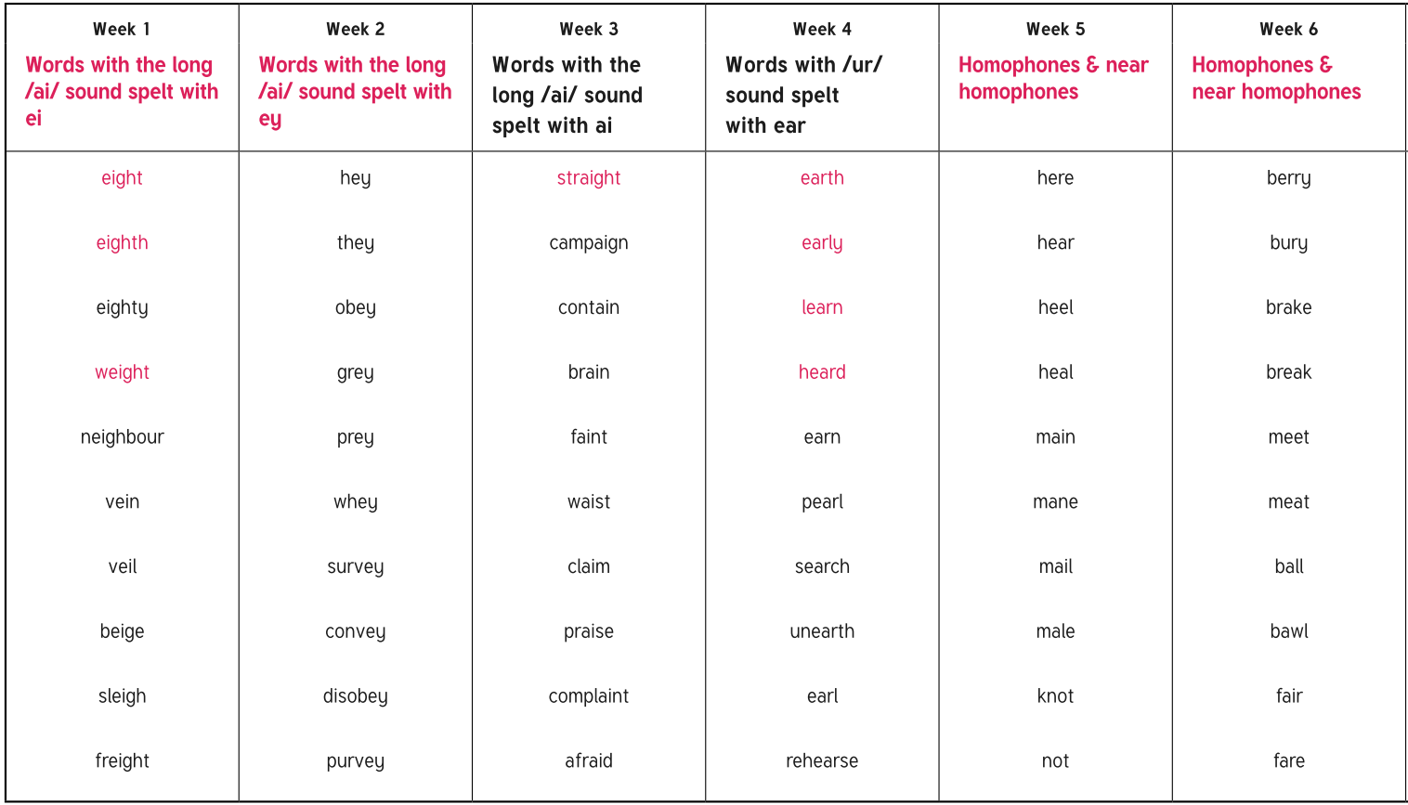
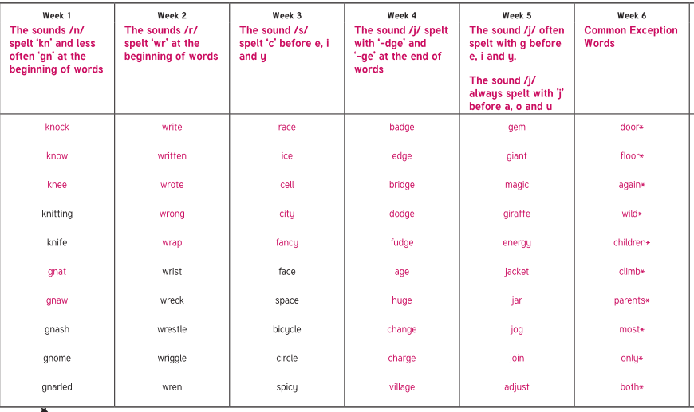
Spellings in Rowan Class
Spelling will be handed out on a Friday and then the children will be tested on the following Friday.
Most children have been split into groups (Pink/ Yellow) and the spellings for the half term can be found on the class page of the website.
Children will be given a log in for spelling frame where they can practise
their spelling, this is NOT compulsory, some children find this resource helpful. https://spellingframe.co.uk/
High Frequency Words (HFW)
Year 2 list
Year 3 and 4 list
Statutory requirement rules
Example words

Slide 11
Spellings in Sycamore Class
Spelling will be handed out on a Wednesday and then the children will be tested on the following Wednesday,
Children have been split into groups (Group A and Group B) and the spellings for the half term can be found on the class page of the website.
Children will be giving a log in for spelling frame where they can practise
their spelling, this is NOT compulsory, some children find this resource helpful. https://spellingframe.co.uk/

Slide 12
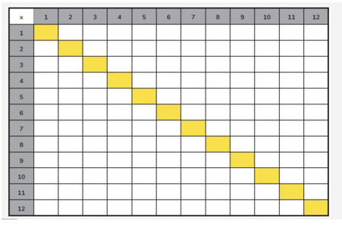


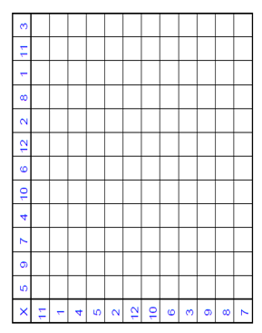
Times Tables
Please ensure your child is learning their Times Tables, the children will be doing a weekly timetables test on a multiplication grid. They will initially have 15 minutes to fill out as much as they can, this is to show their personal progression throughout the year. This will decrease to 10 minutes later in the year, also with a mixed up grid.
Children will be given a log in for Timetables Rockstars which they can use to help them practise their timetables. this is NOT compulsory and not part of the test, some children find this resource helpful to practice https://play.ttrockstars.com/auth/school/student
If they do not want to use this way to help practice there are alternative options below.
There are a lot of Times Tables games online (I have attached some links which may help) and we will also
practice weekly in class.
Games / apps
http://www.topmarks.co.uk/maths-games/7-11-years/times-tables
http://resources.woodlands-junior.kent.sch.uk/maths/timestable/
http://www.teachingtables.co.uk/
Songs
Percy Parker
(App or CD http://www.percyparker.com/singyourtimestables/index.html)

Slide 13

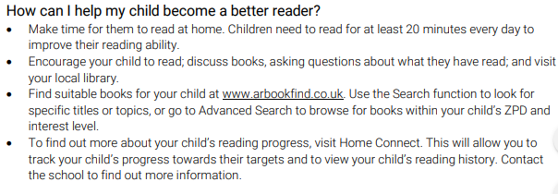
Accelerated Reader

Slide 14

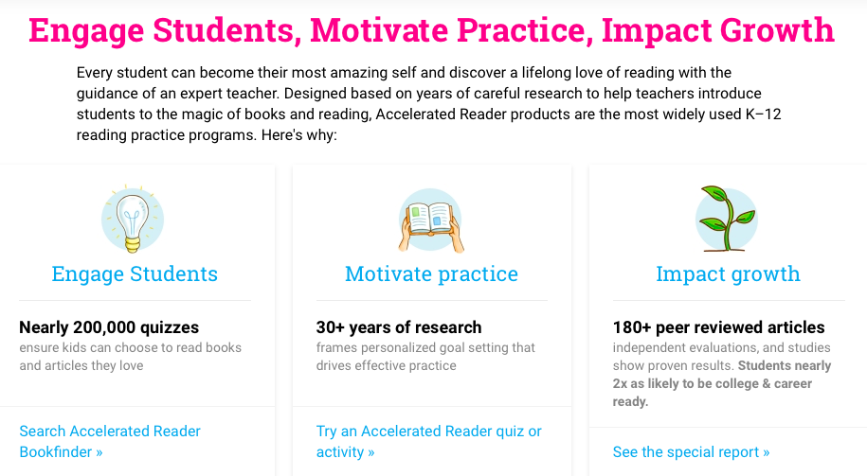
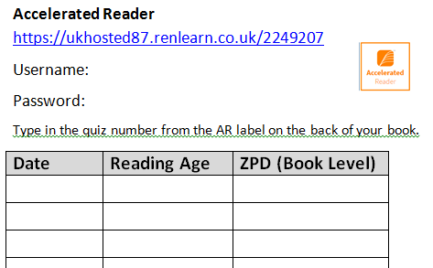
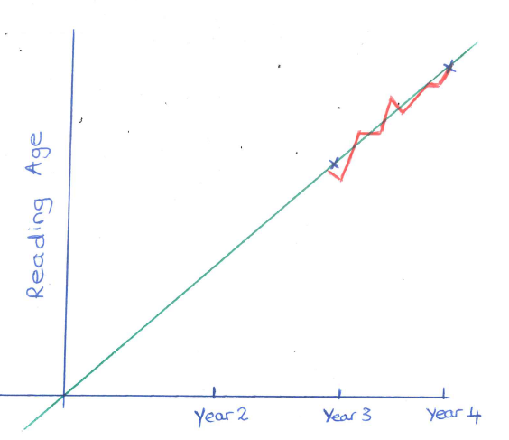
https://www.renaissance.com/products/practice/accelerated-reader-360/

Slide 15


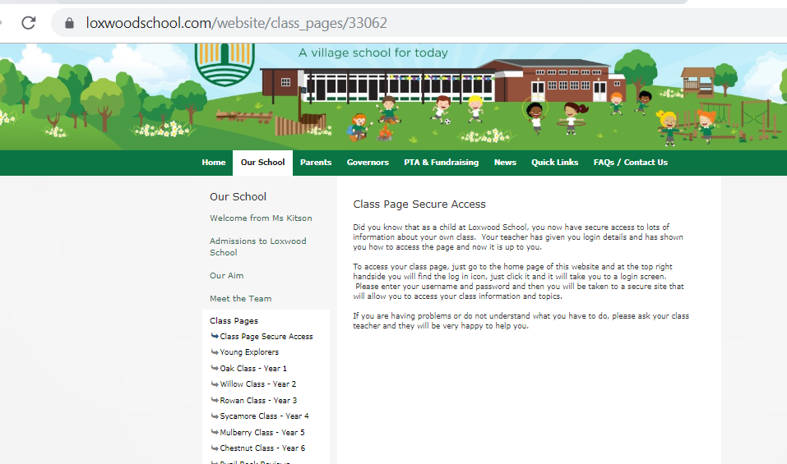
Loxwood School page
School website
Dates
Topic Web
Homework
Spellings
Useful links
Photos

Slide 16
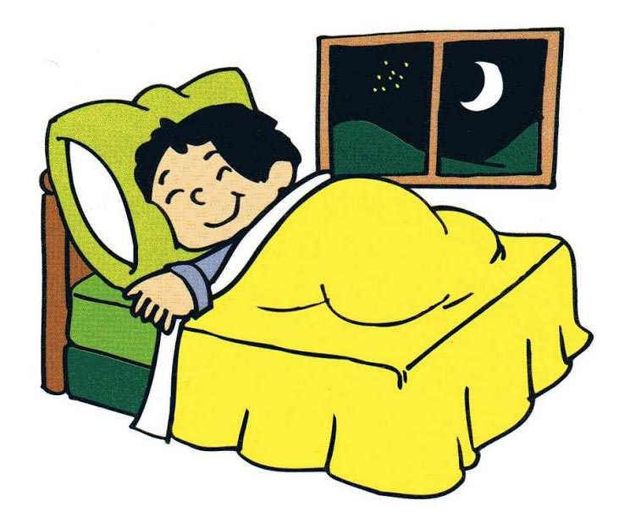
How can you help your child over this busy year?
SLEEP
BREAKFAST
SNACK for snack time (fruit or vegetables only) & Water, this is important as the day is long.
HOMEWORK
INDEPENDENT/ORGANISED
ALL UNIFORM NAMED.

Slide 17
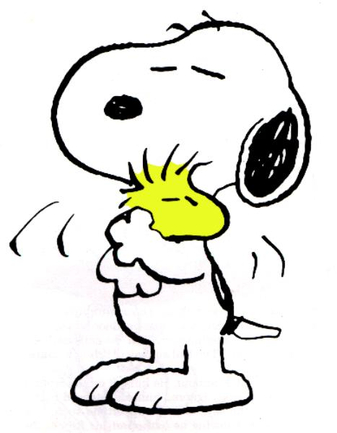
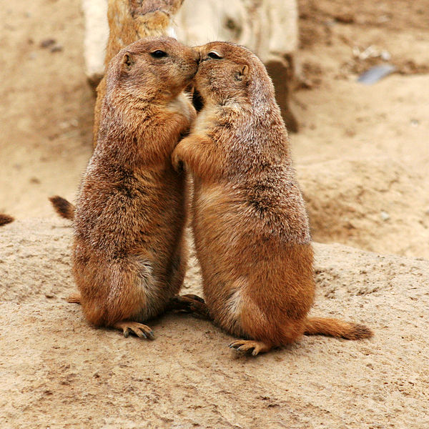
Emotional Well-Being
I am sure that the children's emotional well-being is of paramount importance to us all. We are extremely aware of emotional well-being in children, these are the years they become more independent and improve their self esteem with help and guidance. If a child in our care is not acting their usual self, or is withdrawn from the class or their friends, we will always take the time to reassure them that we are here to help. If you feel that your child might be affected by something at home, such as a bereavement (be it pet or human) or arguments with siblings etc, please take the time to briefly inform us, as it might help us to help them.

Slide 18

Questions?
Please feel free to ask any further questions you may have.

