Slide 1





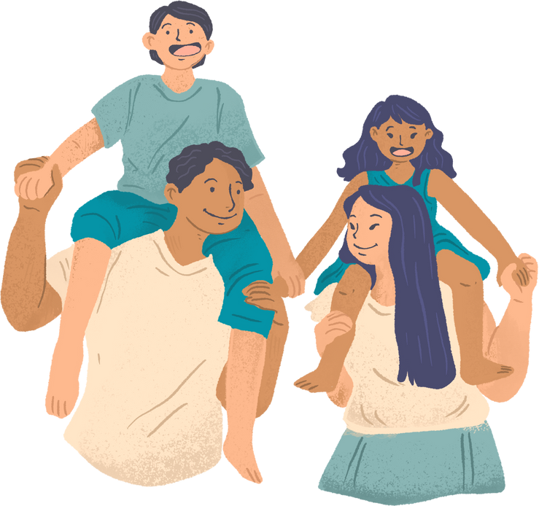


Early Help
Dedicated Schools Team
Supporting My Child
Positive Communication

Slide 2

Housekeeping
Ask questions
Listen to each other
Allow time to speak
Make these sessions a safe space
Only share what you feel comfortable sharing about yourself

Slide 3


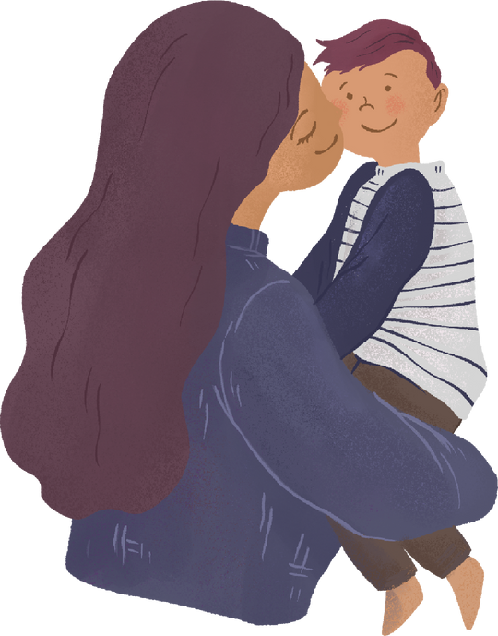
Welcome and Introduction
What is positive communication?
Notes:
Introduce yourself
Clip on what happens when communication goes wrong.

Slide 4
LISTENING - helps to understand and observe what is going on for them.
Listening needs to be a habit and then your child will make a habit of talking.
Model when they listen to you it is important to listen to them.
Acknowledge what they are telling you.
Avoid natural reaction to fill in the blanks. Embrace silences even if it feels awkward.
SPEAKING - Use positive words.
Tell your child what you want them to do rather than what you don’t want them to do.
TONE - Your voice is a powerful tool.
Use a calm quiet voice and a neutral tone.
If you speak in a completely different manner to which they expected, they might be surprised.
Your tone can be enough to stop a fraught situation or support your child to do what you want them to do.
Notes:
Language – Give an example of changing your language to positive.

Slide 5
BODY LANGUAGE – Non -verbal communication
Touch, smiling, kissing and cuddling tells them that you love them.
Give them your attention.
Look pleased.
Seek eye contact.
FEELINGS
Help them to find the words to express how they are feeling. ‘I can see that you are feeling sad……..'
Model this by talking about how you are feeling and why. ‘It makes me feel sad when …..'
RESPONDING WITH EMPATHY - Explaining, give children choices.
There are times when you need to say NO. Give your child a reason and offer an alternative.
Notes:
Explaining – give an example

Slide 6
PRAISE – Praise for doing and praise for being.
Notice what they are doing well, so that you are encouraging the behaviour you want to see.
Try not to stress over the little things – pick your battles.
The more we practice the easier it becomes.
Beware of pitfalls – criticism, offering advice that might not be needed at that moment.
CONSISTANCY – Be careful about not giving mixed messages.
If you make promises make sure you keep these.
If there are consequences, they must be carried through.

Slide 7
BOUNDARIES - Setting Limits
Boundaries need to be set to show love and guidance.
Establish and maintain clear consistent boundaries.
Keep to just a few rules and include the whole family.
Use reasonable consequences in response to negative behaviour.
If trying a new routine get this working well before moving on to the next one.
REWARDS – do not need material rewards.
Love Languages and kindness charts.
Look for the good things.
Encouragement and praise boosts self–esteem, awareness and works wonders.

Slide 8
COMMUNICATION THROUGH PLAY
Play is important, enjoyable and children can learn a lot from it.
When they are younger play might be creating works of art, playing with a bowl of water, plastic cups and jugs.
Let their imagination run wild setting up a tea party or a shop….
As they grow introduce games, Dominoes, Cards, Connect 4, Uno …….
As well as learning how to take turns and follow rules, it
creates a fun environment for conversation.

Slide 9
CHALLENGES & Overwhelm
It can be very difficult to communicate positively during moments of overwhelm.
There might be specific triggers or times when this happens so be aware of these and try different approaches.
They can happen when there is a lot to do in a short space of time.
It takes time for children to learn how to behave.
It takes time for parents to work out how to get the best out of your child.
Find out the reason behind the challenging behaviour.
*Are they upset or anxious about something
* Do they feel jealous about a sibling
*Do they want you to listen to them
*Are they wanting your attention

Slide 10
Try………
Distractions.
Withdraw privileges.
Stay Calm. Swap the adult.
Use phrases that will reassure a child that they are safe.
Acknowledge and validate how they are feeling.
Notes:
What we mean by privileges for example a treat, a toy, a game, an outing that you were planning to do with them or a friend

Slide 11

TIME
As parents we are all very busy. Try to get into the habit of having a time of the day to chat. This could be meals times or before bed. Side by side conversations, like when walking the dog or when driving often flow better. Make sure we are focussed so we are off our phones or computers. Maybe you could agree a signal with your child when they need to talk for example sending you an emoji or a code word.

Slide 12
COMMUNICATION CHANGES AS THEY GROW
Children's needs and ​understanding changes as they grow.
Part of growing up for your child will be pushing boundaries. ​
Support this independence by helping them to start doing things for ​themselves. ​
Your child will learn from you so give lots of praise and attention for good behaviour.
If you only pay attention to your child when they ​misbehave, they will learn to misbehave to get your attention.
Notes:
~ Try phrases like ~ I’m here. I’ve got you It’s okay, you’re safe I’m going to stay with you You’re going to be okay It’s okay to cry You’re not in trouble.
That must be really hard I’m sorry that X is making you anxious Let's begin to unpick your worry Do you want to talk about it? You're worried, how can I help?

Slide 13
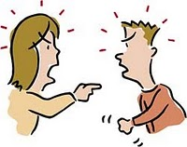

BE A ROLE MODEL
How do you communicate?
ThePhoto by PhotoAuthor is licensed under CCYYSA.

Slide 14
GOOD QUESTIONS
Open questions will help a child enter a conversation.
Be curious about their world and what is going on for them.
You don’t have to get into any tough questions straight away.
Hold back without judgement.
Start with less sensitive ones first, get the rhythm and rapport going and build up.
Tips and prompts to deeper conversations:
https://www.pookyknightsmith.com/video-5-phrases-for-prompting-deeper-conversations/

Slide 15
Communication is more than just a way to resolve conflict or avoid problems. It isn't straightforward, you will find ways that work best for you and your child.
"For positive communication family relationships are strengthened.
Joys can be shared burdens can be lifted, and love can be expressed.
The rewards are well worth the effort."

Slide 16

This Photo by Unknown Author is licensed under CC BY-NC-ND
Notes:
Finish with a take away of the love languages.
5lovelanguages.com/quizzes/love-language

