Slide 1

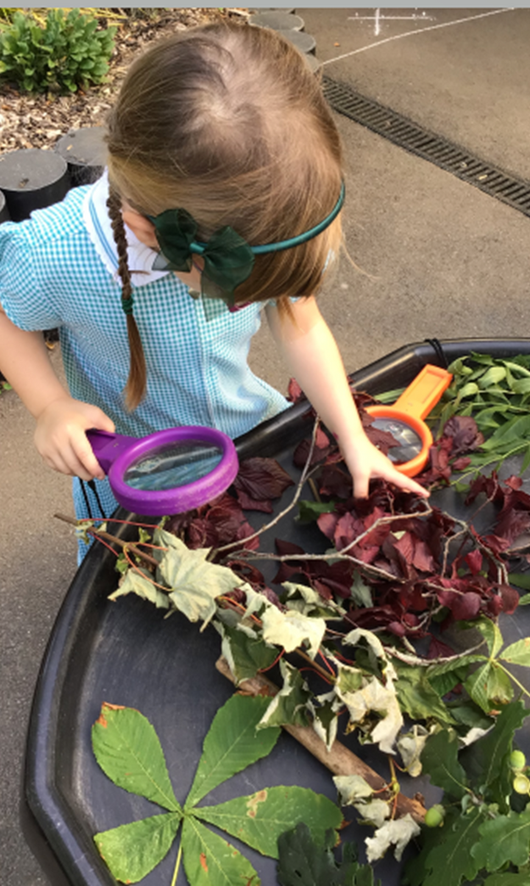



Why
Loxwood?
2025

Slide 2

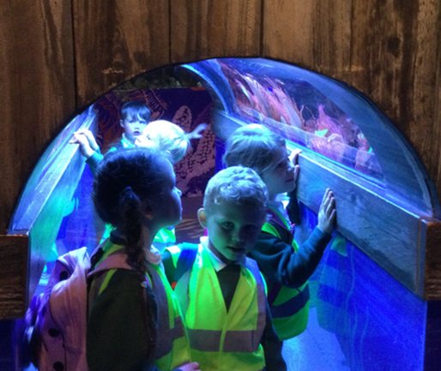
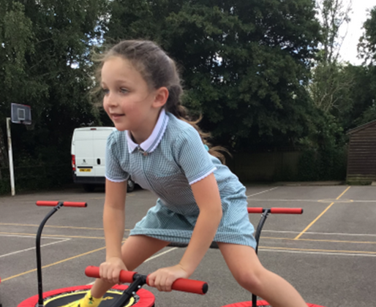
Our Curriculum Is...
Current
Relevant
Fun
We use topics that are current to children’s lives and we utilise our beautiful outside area to enhance the learning.
Our topics are chosen to engage and motivate children. Our yearly trips are a great way to bring learning to life, such as the reception trip to the Sea Life Centre.
Happy children make happy learners.

Slide 3

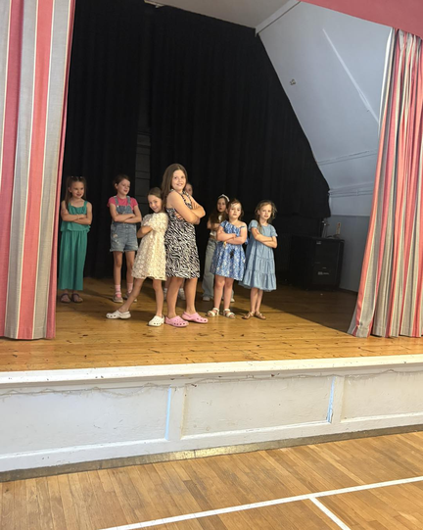
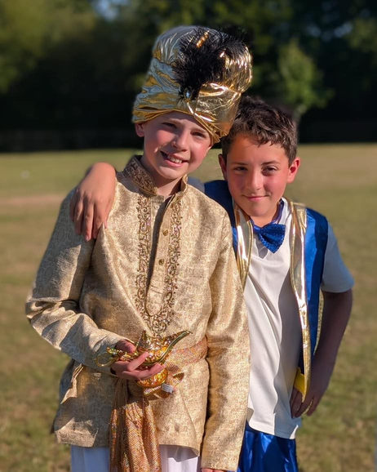
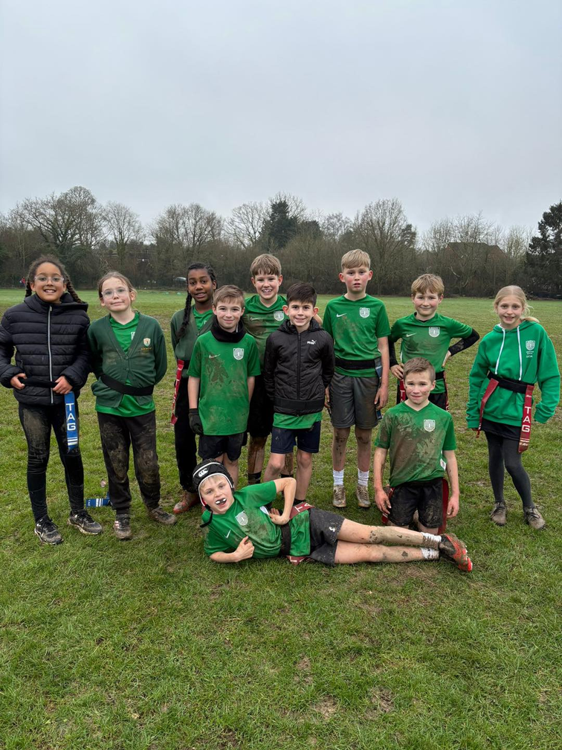
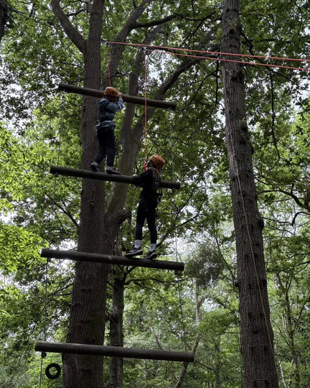
Loxwood’s Life List
Visiting the canal
Enjoying a pantomime
Going on a residential
Performing on stage
Learning to swim
Representing the school
Supporting a charity

Slide 4





Our Values
We like children to ask questions about the world around them.
We prepare children for secondary school and beyond.
Kindness is at the heart of everything we do.
We encourage children to make mistakes in a safe environment and to have the confidence to try again.
We teach children to respect themselves, those around them and the environment.

Slide 5
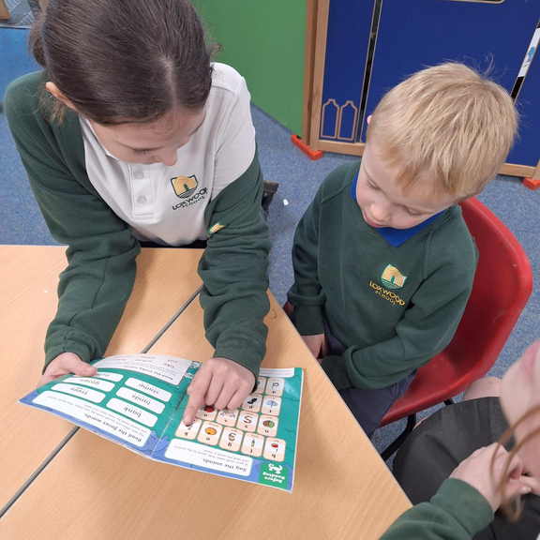
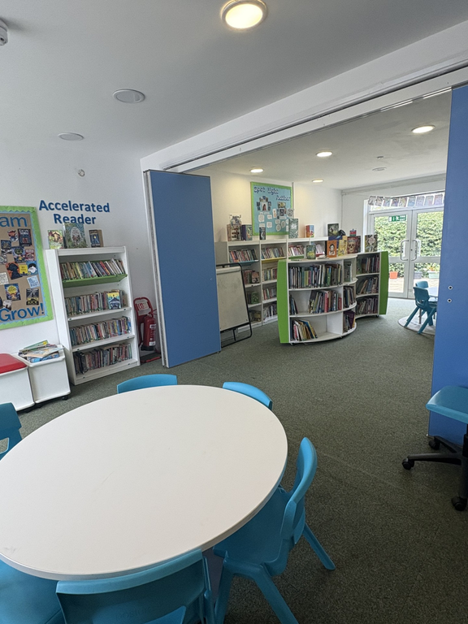
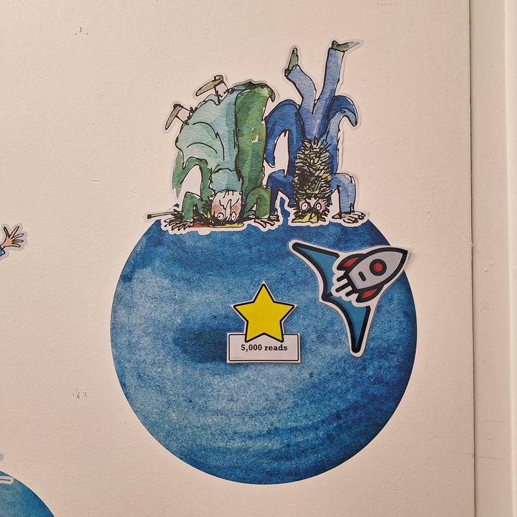
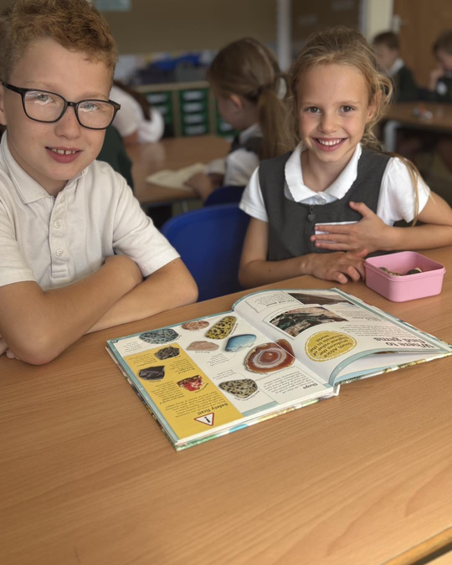
Reading at Loxwood
  Our aim: to nurture a lifelong love of reading in every child
  Our beautiful school library is used weekly by every class
  Children from Reception to Year 4 who need phonics follow the Read Write Inc. scheme
  Once they graduate from phonics, they move on to Accelerated Reader to support their reading journey
  Every Friday afternoon we enjoy Shared ERIC (Everyone Reading In Class), where children mix with another year group to share a book for pleasure
  The whole school takes part in our Reading Rocket reward scheme, working together towards exciting rewards

Slide 6
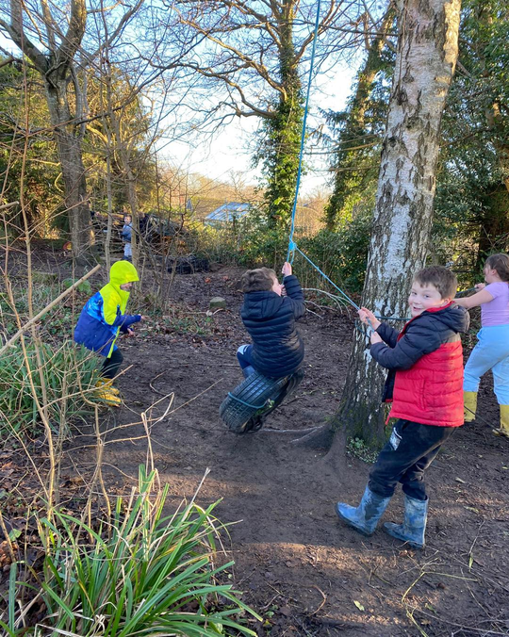
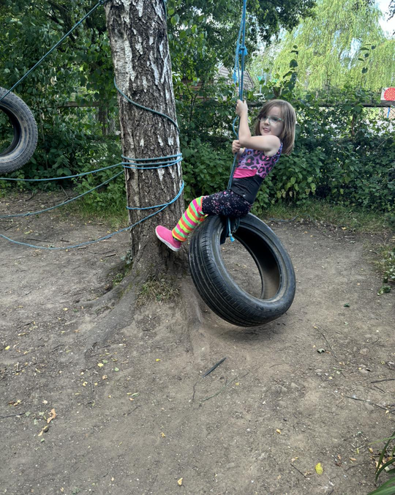
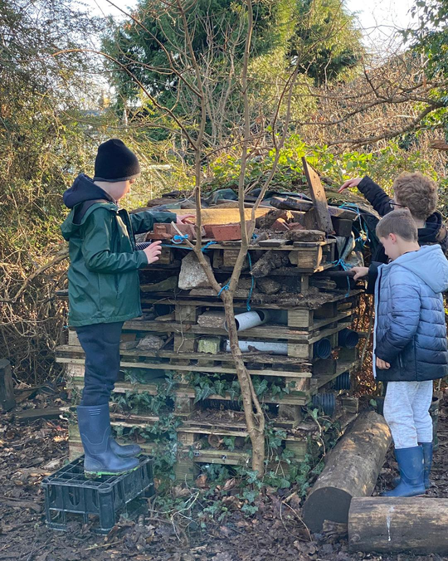
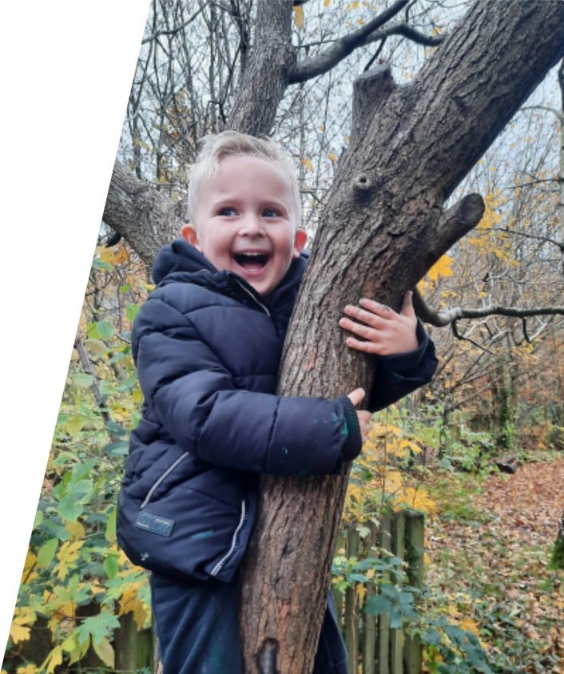
Woodland Learning
We make the most of our extensive grounds and beautiful local environment to bring learning to life. Every class takes part in Woodland Learning every other week, as well as enjoying regular outdoor lessons that are focused, hands-on and exciting. Our specialist teacher helps children develop new skills – from cooking and safe knife use to building confidence, independence and physical strength. With our woodland, open spaces and even a school pond, Loxwood is a fun and inspiring place to learn!

Slide 7
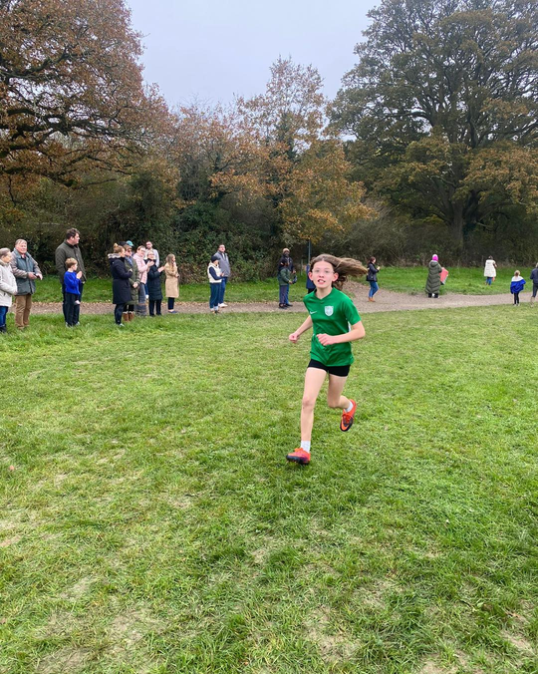
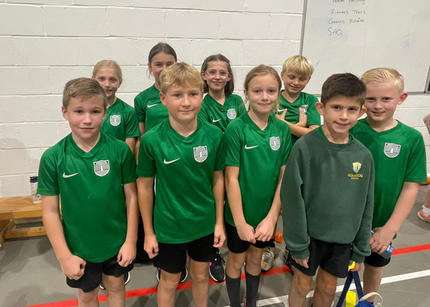
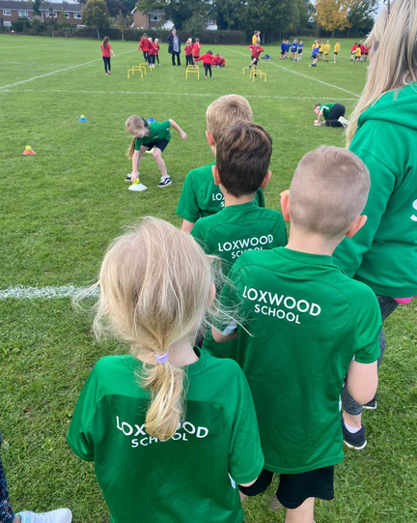

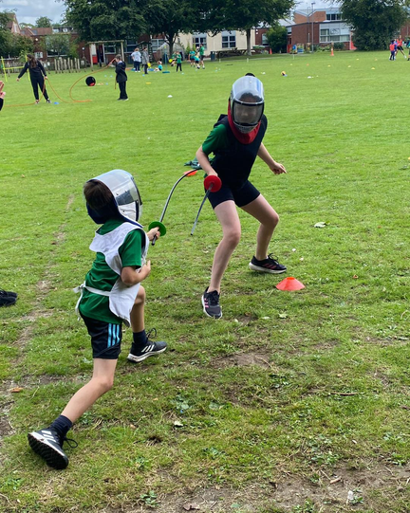
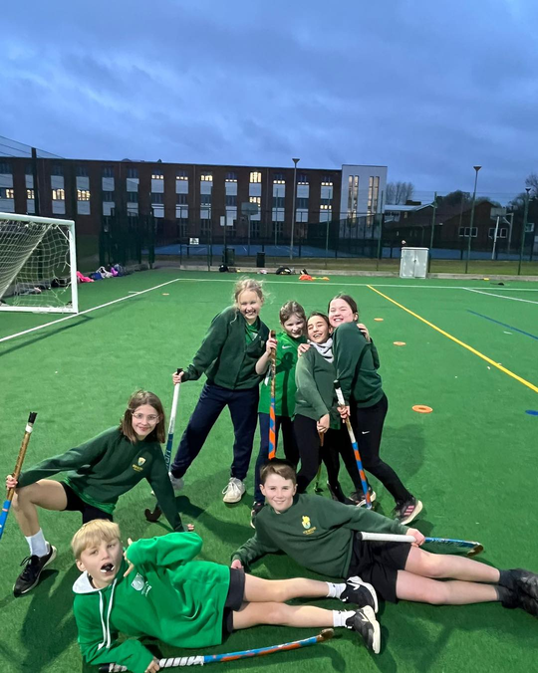
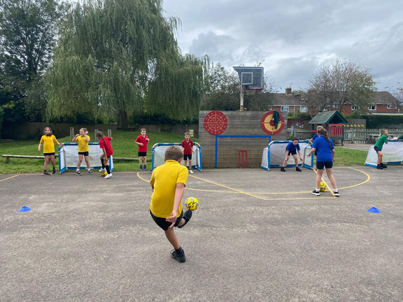
Sports
We are passionate about sport at Loxwood and proud to have achieved the Platinum School Games Award for the fourth consecutive year. Our children experience a wide variety of sports both in school and through external opportunities with the Weald Locality and Horsham District events. We take part in both competitive and inclusive events, ensuring every child has the chance to be involved. Every Wednesday, our specialist sports coach works across the school, providing high-quality teaching and inspiring our pupils to enjoy and excel in sport.

Slide 8

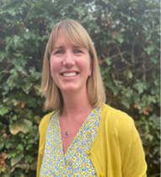
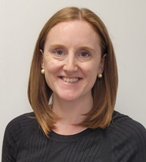
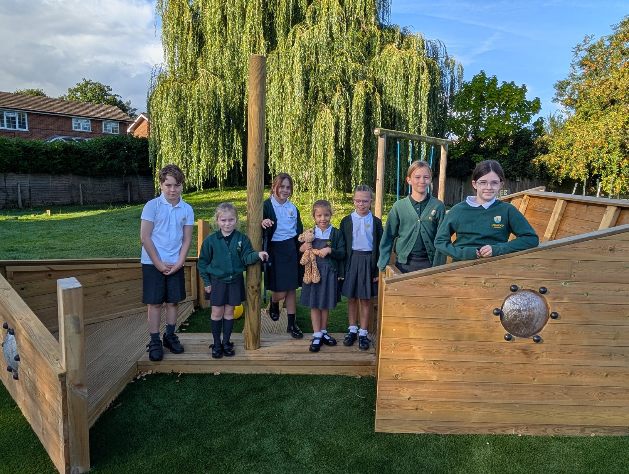
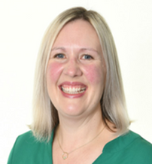
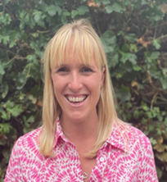
Well-Being Team
Mrs Swann
Learning Mentor, Wellbeing Ambassadors Lead and Mental Health Lead
Mrs Green
Emotional Literacy Support Assistant (ELSA)
We have a large team of staff and children who actively promote and support well being at Loxwood.
Mrs Mellors
Mental Health Lead and Mental Health First Aider
Miss Price
Special Educational Needs Coordinator (SENDCO)
Wellbeing Ambassadors Team of children

Slide 9
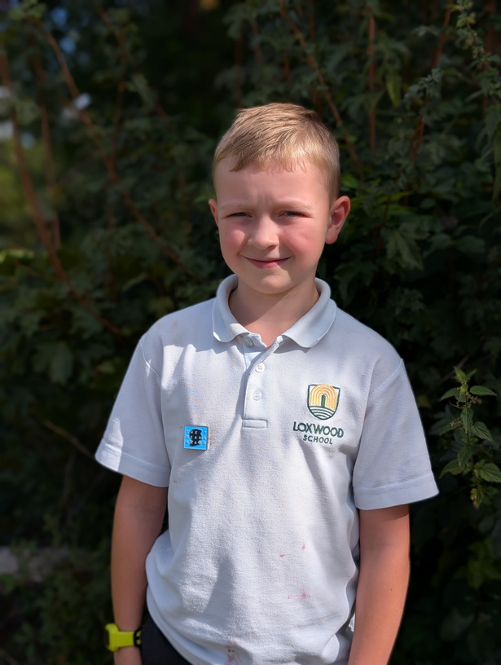
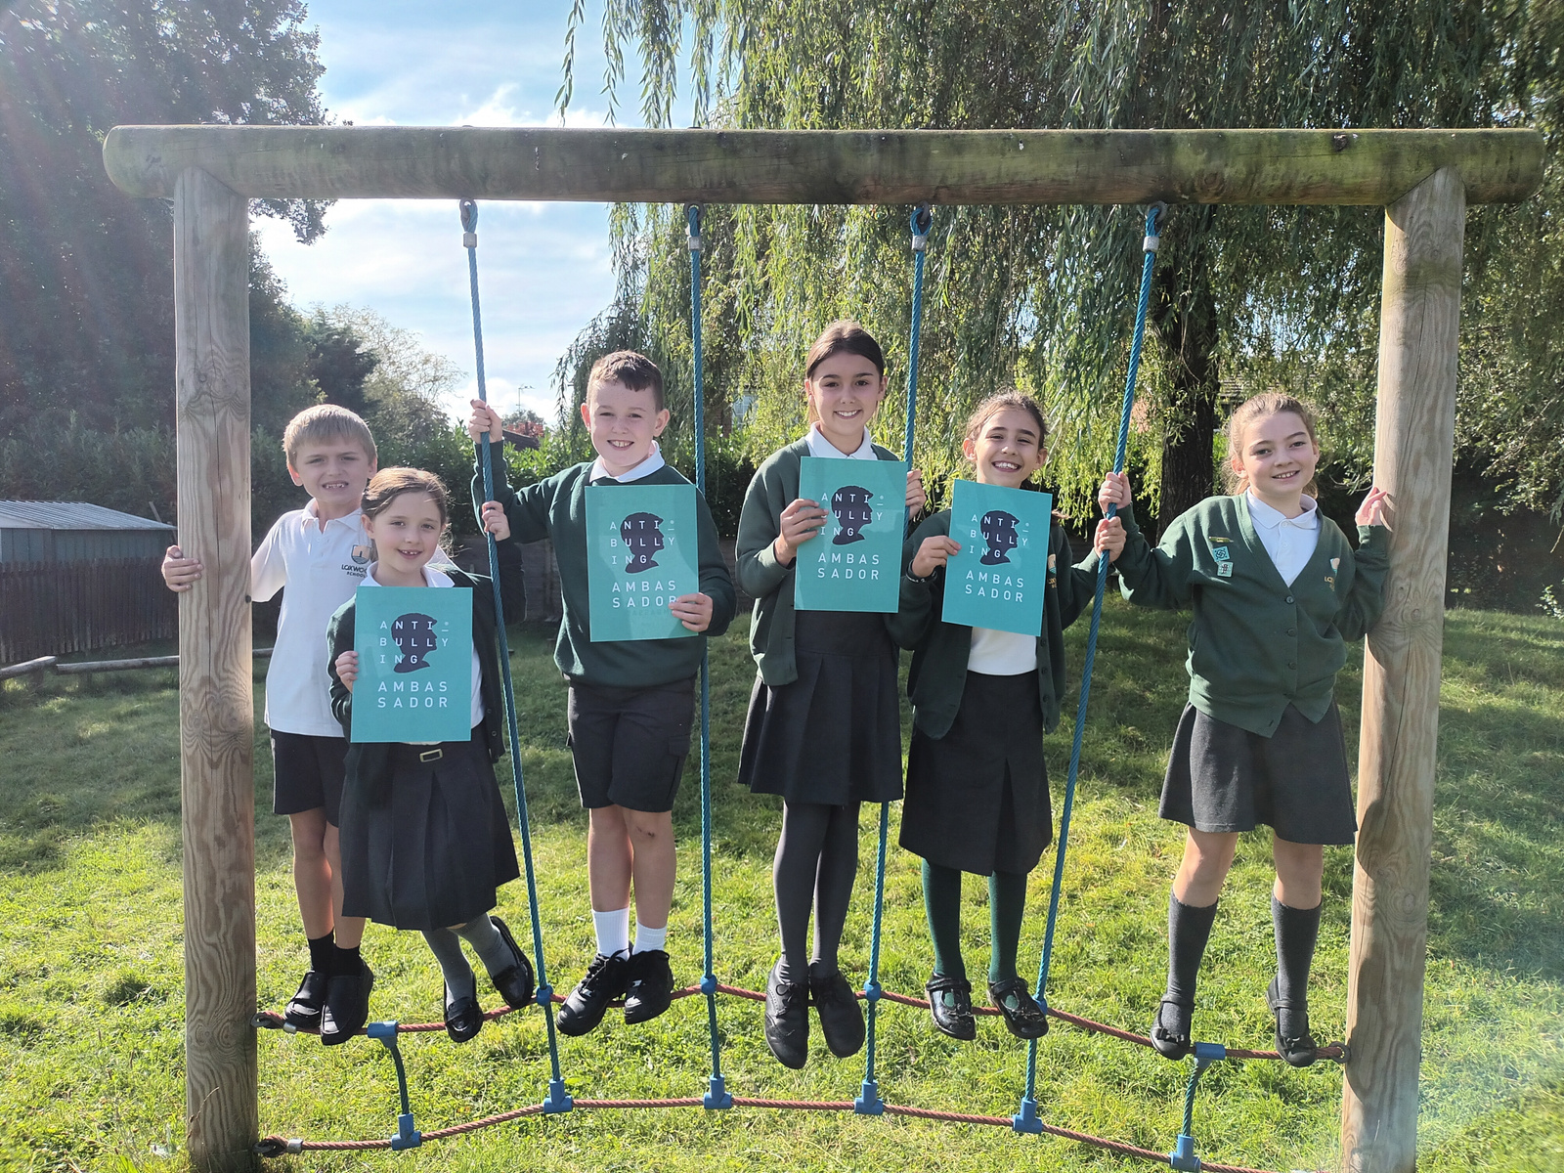

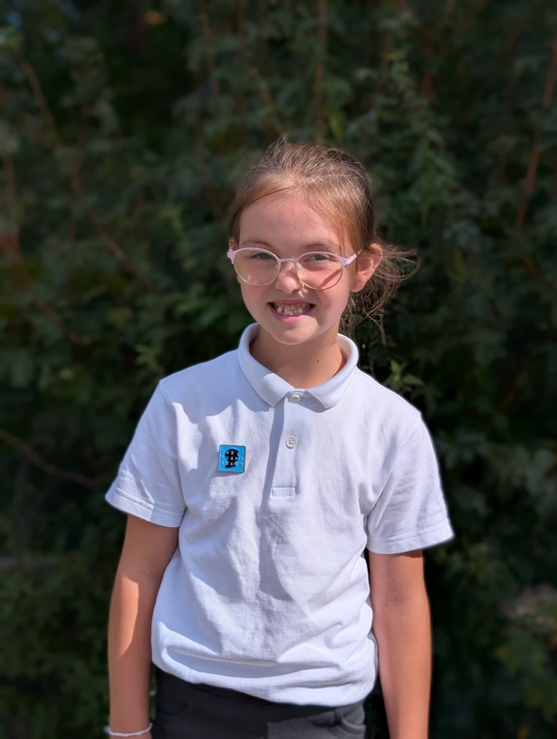
Anti-Bullying Ambassadors
Mrs Swann leads our Anti-Bullying Ambassadors team, who are trained through the Diana Award Anti-Bullying Programme.
Throughout the year, they work towards key badges, support whole-school initiatives such as Anti-Bullying Week and play an active role on the playground.
They also contribute to writing and reviewing our Anti-Bullying Policy and help to promote our school values every day.
Anti-Bullying Ambassadors Team of children

Slide 10

WOW Club
Our Ofsted-registered and externally run wraparound care runs every school day until 6pm, as well as during the school holidays. We provide a safe, fun and friendly setting where children can enjoy a wide range of activities.
  Breakfast Club from 7:30am
  After-school sessions with flexible booking options
  Holiday clubs throughout the year
  Outdoor play and sports in all weathers
  Arts & crafts, games, Lego and creative activities
  A caring team who get to know each child and nurture their interests

Slide 11
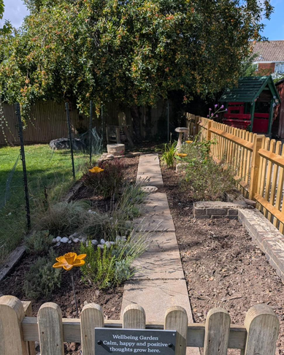
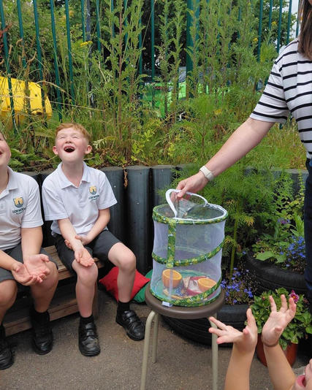
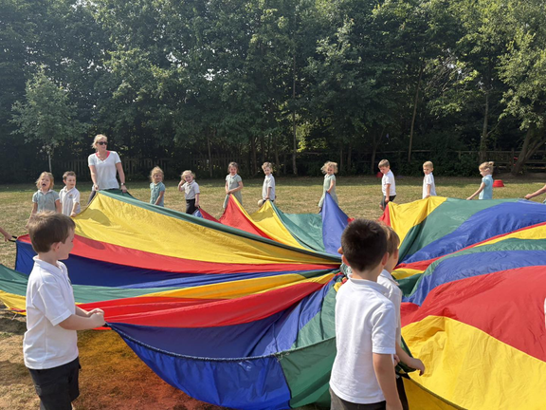
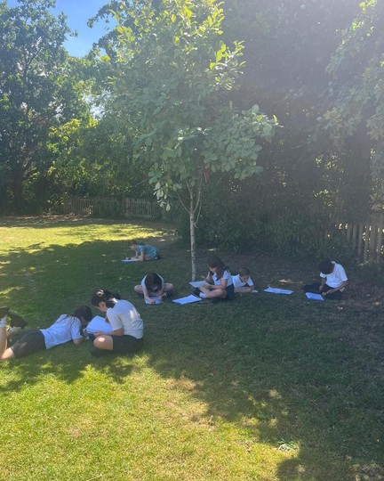
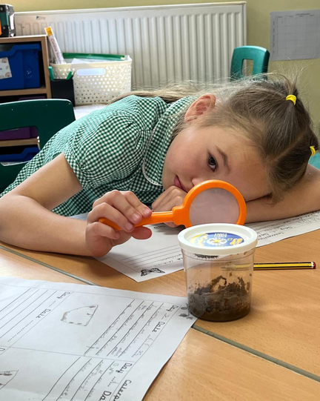
A Place to Belong
We are a small rural primary school at the heart of a beautiful village…
  Where every child is valued as an individual
  Where every member of staff knows every child’s name
  Where every class has a dedicated teaching assistant
  Where children make lifelong friends
  Where every child and parent becomes part of the Loxwood family
  Where we love learning outdoors in our wonderful grounds

