Slide 1

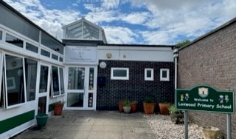

MOVING ON TO YEAR 1
Loxwood Primary School

Slide 2
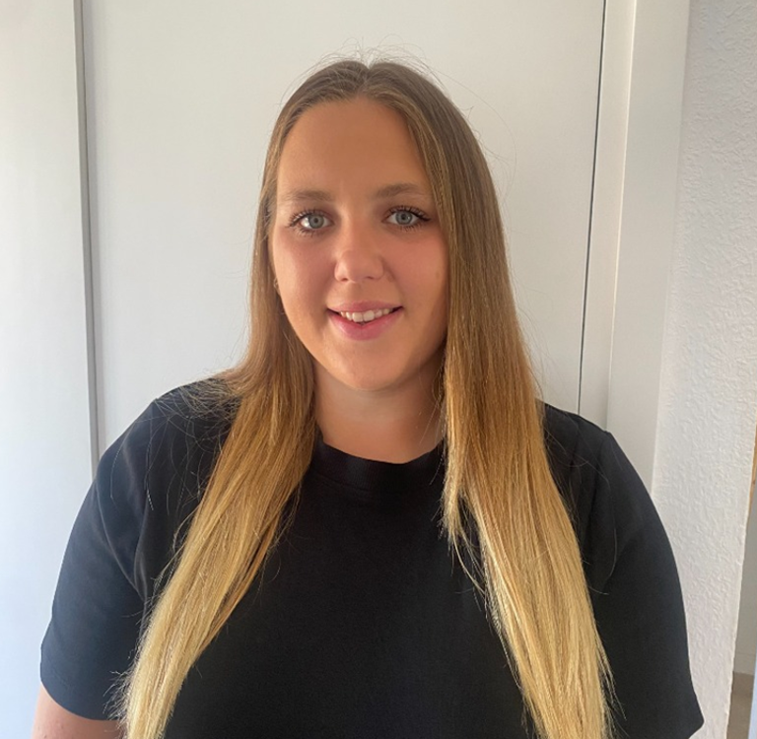
I am Mrs Milner-Darke.
I am excited to be your class teacher.
Our class will be called Cherry Class.

Slide 3


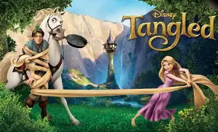
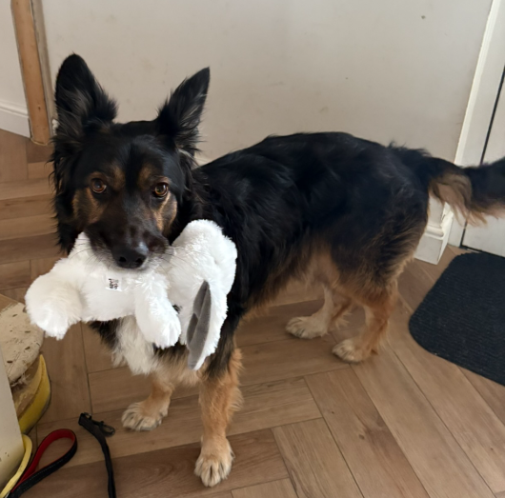
A FEW OF MY FAVOURITE THINGS
Mrs Milner-Darke's favourite children’s book:
The Day the Crayons Quit by Oliver Jeffers. I love this book because it is really funny to imagine our crayons having feelings and thoughts about our pictures. I also love reading the story ‘The lion Inside’ as it shows we can all be brave when we believe in ourselves.
Hobbies:
I like to listen to music (especially the song Golden) whilst going on walks with my dog. I also like to go to the theatre and watch musicals when I can. When it is cold or I’m tired, I enjoy eating popcorn and watching all the new and old Disney films. Tangled is my favourite!
Aims for the summer:
I am going to Spain in the holidays, so am really looking forward to doing lot’s of swimming in the pool and spending time with my family. I am also hoping to go on many walks around the countryside with my dog whilst catching up with friends.

Slide 4
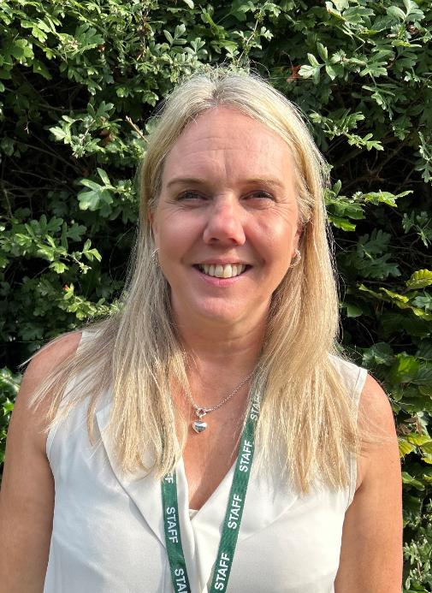
I am excited to be your Assistant Teacher.
I am Miss Rose.

Slide 5
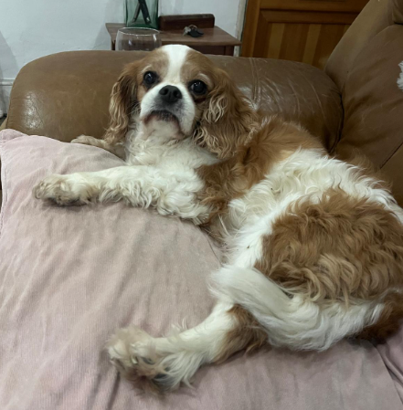

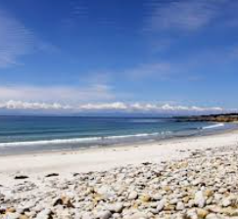
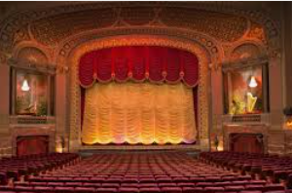
A few of my favourite things
Miss Rose likes going to the theatre and amateur dramatics.
She enjoys walking in the countryside and along the beach.
Miss Rose enjoys spending time with her friends and family.
She really enjoys supernatural books and her favourite children’s book is ‘The Hungry Caterpillar’.
Her dog’s name is Chester and he is a King Charles Cavalier Spaniel.

Slide 6
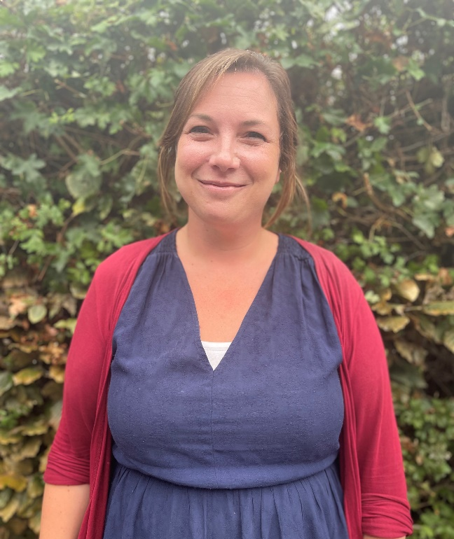
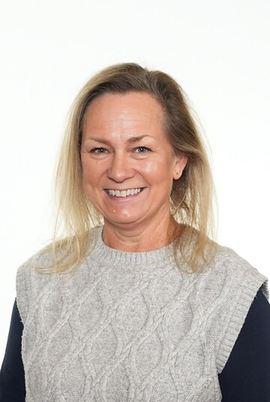
When your teacher gets some time out of class to do their planning, we will be teaching you.
We are Mrs Harder and Mrs Simpson.
Mrs Harder
Every other Wednesday pm
Mrs Simpson
Every other Wednesday am

Slide 7
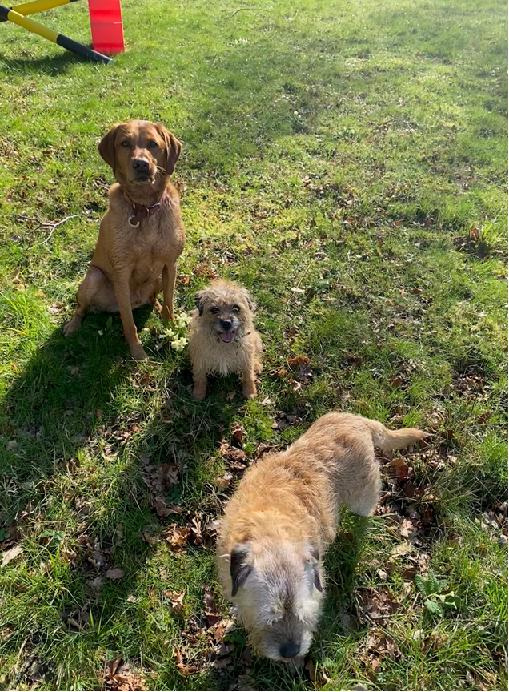
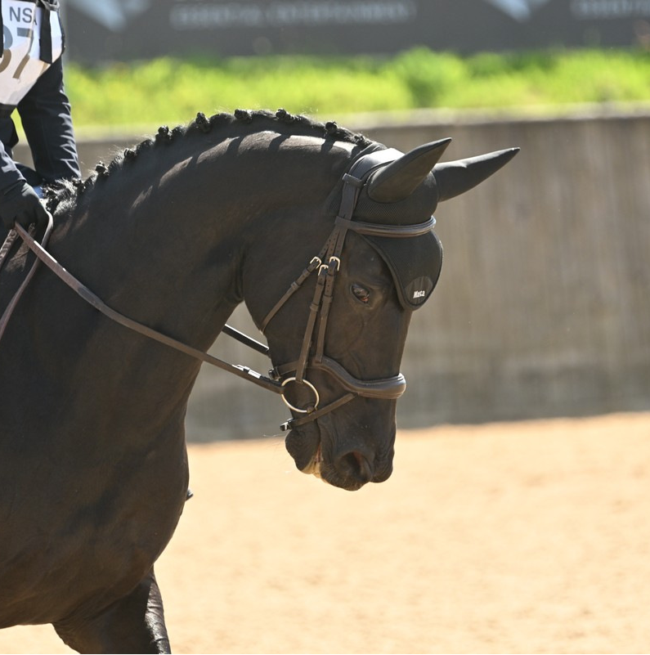
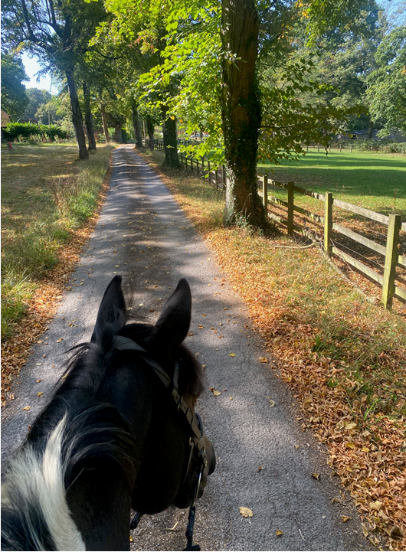
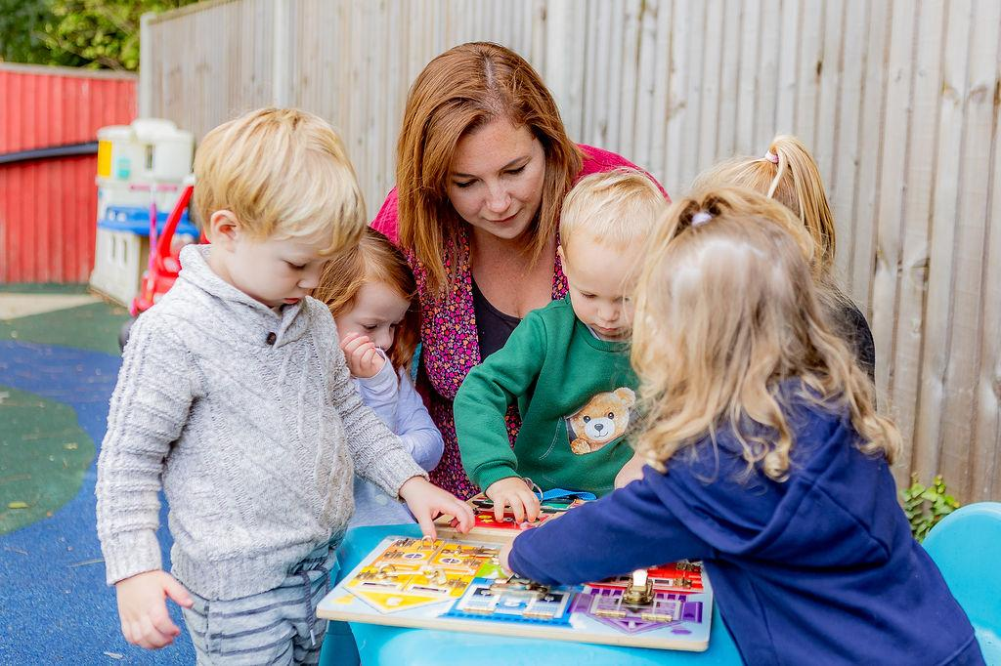

A FEW OF OUR FAVOURITE THINGS
Mrs Simpson has lots of animals, including 2 dogs, 5 chickens, a cat and 2 horses!
Mrs Simpson lives on a small farm and loves riding her horses through the nearby woodland.
Mrs Harder manages Loxwood Pre-School and enjoys all the fun of the early years!
Mrs Harder loves to be busy in the kitchen, baking delicious treats for the staff room!

Slide 8
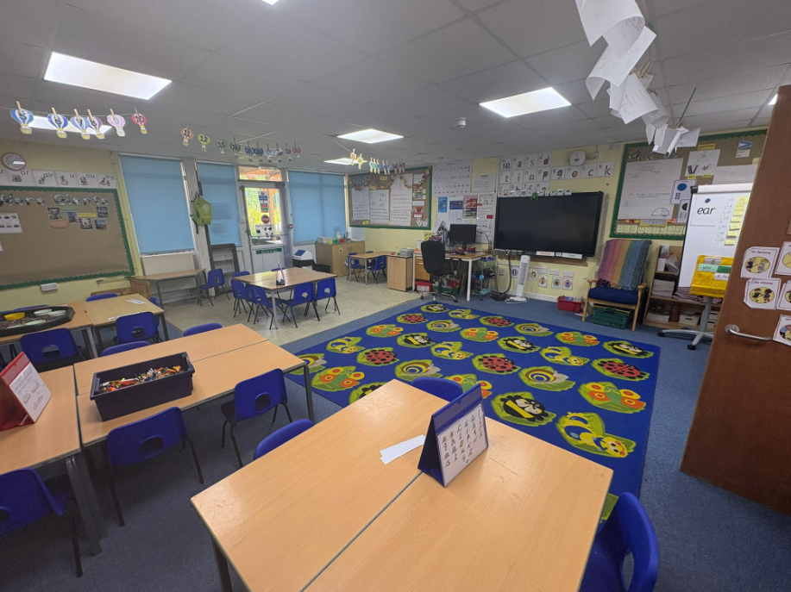
CHERRY CLASSROOM

Slide 9
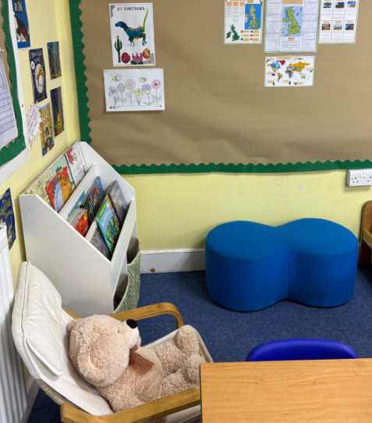
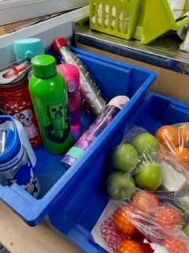
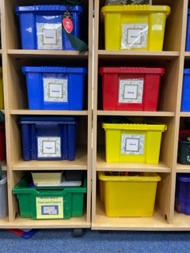
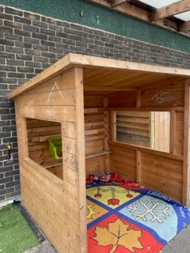
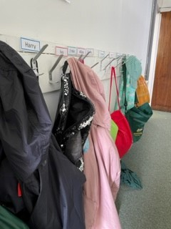
OUR CLASSROOM
Our pegs are just outside our classroom.
We have a special area for our water bottles and snacks.
You will have your own tray where you can keep your book bag and your lunch box.
You might enjoy a quiet moment in our reading area – what will you read on our reading bench?
Our outside area has many exciting activities for you to try.

Slide 10






WHAT IS STAYING THE SAME IN YEAR 1?
Fun Learning
You’ll still read, write and explore exciting topics.
Our School
Same building, same playground, same happy place.
Your Friends
You’ll still see your classmates and play together.
Helpful Grown-Ups
You’ll still have teachers and assistant teachers who care about you.
Cool Activities
Art, PE, Woodland Learning and special days will still be part of the fun.
School Routine
You’ll still have breaktime, lunchtime and home time just like before.

Slide 11
OVER THE SUMMER…
After all your hard work this year, make sure you enjoy your time off and enjoy being outdoors and spending time with your family.
In the summer, you could:
Read a new book and draw a picture of your favourite book that you have read over the summer. Bring it in on your first day to share with me and the class. We love reading in year 1 and will be exploring lots of fun stories together. I can’t wait!
Practise your numbers to 20 – can you go on a walk and count all the flowers you see? You could also practise writing your numbers in the sand at the beach or use paint or colouring pencils to write them at home.
Can you draw and write down something fun you did over the holidays to share on our first day? I would love to hear all the exciting things you get up to!
In My Bookbag - Imagine you’re packing a bookbag for the first day of school. What 5 items would you bring to show who you are? Example: a football, a book, a pet photo, a LEGO figure, a favourite snack.
Have lots of fun!
It would be wonderful if you could share a few pictures of your summer holidays, so we have something lovely to talk about with you.

Slide 12
See You In September!
In September, the grown-ups in school will be here to welcome you in, show you where to go and what to do and to make sure you are happy and safe.
We are going to have a great year learning together!
Here are some videos that might support children with 'Back-to-School Wobbles':
https://www.youtube.com/watch?v=jaqM6-qjMjA&t=1s
https://www.youtube.com/watch?v=qDsiGUHkKaE&t=3s

