Slide 1
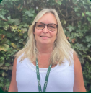
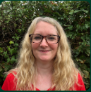
Oak class Meet the Team
Mrs Donnelly
Class Teacher
Mrs Coupe
Learning Support Assistant

Slide 2
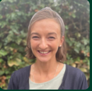
Support staff
Mrs Bilthouse
Learning Support Assistant
Monday, Tuesday and Wednesday mornings
Mrs Crofts
Learning Support Assistant
Thursday and Friday
mornings

Slide 3
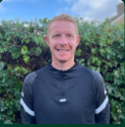
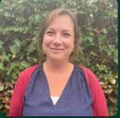
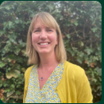
Mr Green
PE teacher
Mrs Harder
Woodlands learning teacher
Mrs Swann
Teacher and Learning mentor

Slide 4
The Foundation Stage Curriculum
3 prime
areas of learning:
4 specific
areas of learning:
Communication and Language
Literacy
THE HOW
THE WHAT
Mathematics
Physical Development
Understanding of the World
Personal, Social and
Emotional Development
Expressive Arts
and Design
We collect evidence against these areas
Contributions from home are really important – please add to these to Tapestry
Notes:
‘Discovery Time’ – ‘bump into philosophy’
Evidence – observations, photos, 1:1 and group work, whole class
Verbal Feedback
Individual levels and attention span
Post-it activity – write down one thing your child has achieved at home recently. (Evidence for WOW books).
VIDEO

Slide 5
More information about Areas of Learning and Characteristics of Effective Learning can be found in these guidance materials:
https://www.gov.uk/government/publications/development-matters--2
https://birthto5matters.org.uk/
Notes:
Address on handout
Gives an insight into working in Early Years.

Slide 6
Influence on Learning
Not sure what to tell us? Just have a go and we will guide you. It might help to think about the Areas of Learning and the Characteristics of Effective Learning.
85% of children’s waking time is out of school. That’s why we love to hear about your learning at home via Tapestry.
Notes:
Consolidating learning
Reading – at home and ‘out and about’ - signs, menus etc.
Counting and recognising numbers
Counting money
Making up stories
World Around Us
EVIDENCE FOR WOW BOOKS
Nursery Rhymes

Slide 7
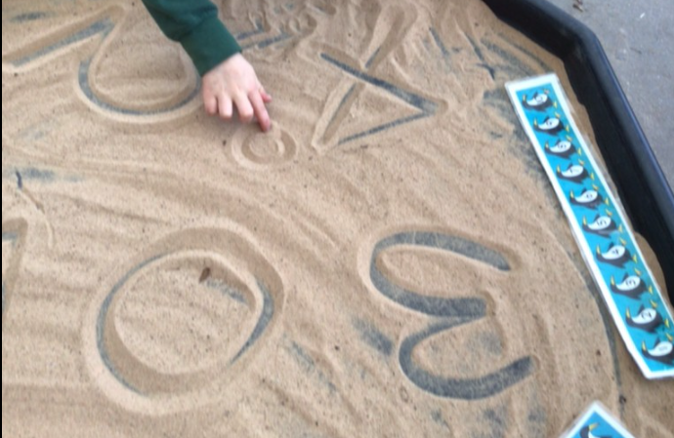
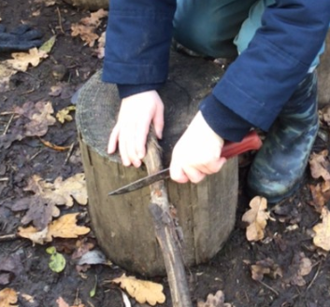
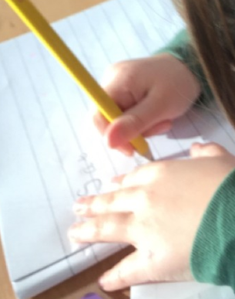
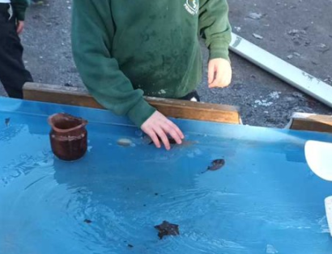
Tapestry
We use an online learning journal called Tapestry.
We record your child’s learning on there and share it with you at home.
If you do not yet have a Tapestry account for this school or you are having problems logging in, please let me know.
You can use Tapestry at home to show us things your child has been doing at home.
You can also respond to our uploads if you wish.
Early Years learning is about the whole child and we would love to see what your child is getting up to at home as well as in school.

Slide 8
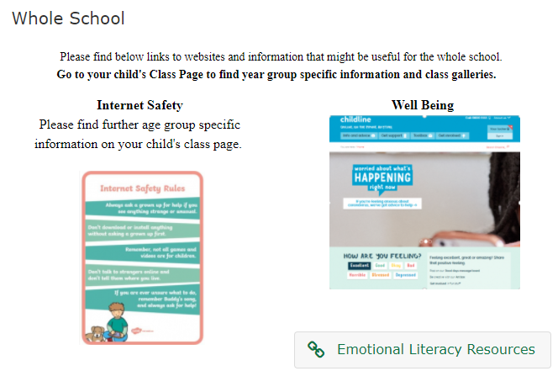
How we communicate with you?
School Website and our Oak Class webpage (found under the ‘Our School’ tab – ‘Class Pages’. Don’t forget to read the ‘Whole School’ information too.
The weekly newsletter: ‘Up to the Minute’
Termly Topic Web on the Website
We are really happy to answer quick queries at the classroom door but remember the children’s safety and settling into school is really important to us and we like to be in the class engaging with them.
Leave a message with the adult on the gate or email: messages@loxwoodschool.com. These messages always arrive promptly in the classroom.
Book an appointment or speak to us at the end of the day.

Slide 9
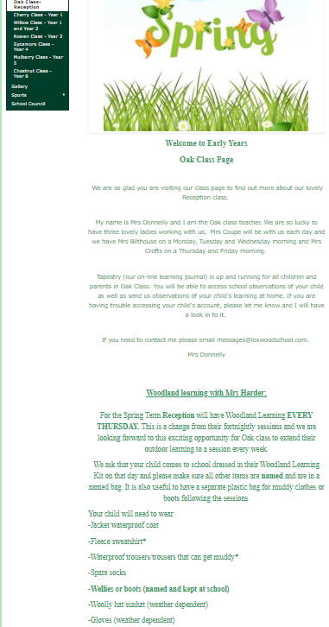
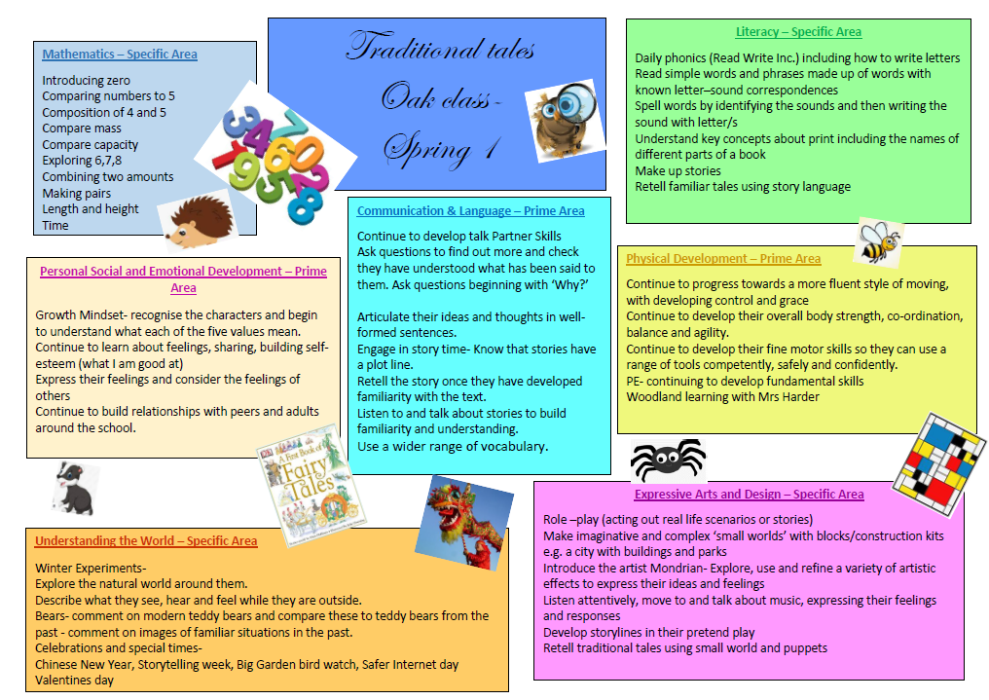
Our class page on the website
This page contains information about what your child is learning- topic web
RWI information and useful links
Woodlands learning information
Links to useful websites
Other useful information about our
class.

Slide 10
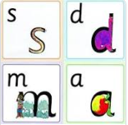
RWI
At Loxwood school, we use the Read, Write, Inc phonic scheme, Your child has a daily phonic input. We begin the day with a whole class input on the carpet.
Each day we introduce a new sound. We have learnt all of the single letter sounds and are now working on the diagraphs (two letters, one sound- sh, ch, th, ng, nk, qu)
The children then go off to explore their independent learning and myself and Mrs Coupe work with small groups to carry on their phonic learning. This includes writing the sound of the day, and making or reading simple CVC words depending on each child’s ability.
There are opportunities for the children to read and write the letter sounds and simple cvc words in the learning environment so that they are constantly being exposed to the letter sounds and words.

Slide 11
What you can expect to see coming home
Before the holidays, every child was given a set 1 speed sounds booklet. If you have just joined us, you will receive one this week.
This is for you to keep and work with your child on recognising and pronouncing the sounds.
Please don’t worry if you are unsure of how to pronounce the sounds- there is a link on our class page to a RWI video which shows you how each sound is pronounced.

Slide 12
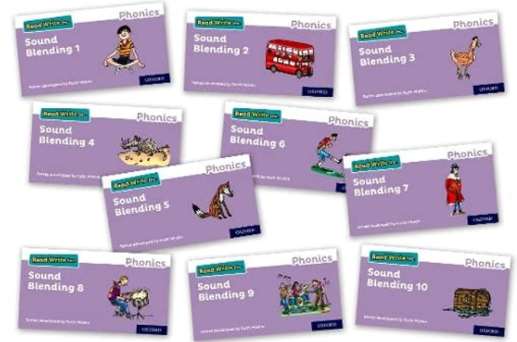
Sound blending books
When we feel you child can blend CVC words confidently, we will start to send home sound blending books. Please trust our judgement and do not worry if your child is not there yet. We are working on daily activities to practise these skills.
If your child does start to take home one of these books, please practise with your child using these sentences:
To sound out each sound, we say: “Fred talk”
To put the sounds together, we say: “Read the word.”
So we introduce the word and say: “Fred talk, read the word.”
When your child begins to read words with diagraphs in them, for example, ‘them’, ‘chip’
We add an extra sentence in and say:
“Spot the special friends, fred talk, read the word.”

Slide 13
Woodlands learning
Your child is going to have a weekly Woodlands Learning session with Mrs Harder. This is different to the rest of the school who will carry on having their bi- weekly session.
Outdoor learning and exploration really supports the Early Years curriculum so I am very excited about this opportunity for your child.
Your child will have Woodland Learning every Thursday and it will alternated between mornings and afternoons each week.
Can you please send your child into school wearing their Woodlands learning clothes on a Thursday.
Please, please, please make sure everything is named.

Slide 14
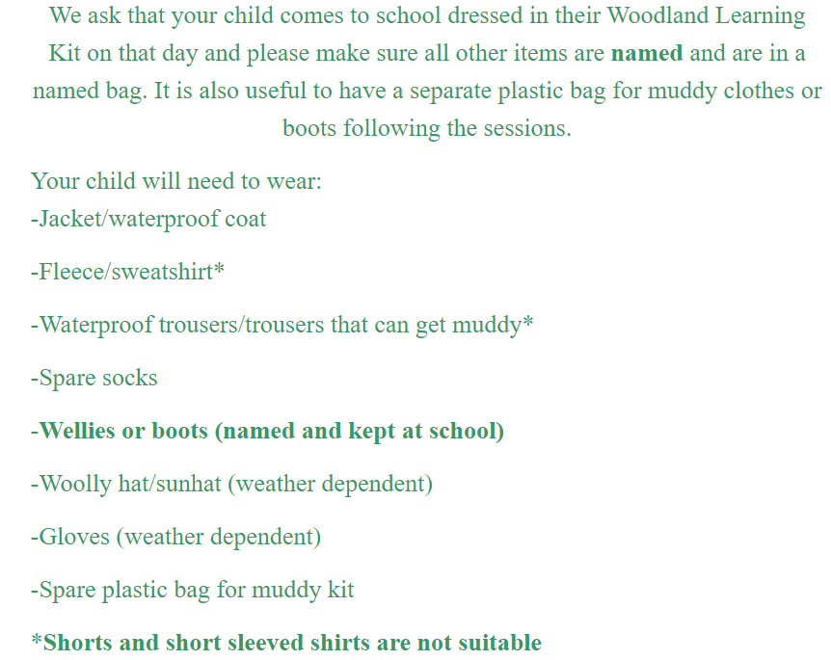

Slide 15
PE
Our PE day for this term will be on a Tuesday or a Friday.
However from time to time this may move around so please make sure that your child has a full PE kit in school every day.
Please, please, please make sure everything is named so that if something does go missing , it can find it’s way back to you.

Slide 16
Snack and water bottles
We encourage the children to keep hydrated and so they need a NAMED water bottle in school every day.
The school provides a healthy fruit snack for your child every day. However, if you would like to send in an extra snack, please do in a NAMED container. Please note that we are a NUT FREE school so do not send anything in that contains nuts please.
Healthy snacks- fruit, vegetables, cheese, crackers- no sweets or chocolate please.

Slide 17
